Slide 1
The Secret of Lights

Slide 2


What color do you see?

Slide 4
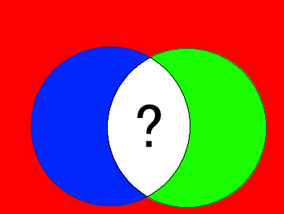

Slide 5
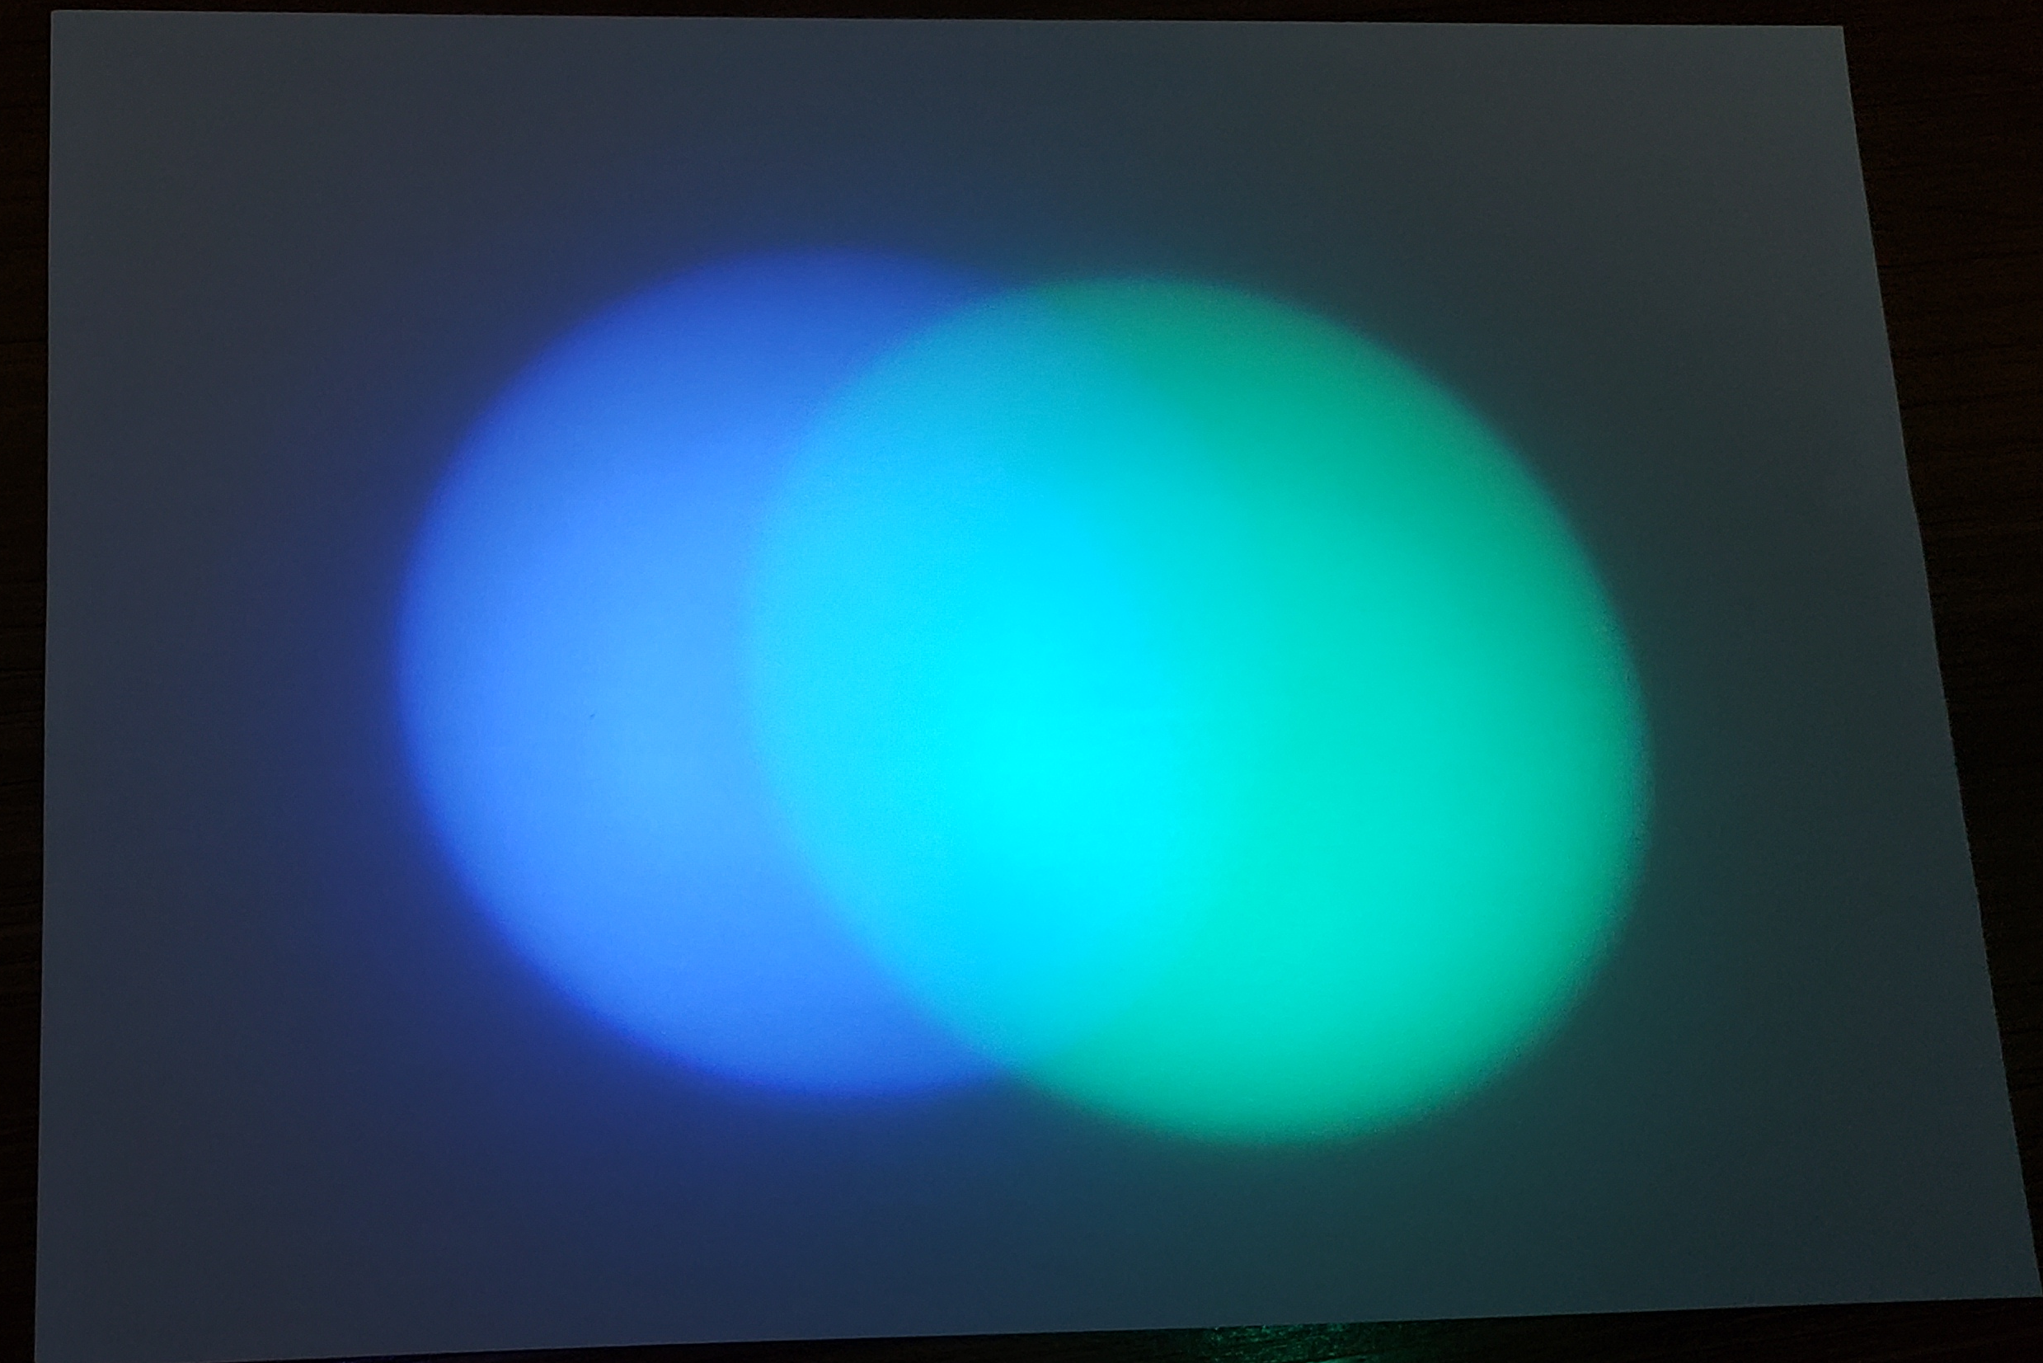

Slide 6
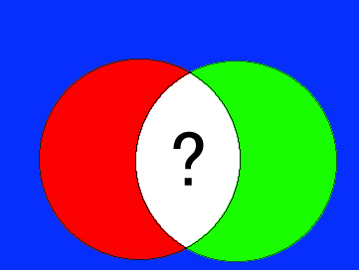

Slide 7
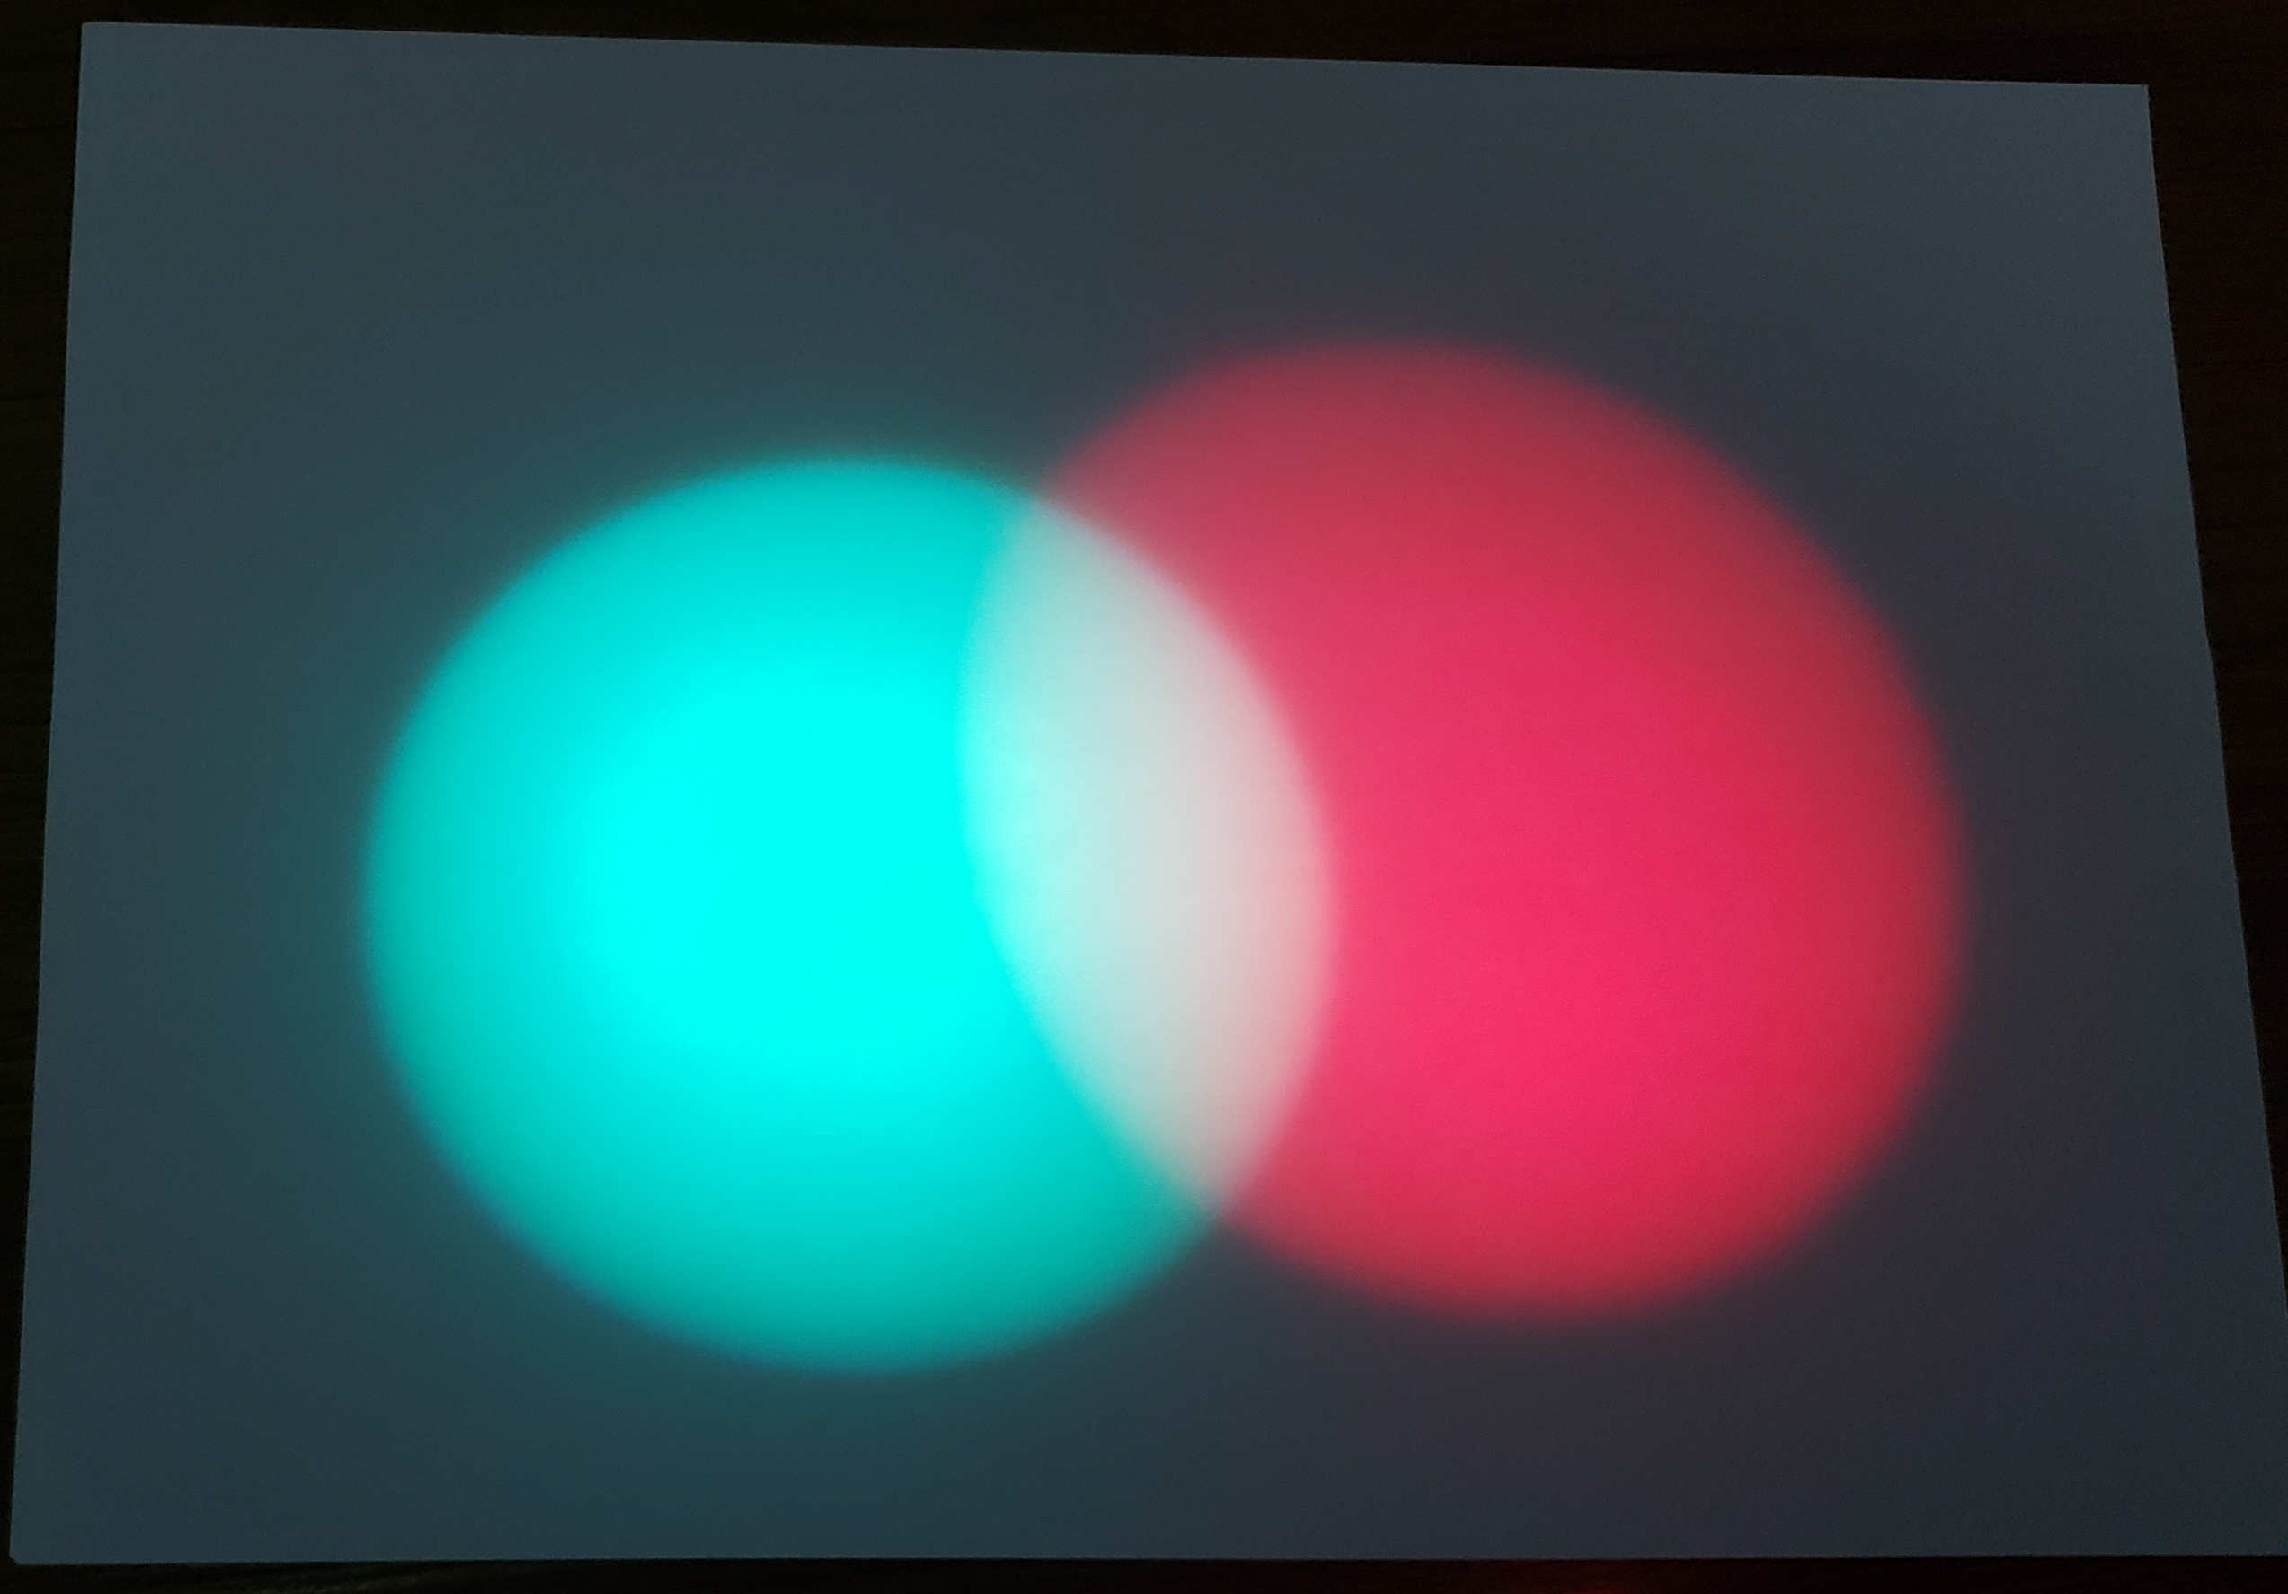

Slide 8
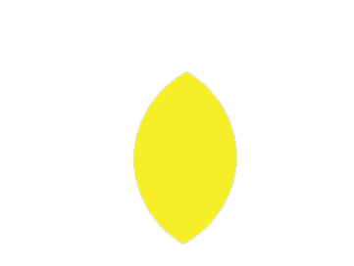

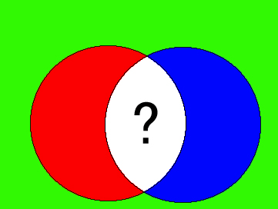


Slide 9
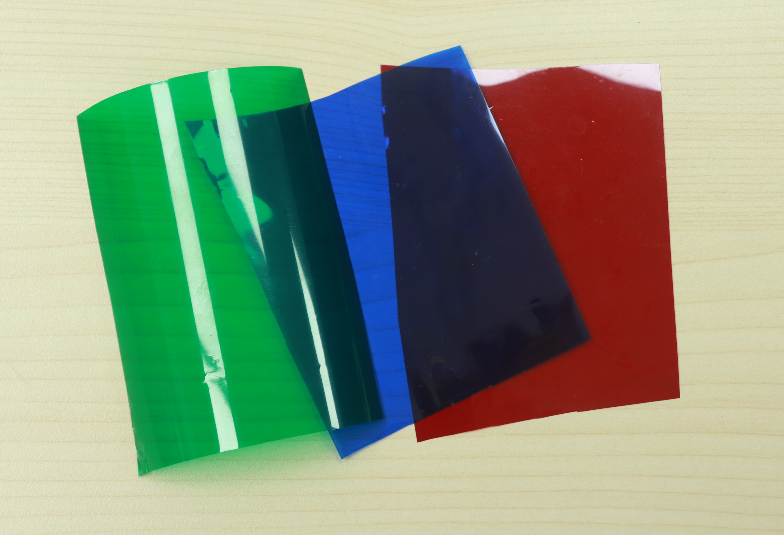
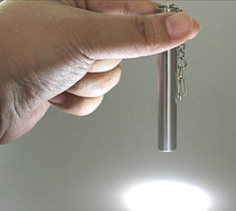
Material
Colored cellophane
FlashLight
玻璃纸
手电筒

Slide 10
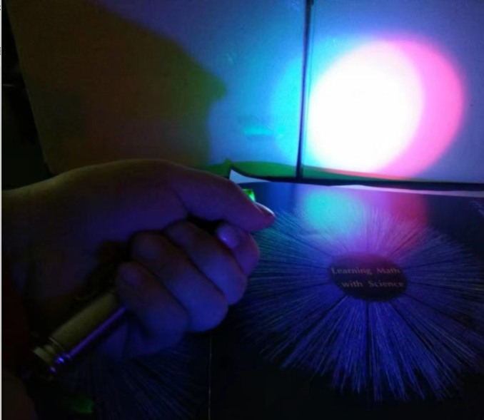
注意::
需要教室环境无光且暗效果较好
玻璃纸需紧贴手电筒前端 打出的光效果较好

Slide 11
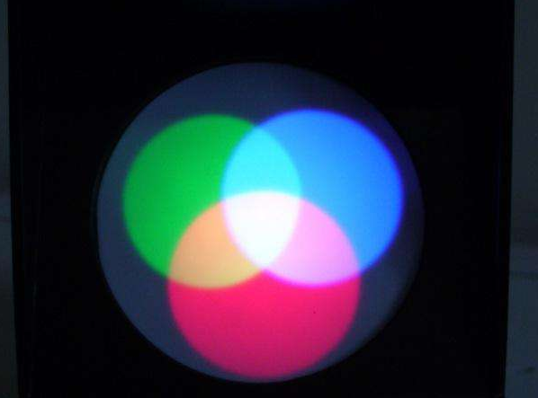
Finished product
Blue
Green
white
Yellow
Red

Slide 12
Thank you

