Slide 1
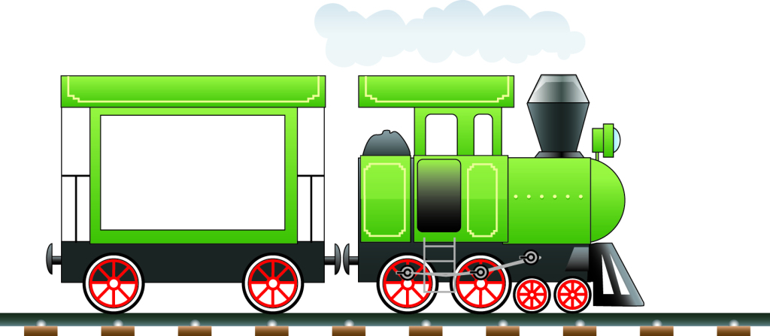
火车嘟嘟开
1
+6
+2
=9

Slide 2
火车嘟嘟开
7
-6
+5
=6

Slide 3
火车嘟嘟开
9
-6
+1
=4

Slide 4
火车嘟嘟开
3
-2
+6
=7

Slide 5
火车嘟嘟开
2
+6
-3
=5

Slide 6
火车嘟嘟开
4
+5
-6
=3

Slide 7
火车嘟嘟开
2
+5
-6
=1

Slide 8
火车嘟嘟开
6
+3
-6
=3

Slide 9
火车嘟嘟开
8
-6
+5
=7

Slide 10
火车嘟嘟开
4
-1
+6
=9

Slide 11
火车嘟嘟开
1
+6
-2
+3
-6
=2

Slide 12
火车嘟嘟开
9
-6
+5
-1
-6
=1

Slide 13
火车嘟嘟开
2
+2
-1
+5
-6
=2

Slide 14
火车嘟嘟开
1
+2
-1
+6
-3
=5

Slide 15
火车嘟嘟开
3
-1
+5
-6
+3
=4

Slide 16
火车嘟嘟开
4
+5
-6
+5
-6
=2

Slide 17
火车嘟嘟开
5
+2
-6
+3
-1
=3

Slide 18
火车嘟嘟开
3
+6
-2
-6
-1
=0

Slide 19
火车嘟嘟开
2
-1
+6
-5
+6
=8

Slide 20
火车嘟嘟开
3
+5
-2
-6
+4
=4

