Slide 1
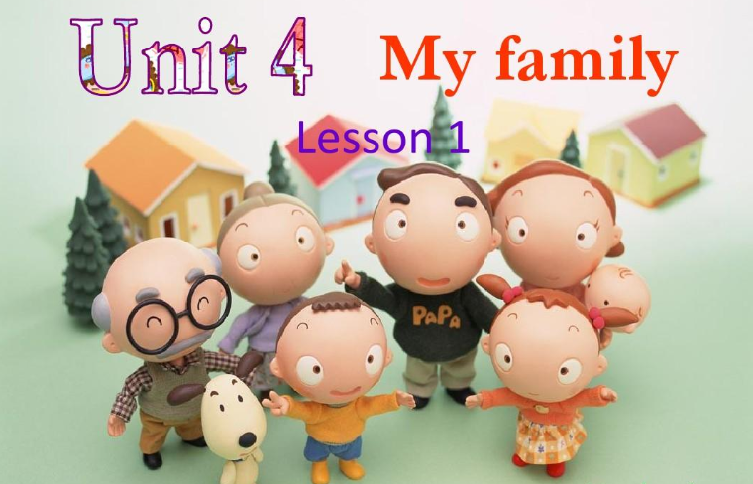

Amanda

Slide 2


Slide 3
red
yellow
pink
green
purple
orange
blue

Slide 4
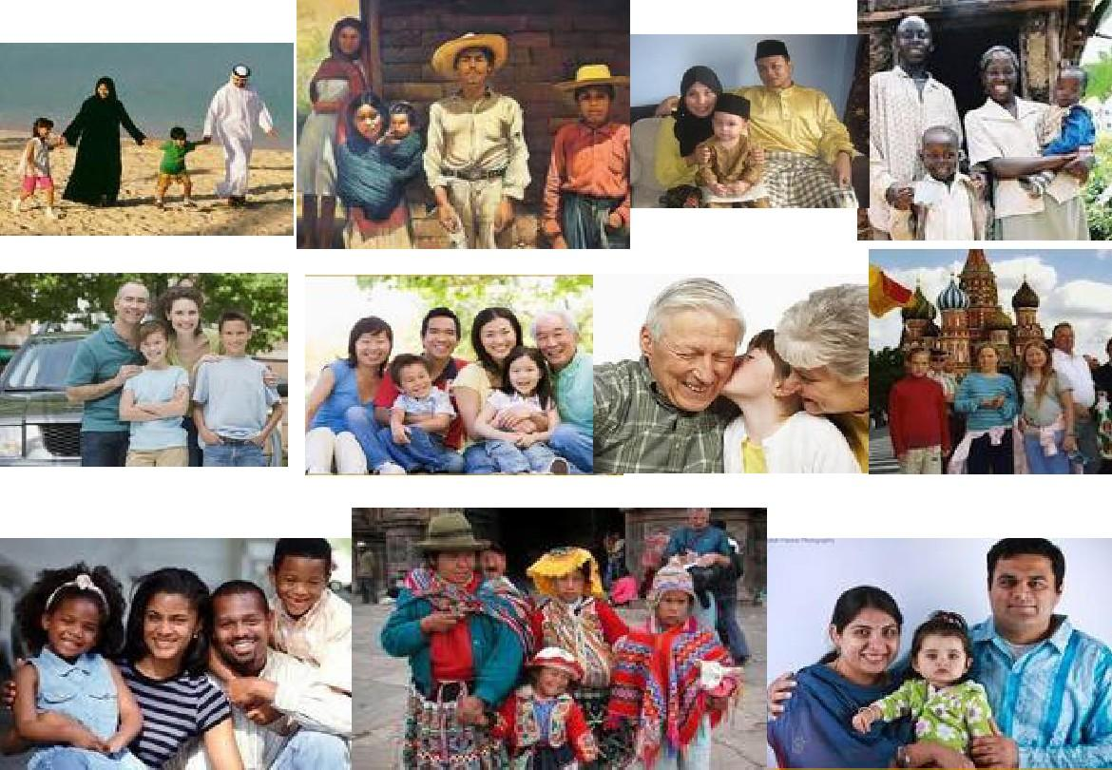

Slide 5

family

Slide 6
family
家庭

Slide 7
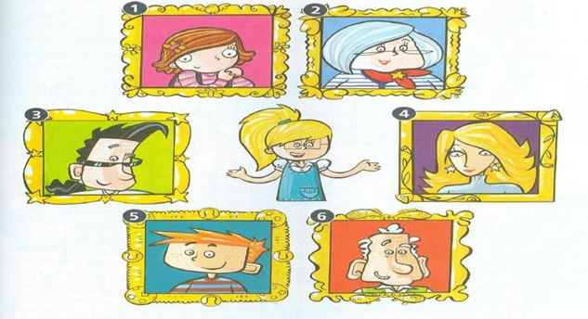
This is Stella’s family.

Slide 8
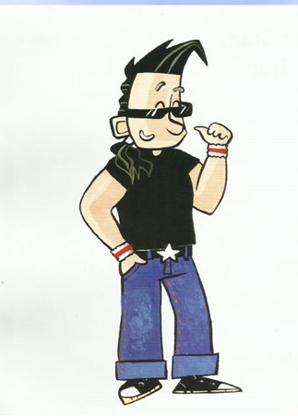
father
(dad)

Slide 9
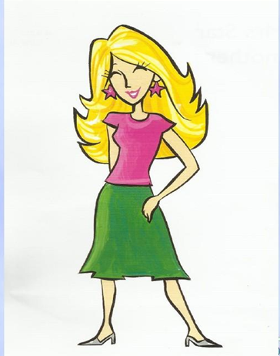
mother
(mum)

Slide 10
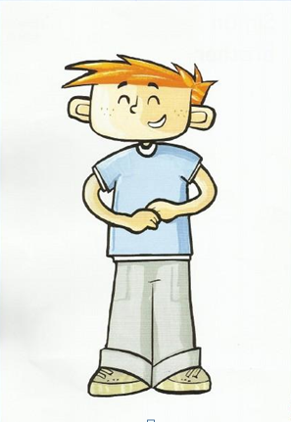
brother

Slide 11
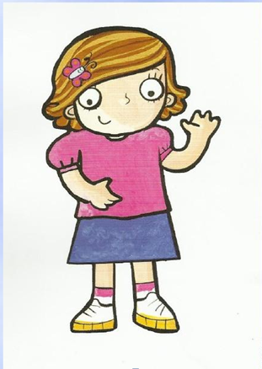
sister

Slide 12
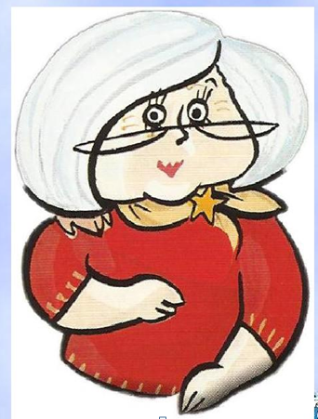
grandmother
(grandma)

Slide 13
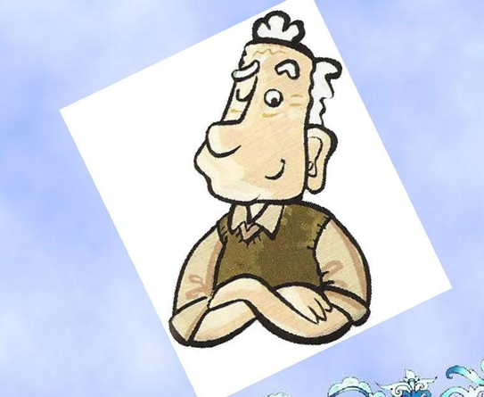
grandfather
(grandpa)

Slide 14
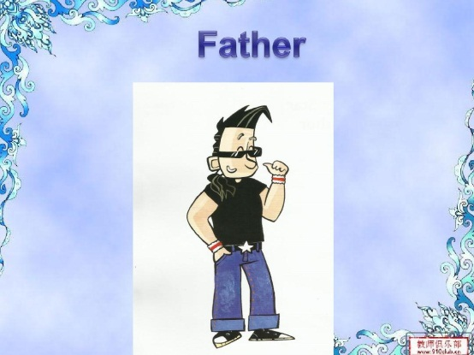
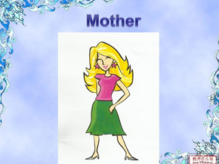
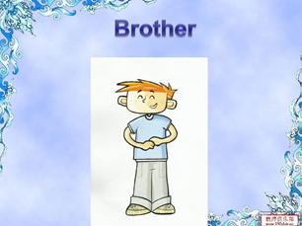
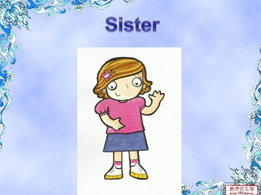
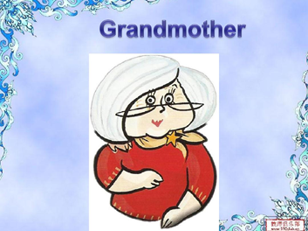

This is my……

Slide 15
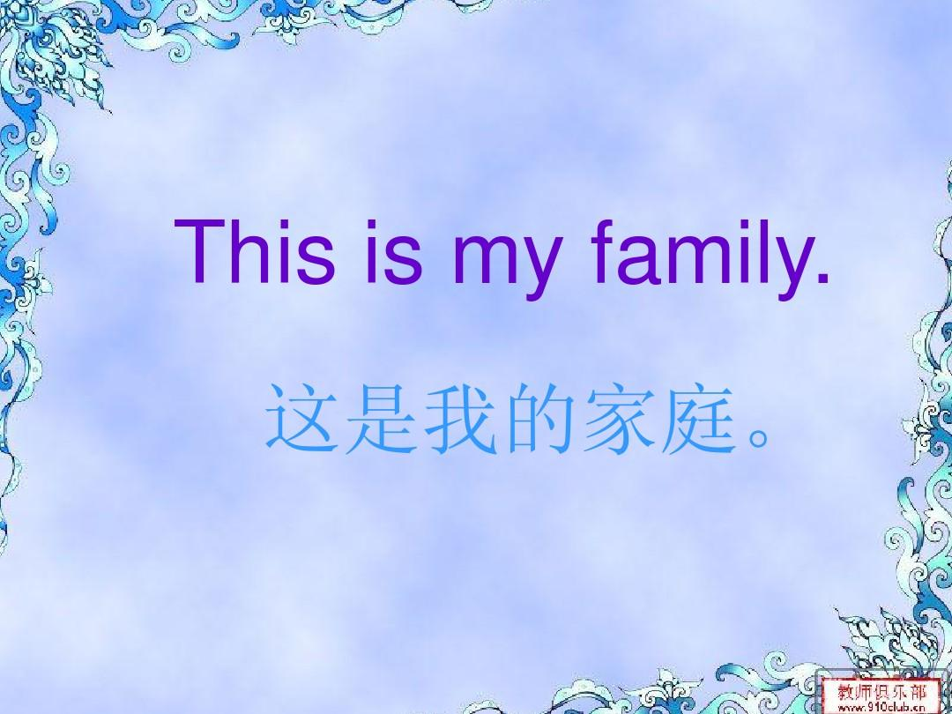

Slide 16
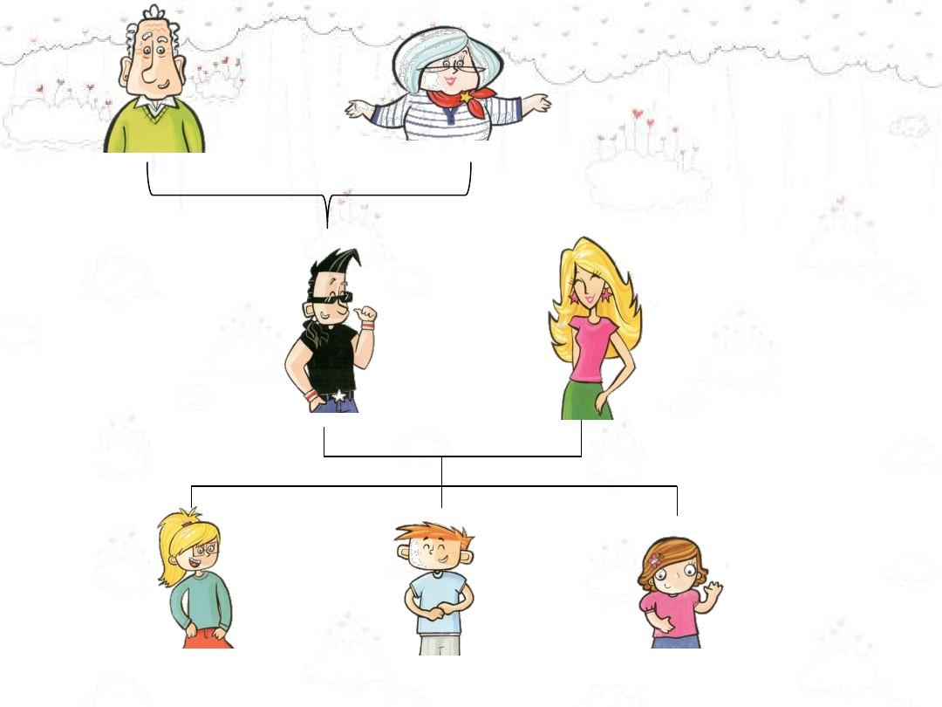
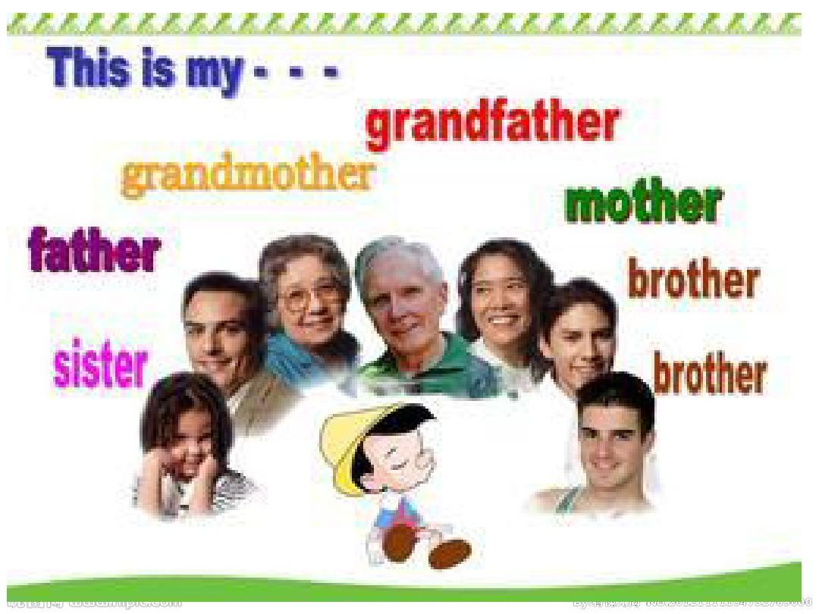

Slide 17
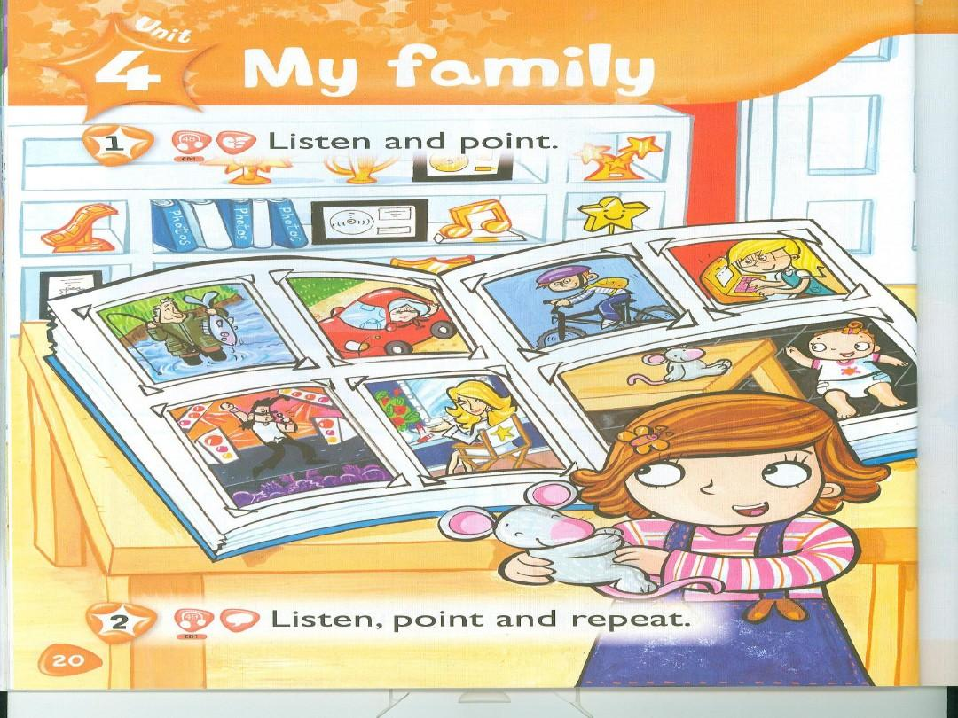

Slide 18
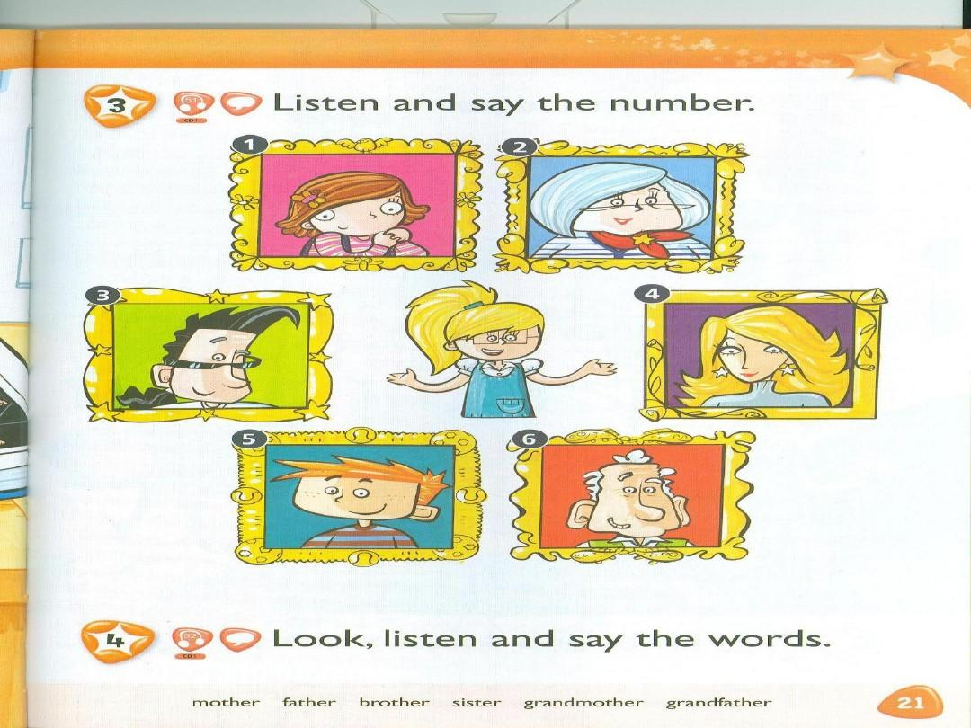

Slide 19
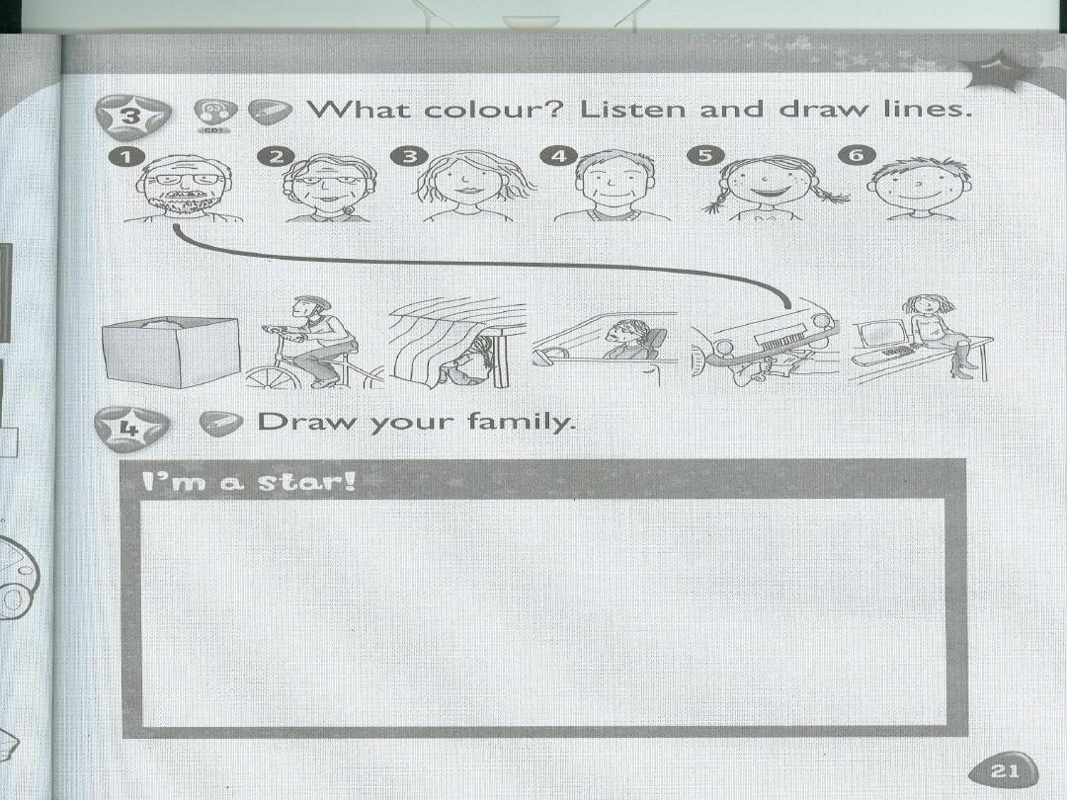

Slide 21
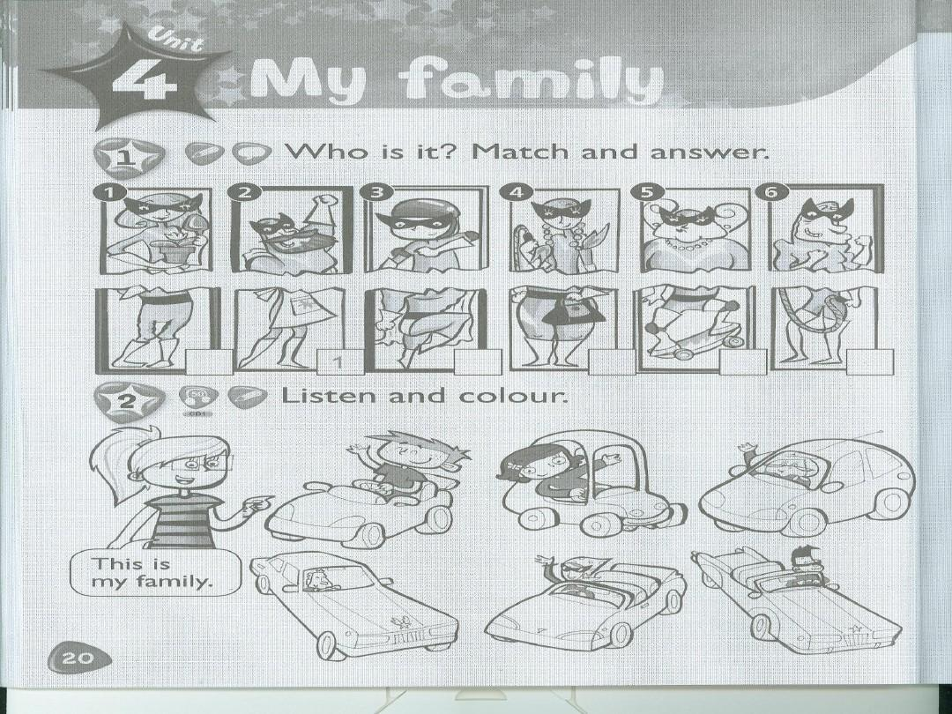

Slide 22
Homework
6个单词 写3行，一行4遍，中文1遍。
语言作业：6个单词的语音作业发微信
微信号：13736612039
微信名：小小鱼（Amanda 金）
时间：周三晚20:00 前

Slide 23
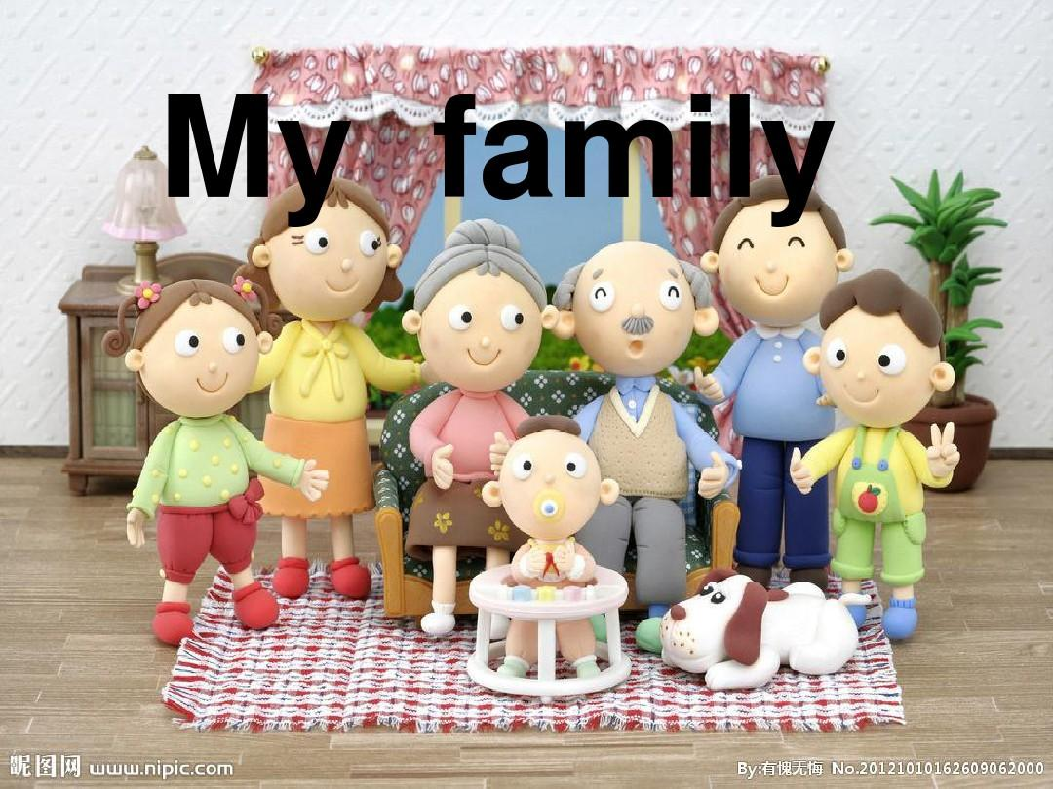
Lesson 2

Slide 24
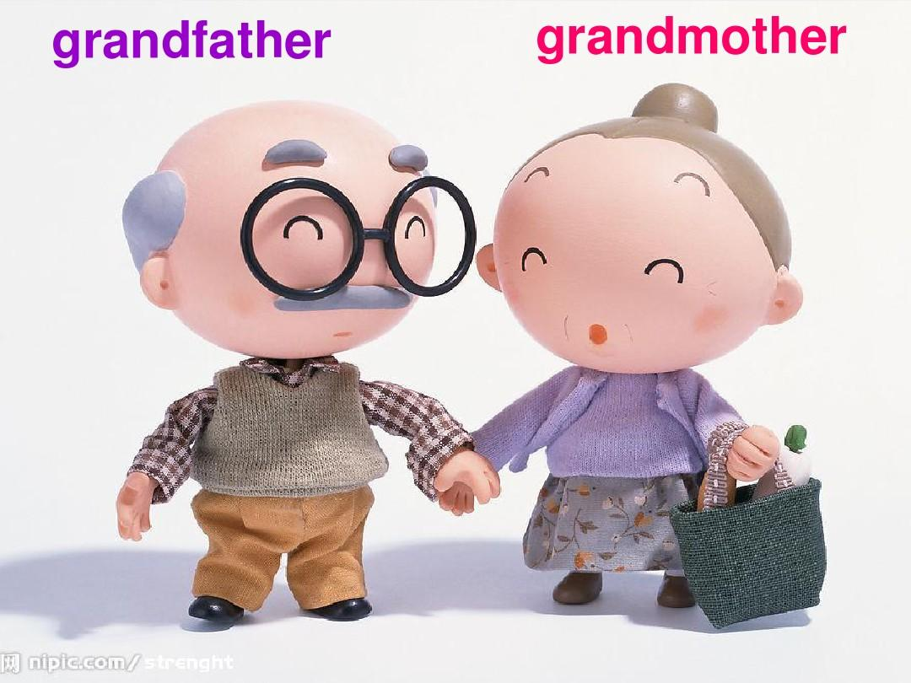
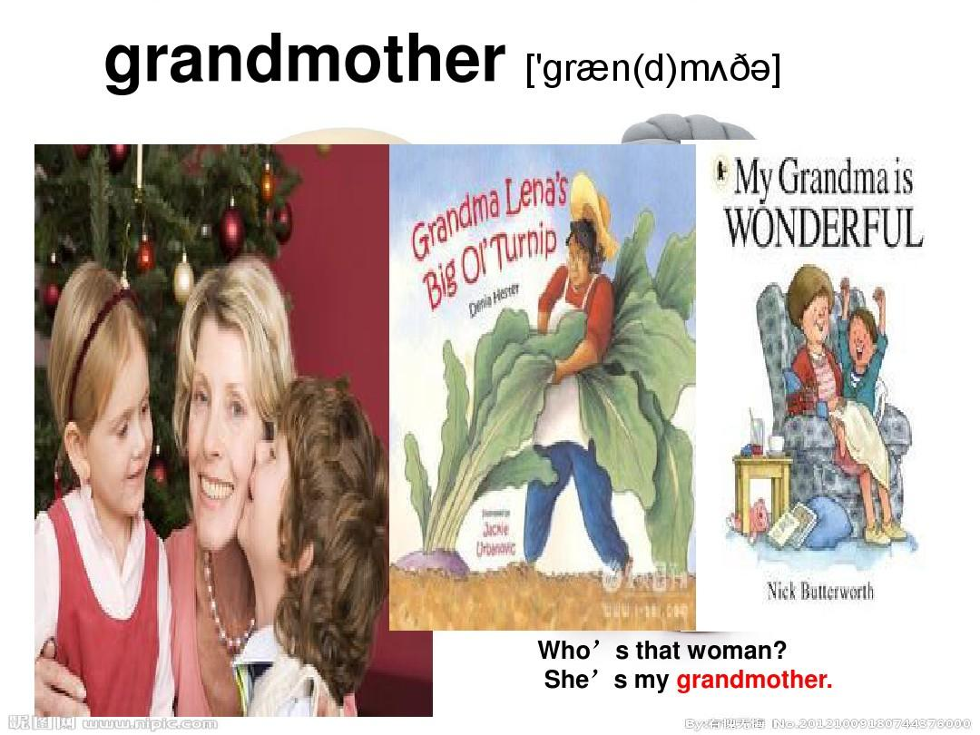

Slide 25
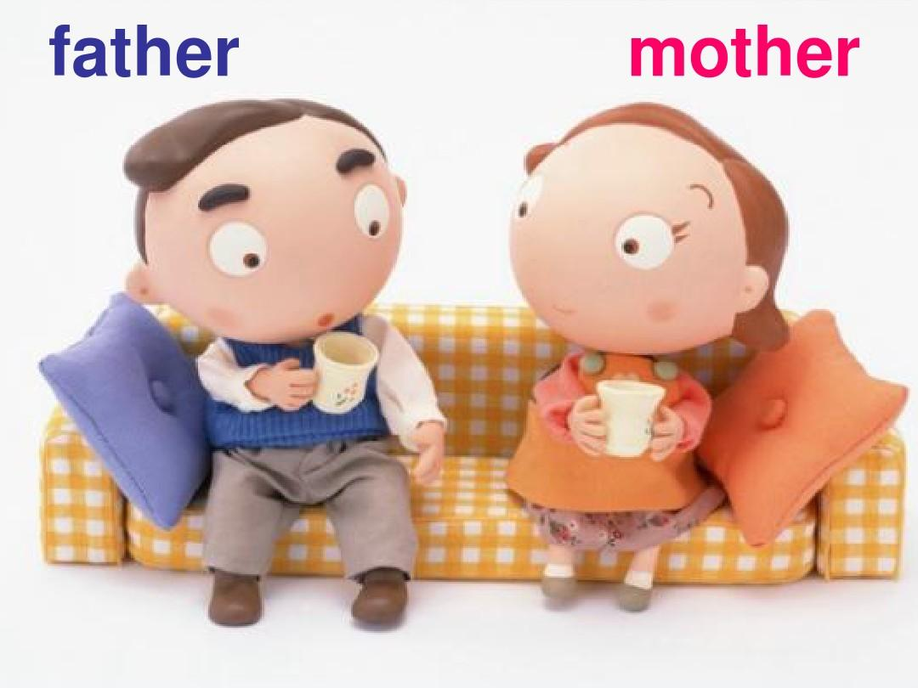

Slide 26
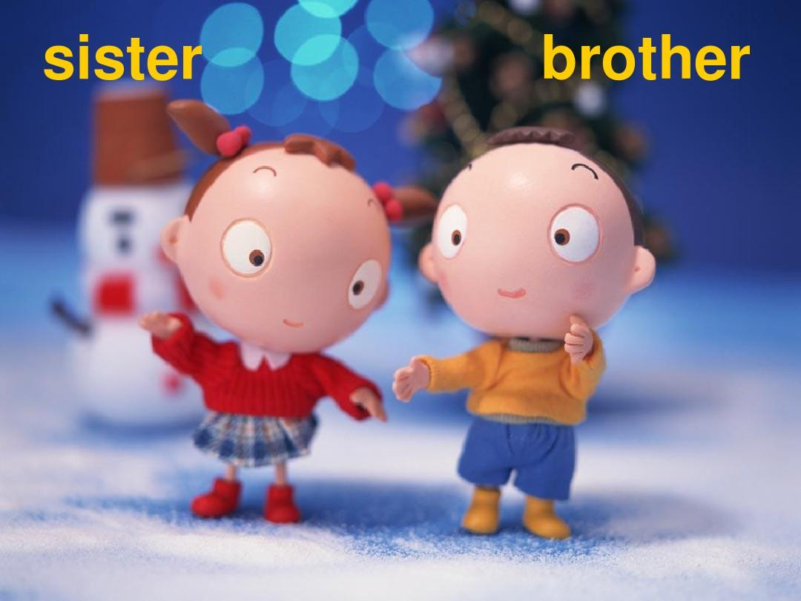

Slide 27
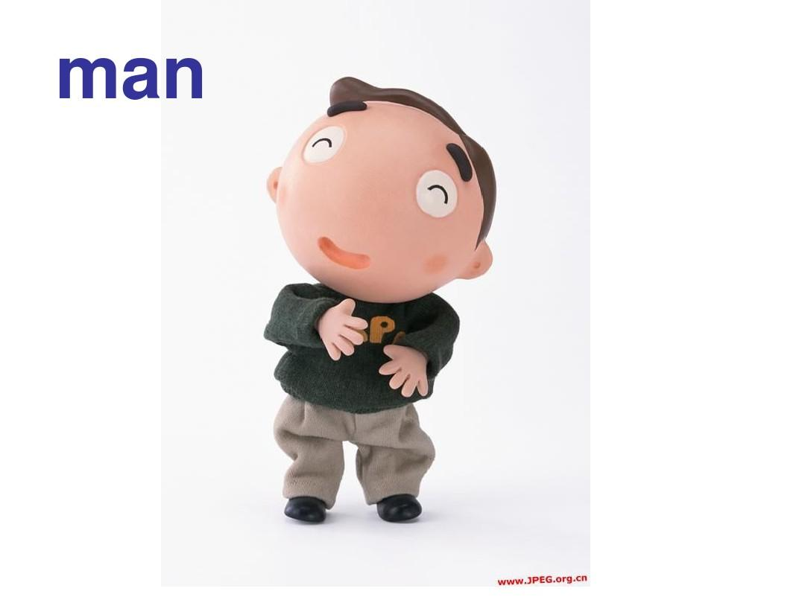

Slide 28


Slide 30
CD 1, 48
SUZY: This is my family. That’s my father, Mr. Star. He’s a pop star. Now, this is a nice picture of my mother. She’s on a whit chair.

Slide 31
Who’s that woman in the car? That’s my grandmother. Mr grandfather is next to my grandmother. He’s funny.

Slide 32
There’s my brother, Simon. He’s on a black bike. And that’s my sister, Stella. She’s seven.

Slide 33
Oh! And who’s that girl next to the table, Monty? That’s me. And, oh, where are you? There you are, on the table.

Slide 35
Activity Book P21

Slide 37
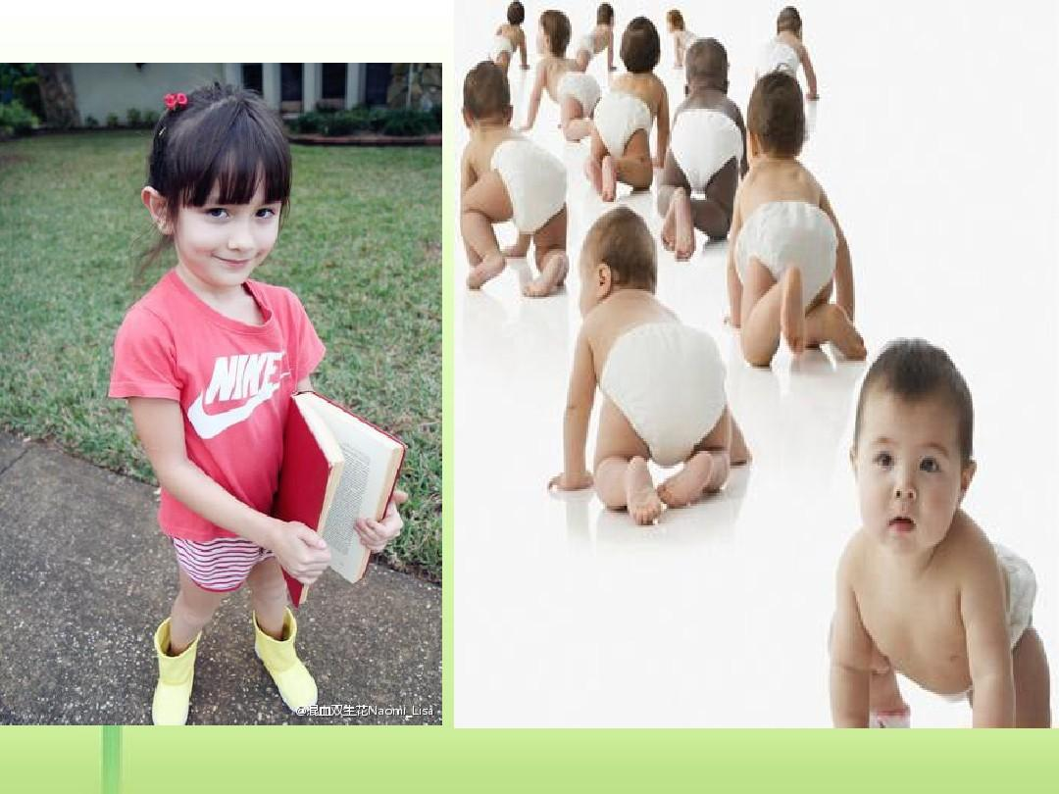
young

Slide 38
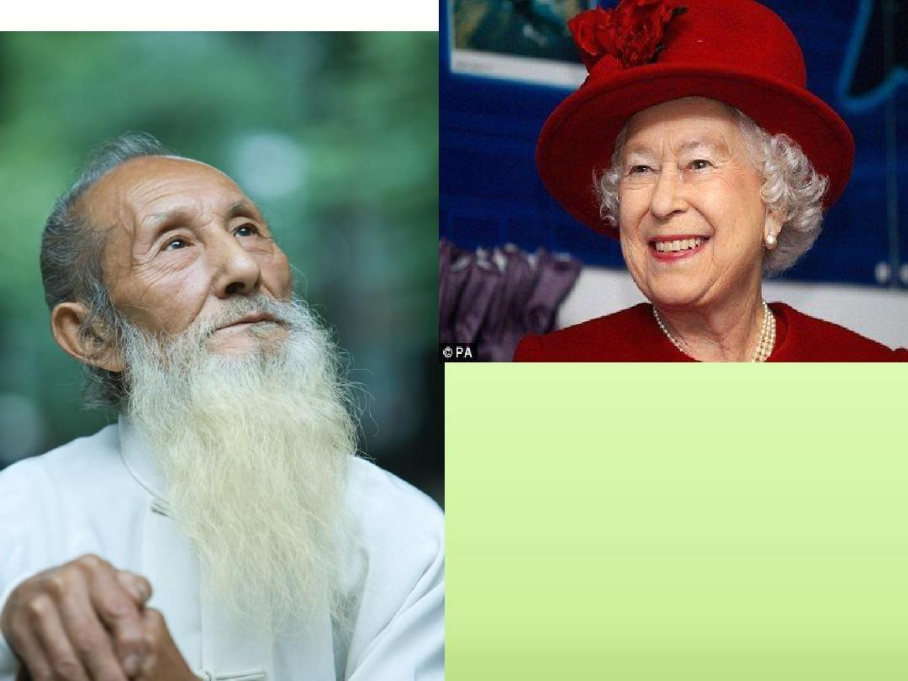
old

Slide 39
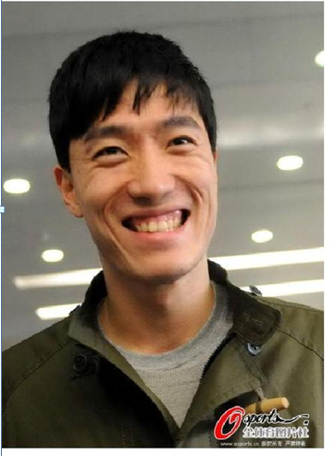
happy

Slide 40

sad

Slide 41
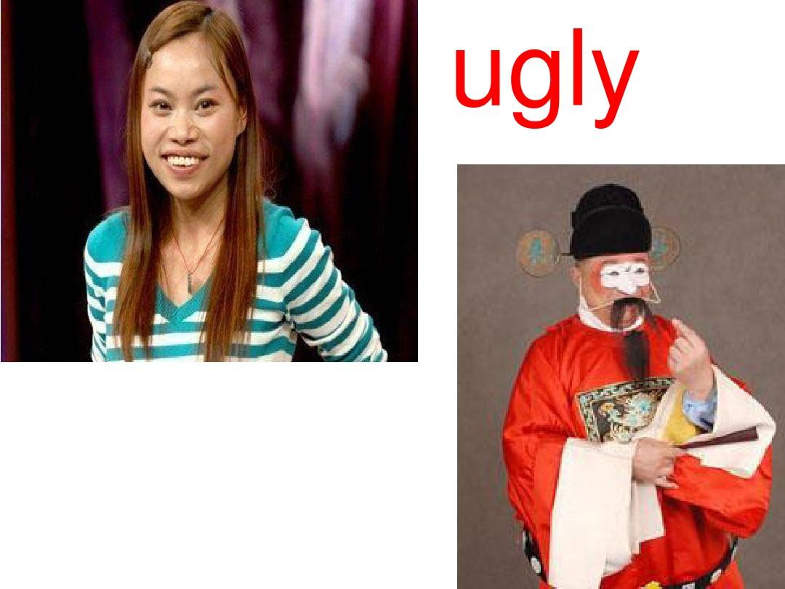
ugly

Slide 42
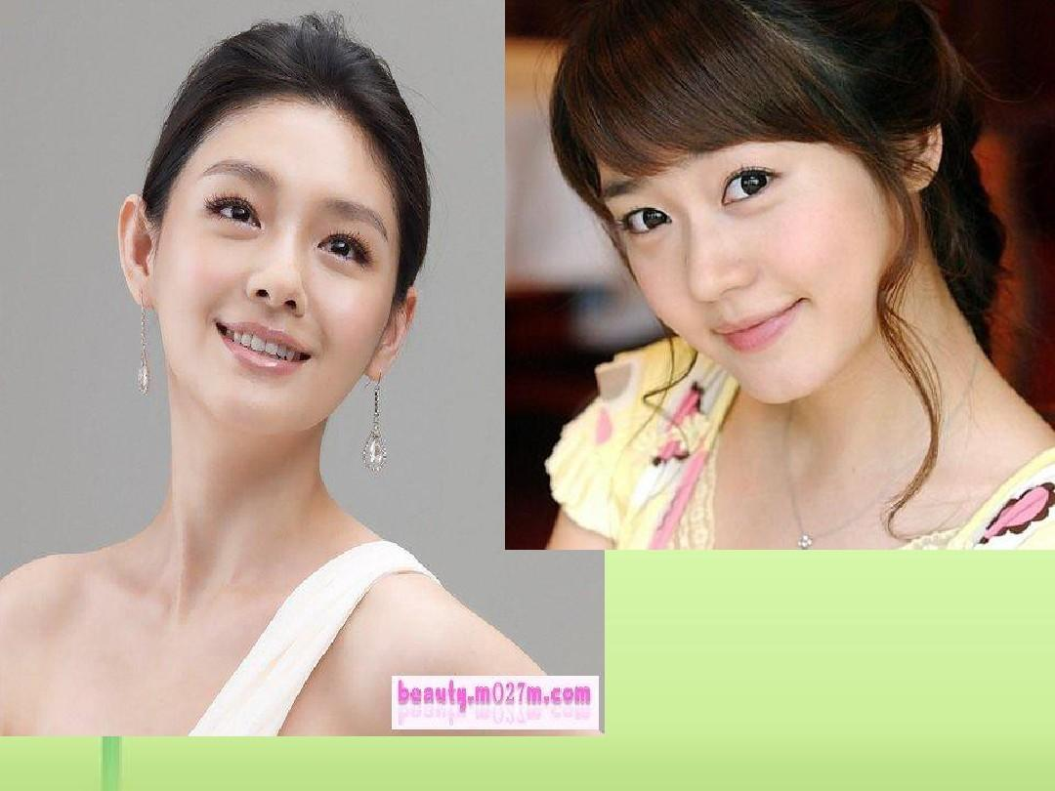
beautiful

Slide 43
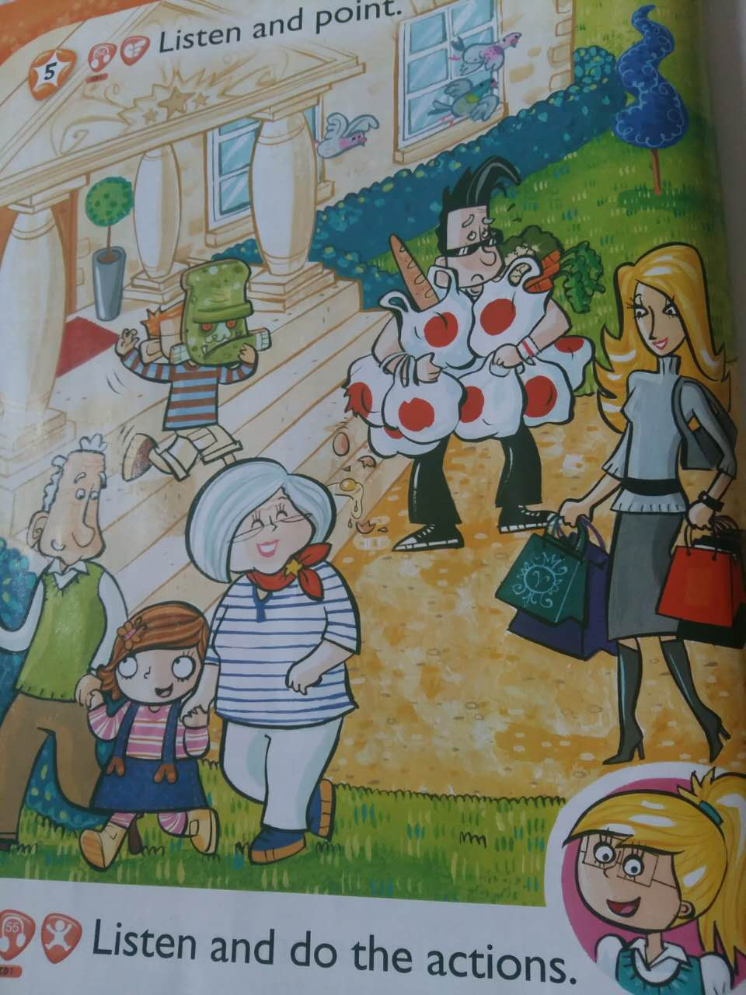

Slide 44
CD 1 ,54
Look at my family. That’s my mother. She’s beautiful. My sister’s young—she’s three. Oh, dear! Look at that bag. My father’s sad. Today my brother’s ugly. My grandfather’s old. He’s next to my sister. My grandfather’s old. He’s next to my sister. My garandmother’s happy.

Slide 45
Activity book P22-5,6

Slide 46
Homework
每天听、读P20、21 的内容，签字
语音作业:复述P20 CD1,48 listen and point 的内容

Slide 47
第三课时

Slide 48
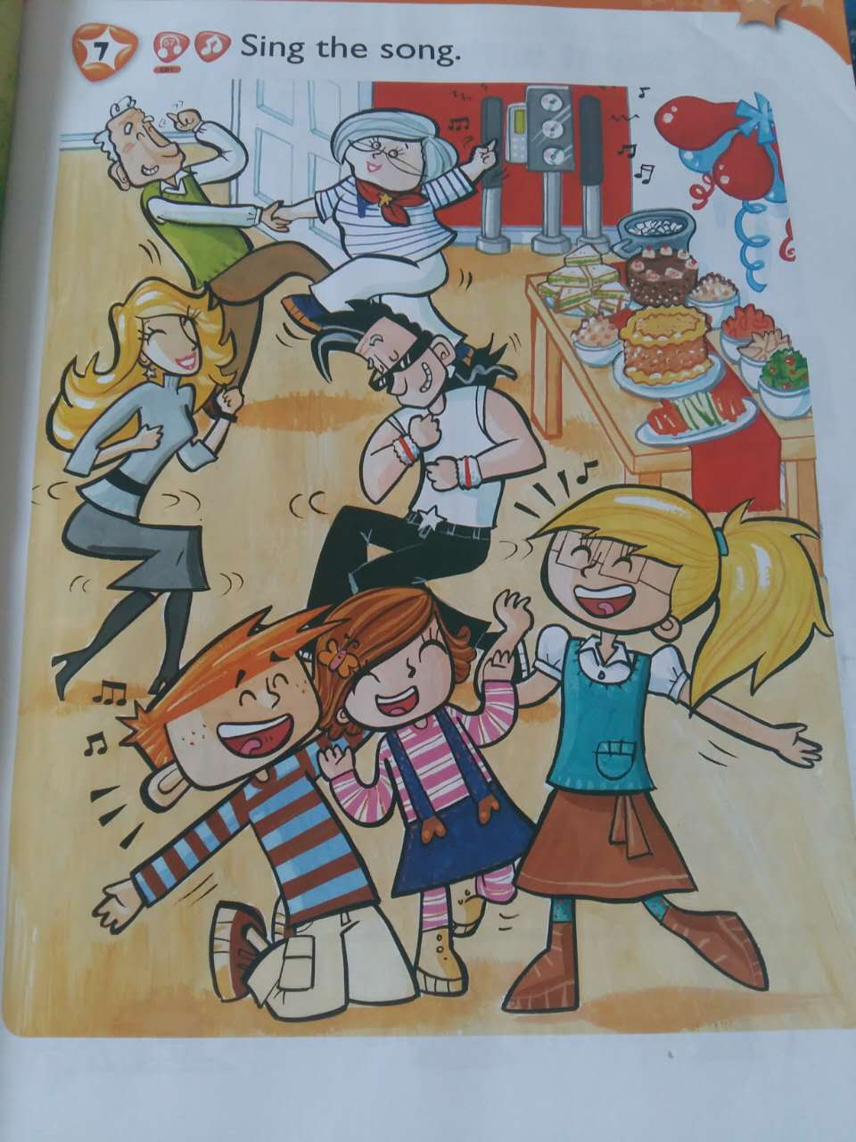

Slide 49


Slide 50
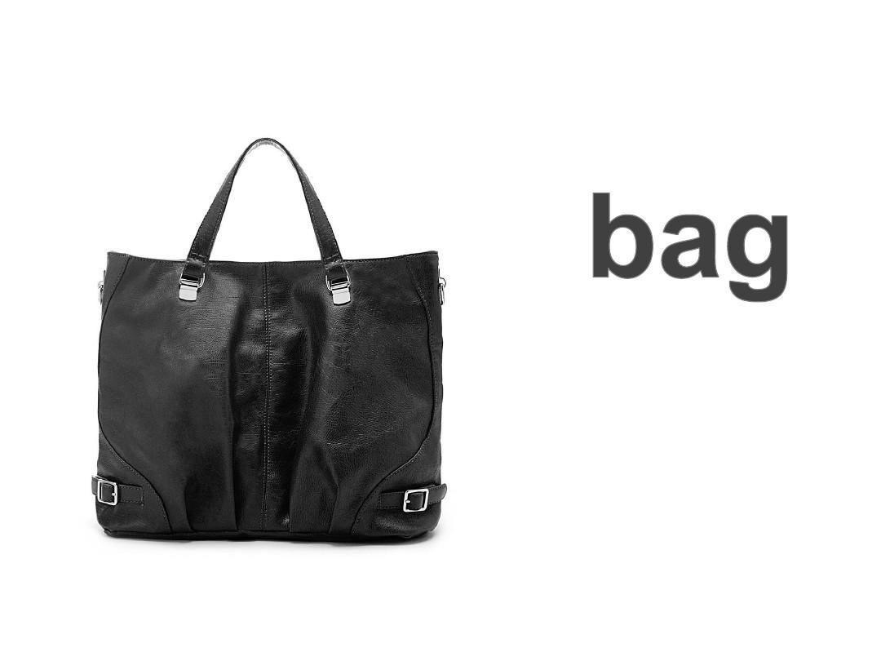

Slide 51


Slide 52
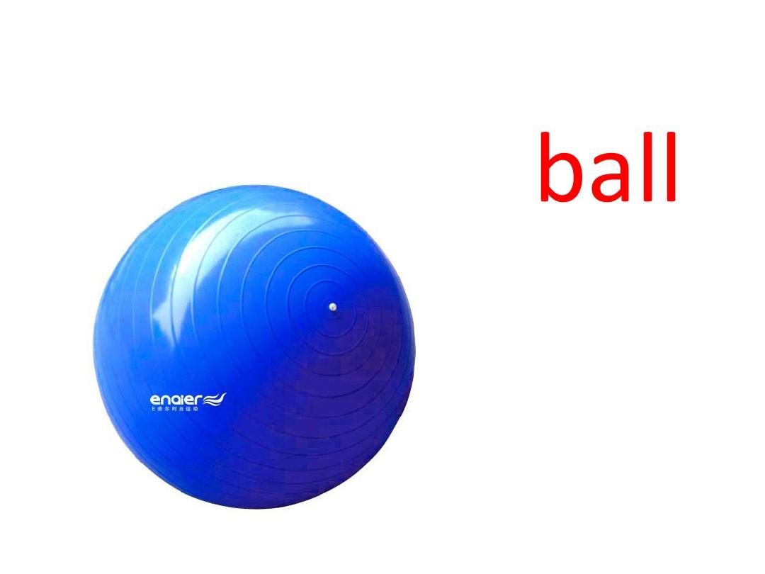

Slide 53
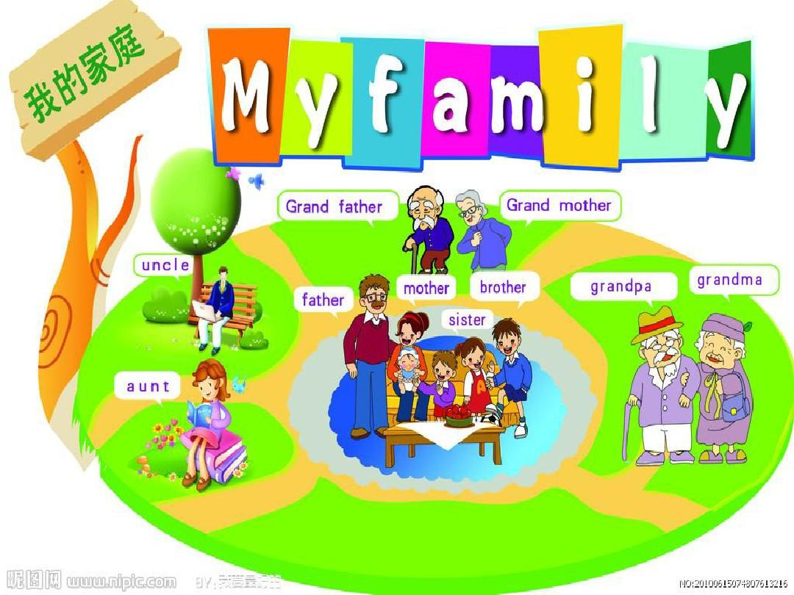

Slide 54
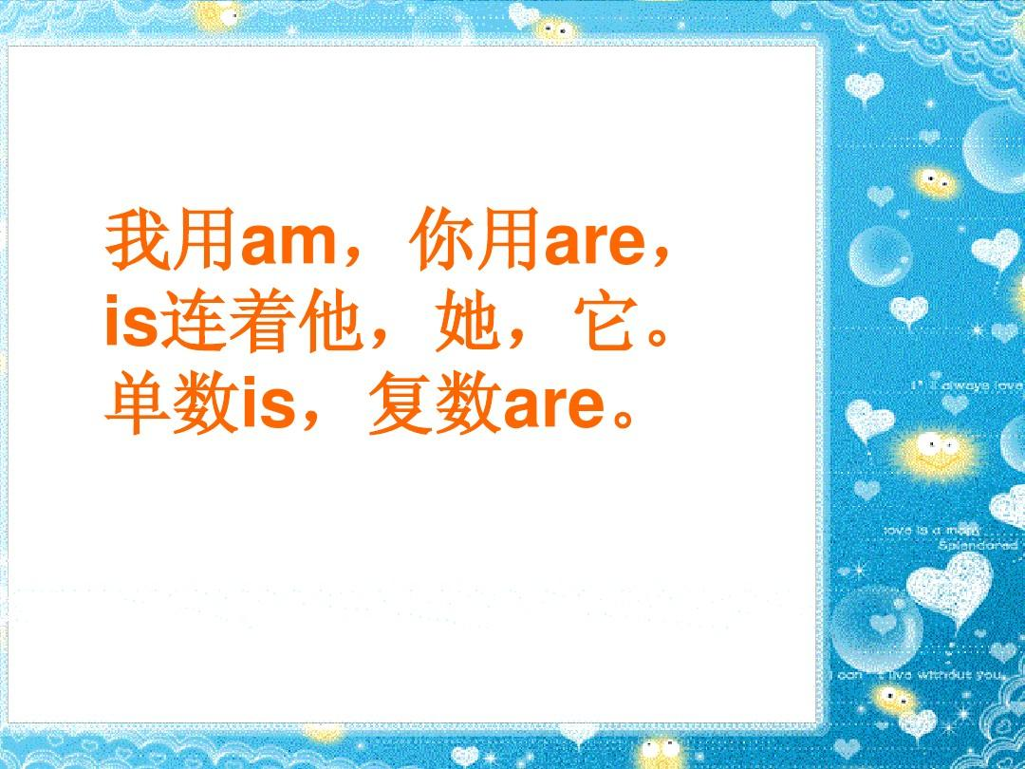

Slide 55
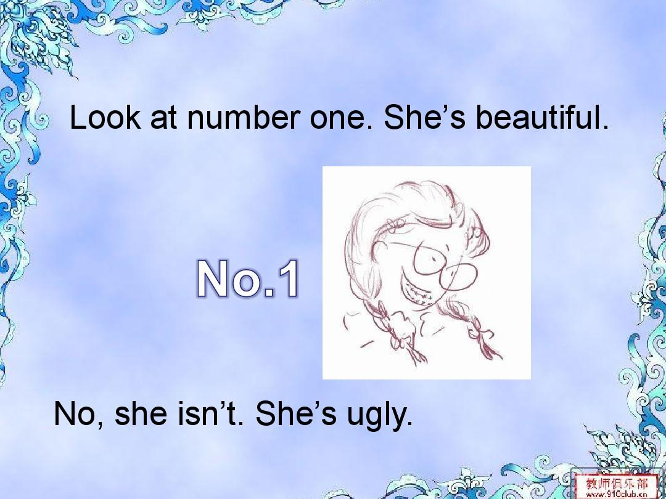

Slide 56
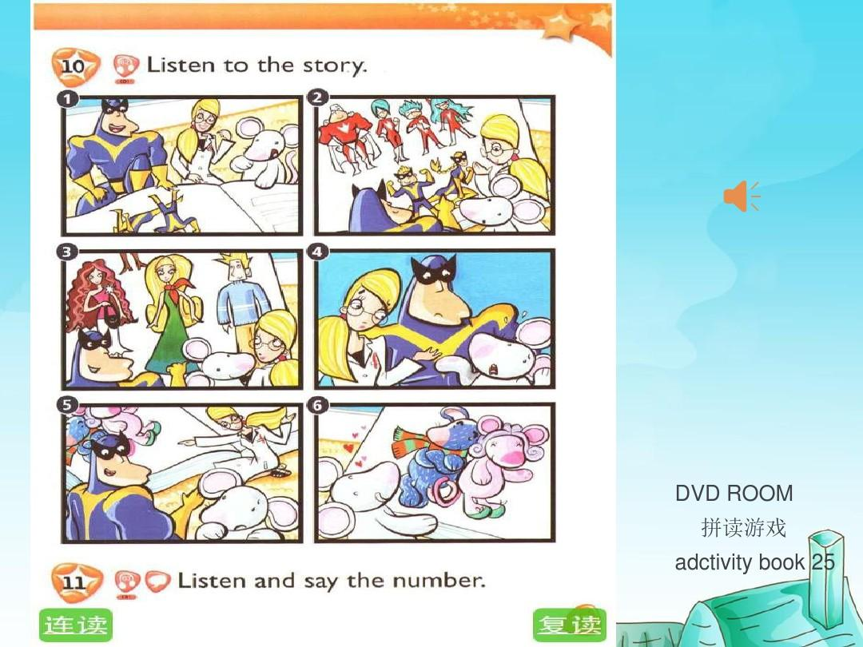

Slide 57
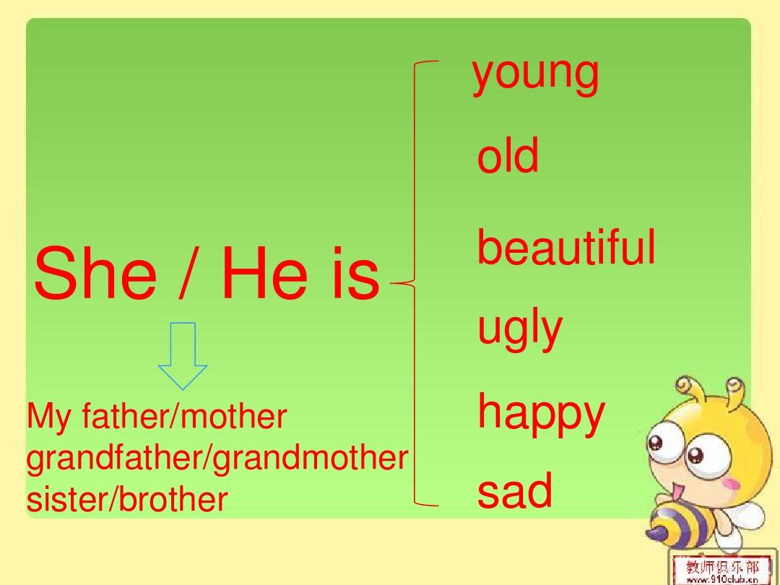

Slide 58
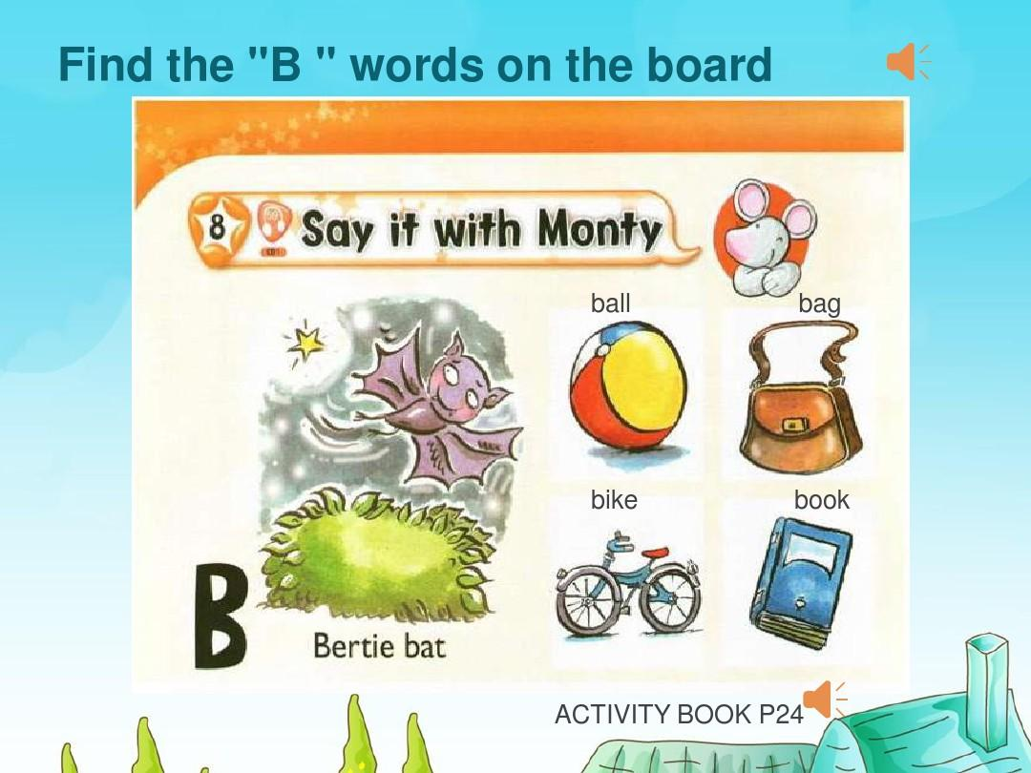
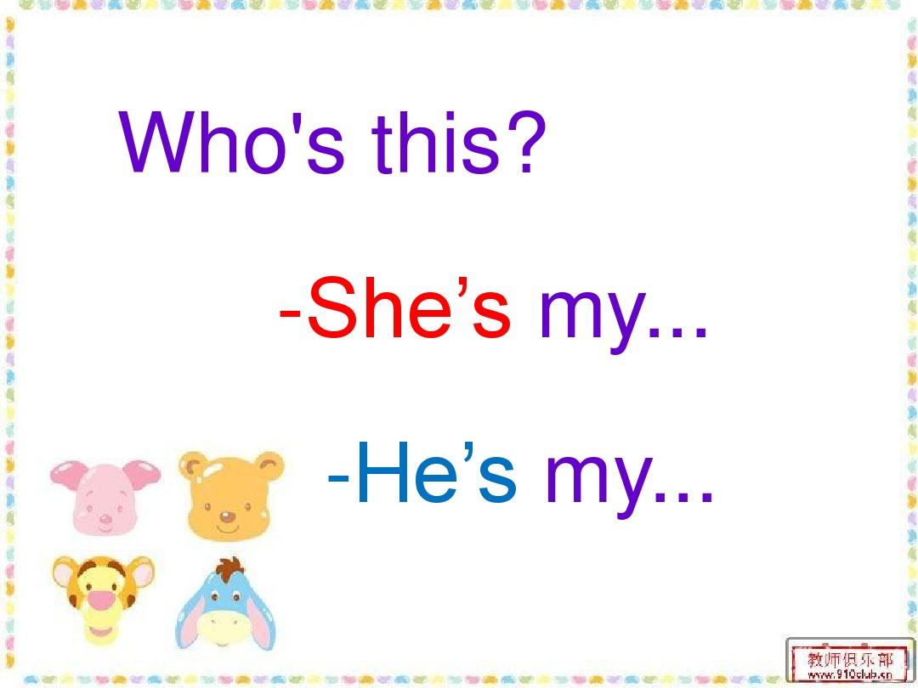

Slide 59


Slide 61


