Slide 1

空白演示
Unit 7
单击输入您的封面副标题

Slide 2
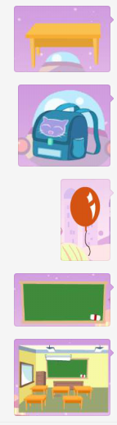
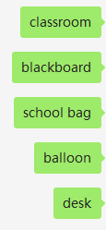


(1)
(2)
four five two one three
(3)
seven six ten nine eight

Slide 3



1.What are ?
are desks.
A.
B.
2.
A.those B.Those
are pencils.

Slide 4
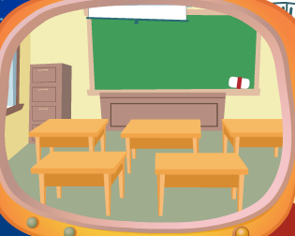
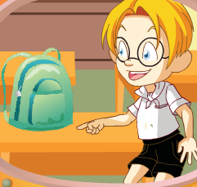
1.How many desks are there?
There desks.
2.How many schoolbags are there?
There desk.

Slide 5
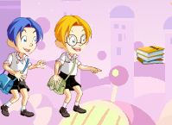
are books.

