Slide 1
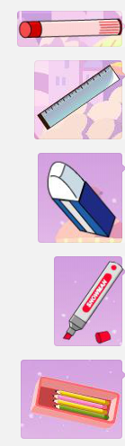


Slide 2
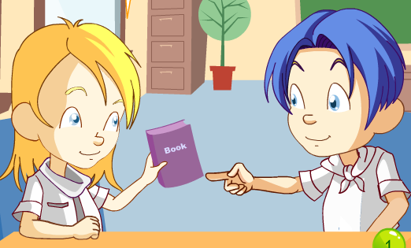
What's this?
This is a .
A.pen. B.book.

Slide 3
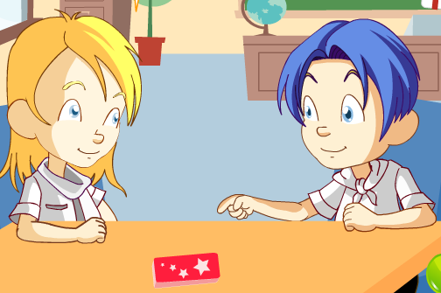
What's ?
is a book.
A.that ,That B.this,This

Slide 4
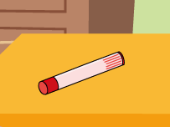
----Is this an eraser?
----
A.Yes,it is. B.No,it isn't.

Slide 5

----Is that an eraser?
---- .
A.Yes,it is. B.No,it isn't.

Slide 6




ook
uler
encil
mar er

