Slide 1

Pro5003 Opening Class

Slide 2
Game Time
my
they
from
will
my
want
will
which
is
where
from
they
some

Slide 3

目录content
C
Sight words Time
B
Sight words reading time
D
Words spelling
A
Story Time
E
Letter blends sound

Slide 4
一、Letter Sound
Aa Bb Cc Dd
Ee Ff Gg Hh
Ii Jj Kk Ll
Mm Nn Oo Pp
Qq Rr Ss Tt
Uu Vv Ww Xx
Yy Zz

Slide 5
CVC sounding time
bat bit mot but bed
mit dot sad pit nit
sun sit dog tid cat

Slide 6
Letter blend sounding time
b
bl
l
b
br
r
c
cl
l
c
cr
r
f
fl
l

Slide 7
Letter blend sounding time
g
gl
l
g
gr
r
t
tr
r
d
dr
r
s
sm
m
s
sn
n

Slide 8
CVC sounding time
snap black bless broom
clap clock crab glass glad
flag frog grass green

Slide 9
Letter blend sounding time
ee
ch
gh
a-e
ea
sh
ou
igh
ay

Slide 10
Letter blend sounding time
peek
cheese
laugh
cake
tea
fish
high
sound
say

Slide 11
Writing Time

Slide 12
6. s
1. bl
7. t
2. pl
8. sh
3. gl
9. fish
4. cr
10. crab
5. fl

Slide 13
Sight Words Time
my
they
am
want
which
will
is
where
some

Slide 14
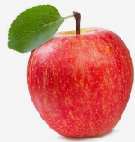
Sight words reading
I am red. apple is red.
which is blue? pen is blue.
I will go to the zoo.
They go to China,but I will go to the UK.
My crab is red. chip is red.

Slide 15
apple
I see an ___________ .
NEXT
A. apple B. banana C. lemon
CHECK

Slide 16

clock
This is a _____________
NEXT
A. clock B. crock C. block
CHECK

Slide 17

snake
There is a ___________ here.
NEXT
A. snack B. snake C.snag
CHECK

Slide 18
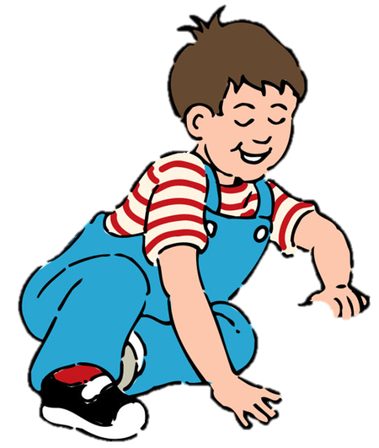

crab
He is playing with a ___________
NEXT
CHECK
A. crab B. clab C. crass

Slide 19
black
There is a ___________ bridge.
A. black B. brack C. clock
NEXT
CHECK

Slide 20

frog
The girl has got a _________
A. frog B. brog C. flog
NEXT
CHECK

Slide 21
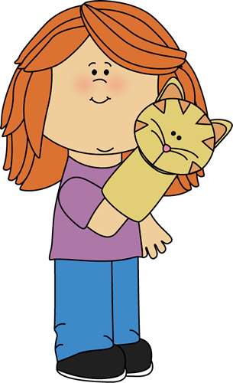
puppet
This girl has got a __________
A. puppet B. poppet C. pippet
NEXT
CHECK

Slide 22

A.
B.
C.

Slide 23
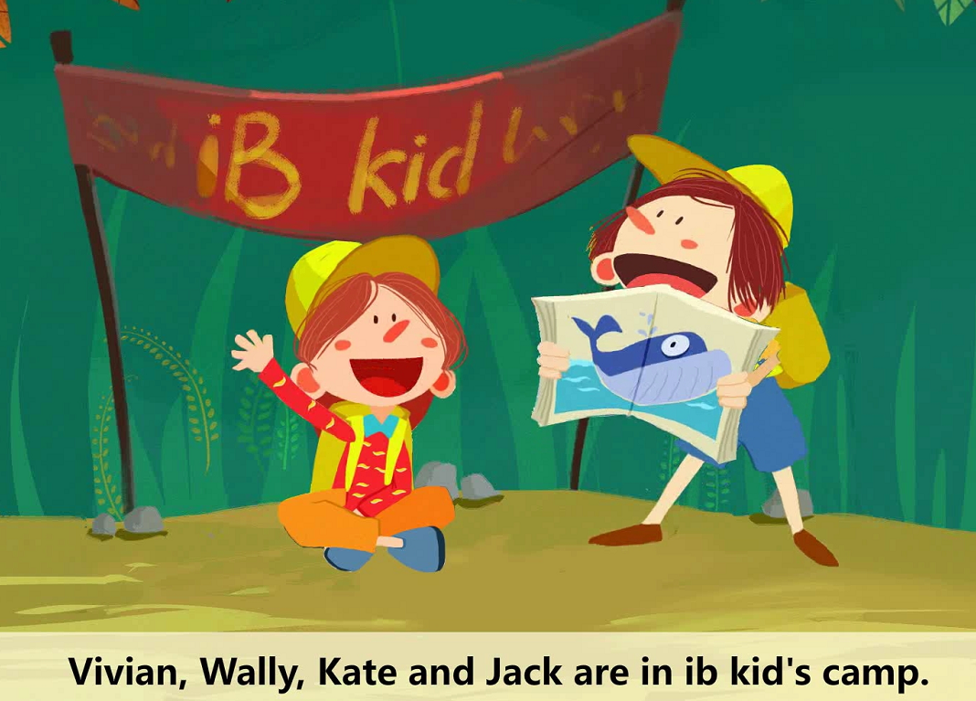
B.
C.

Slide 24
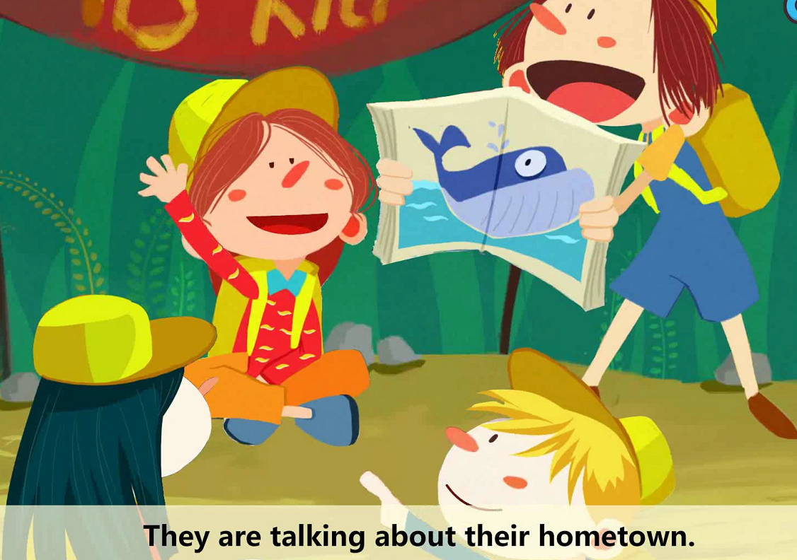

Slide 25
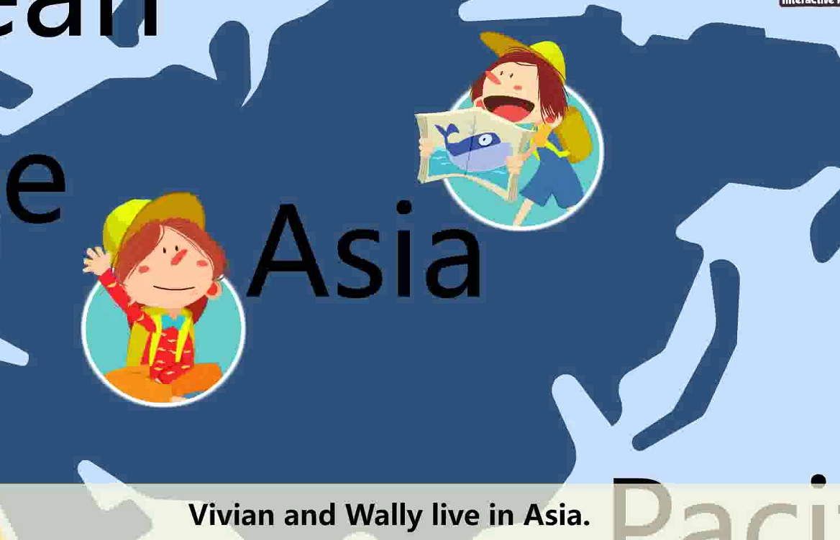

Slide 26
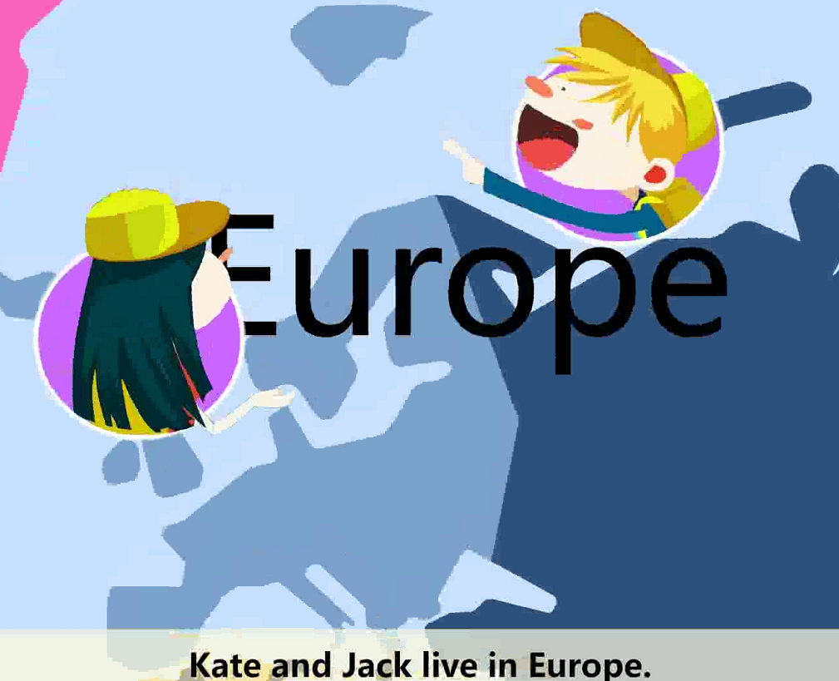

Slide 27
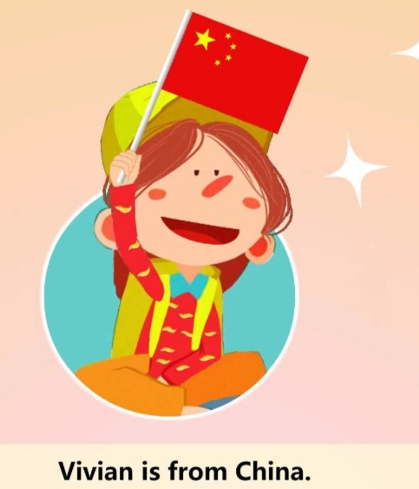
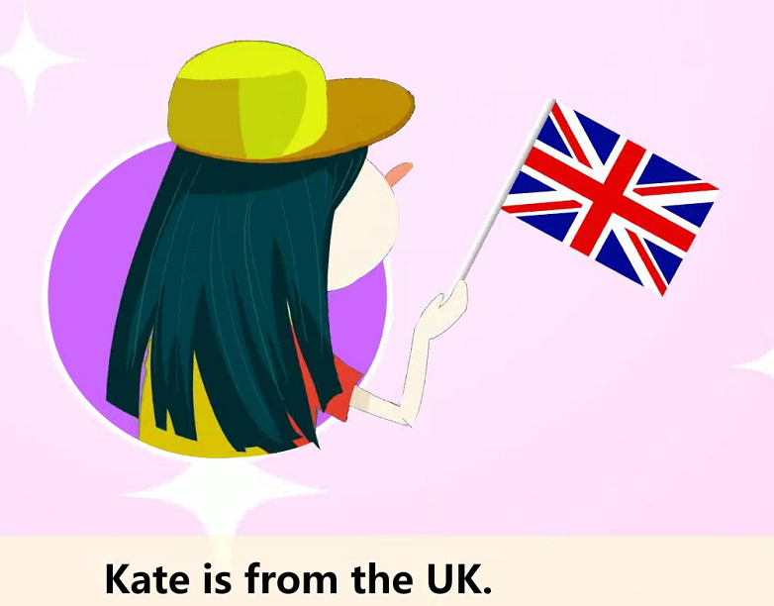
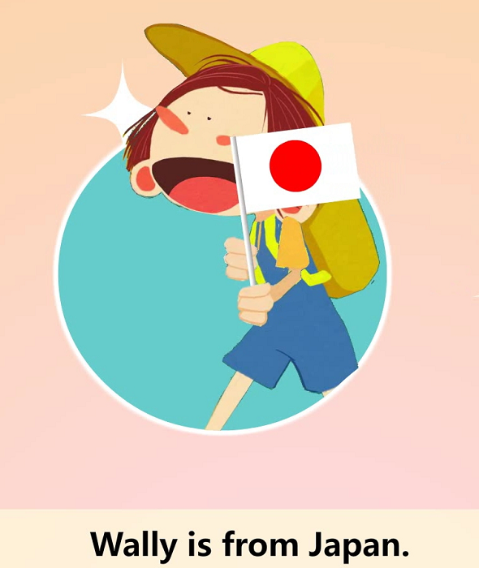


Slide 28
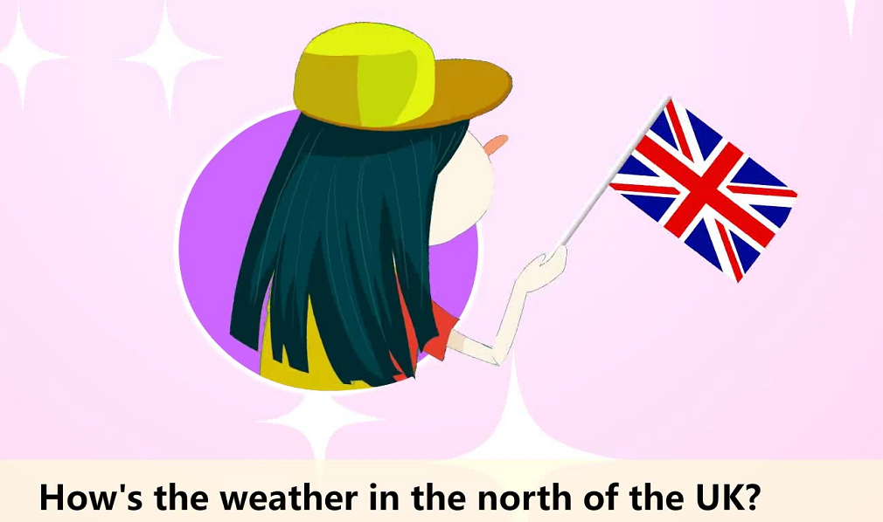
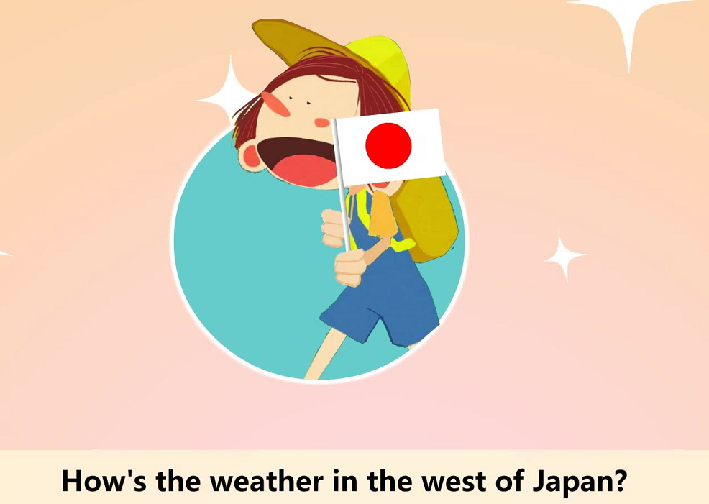
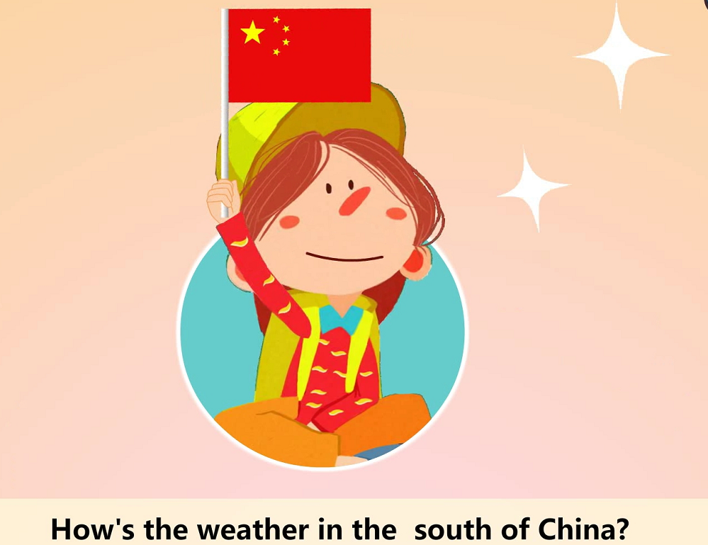
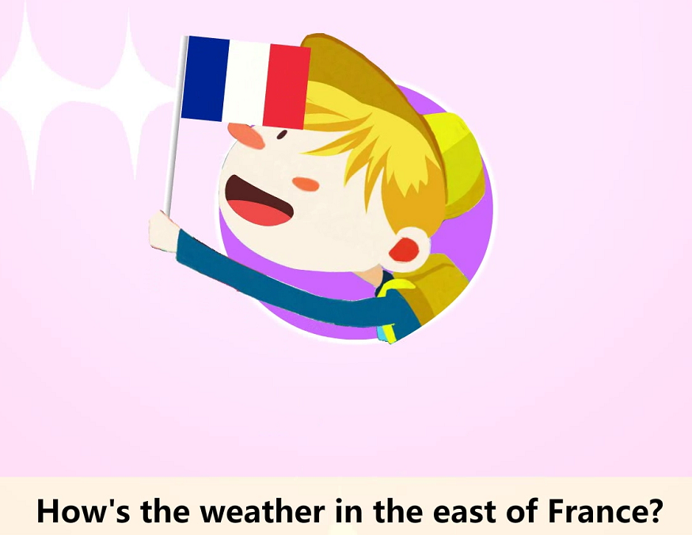
How's the weather?
cool
cold
hot
warm

Slide 29
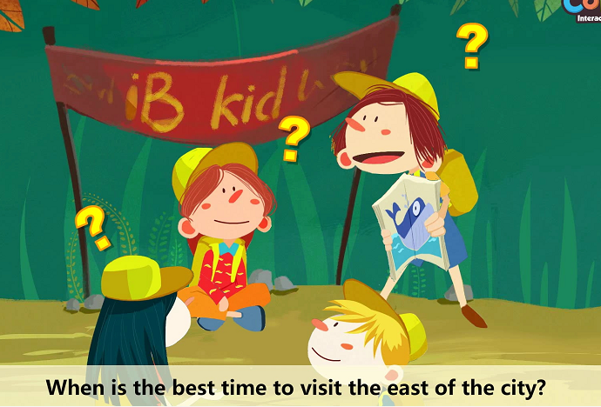
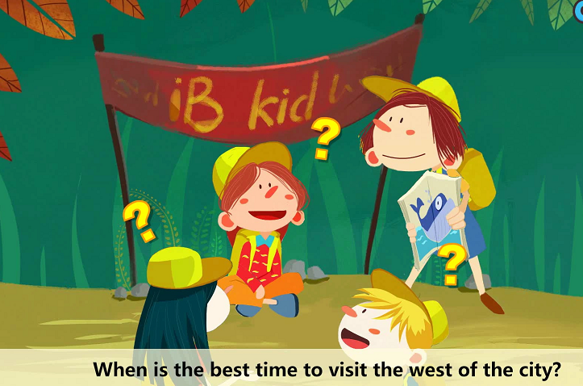
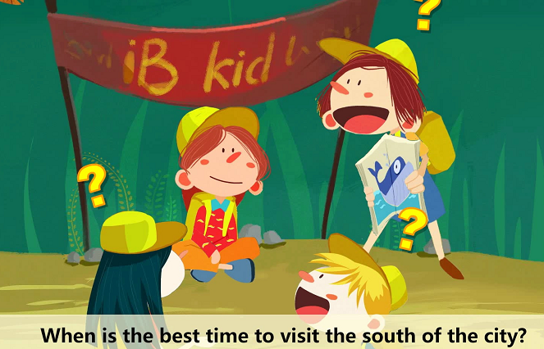
When is the best time to visit...
warm
cool
hot
cold
When is the best time to visit the north of the city?

Slide 30
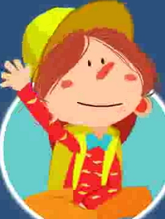

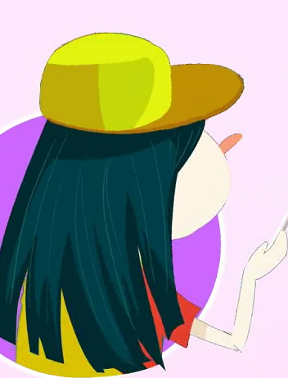



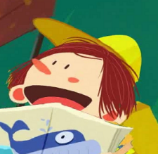

Living in the world
Name | From | Weather | When (Time) | orientation
Vivian
Wally
Kate
Jack
China
hot
winter
south
Japan
cool
west
Fall
The UK
cold
Spring
north
France
warm
Summer
east
Where is ____from? _____is from____
How's the weather here? It's_____ in ____

Slide 31
Thank you!

