Slide 1



YOYO 9 final term PBL CAMP

Slide 2

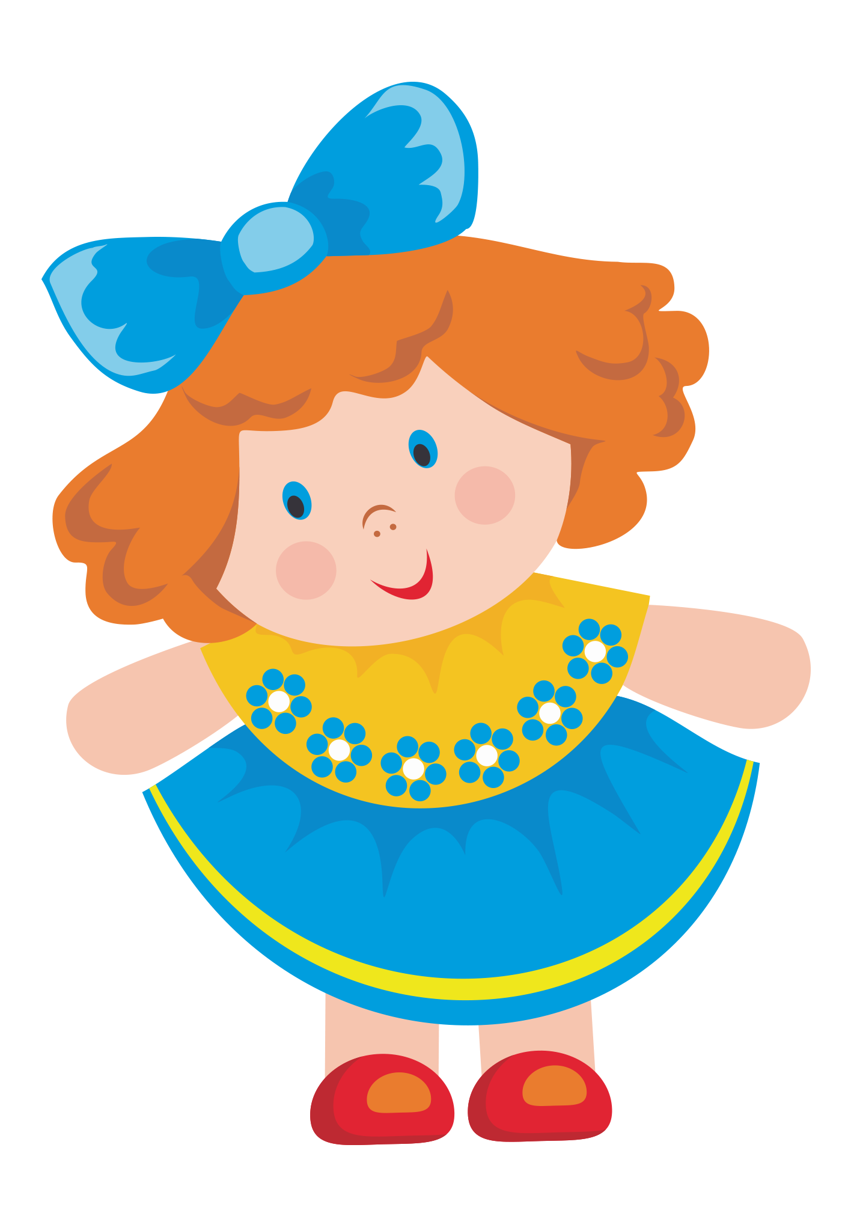
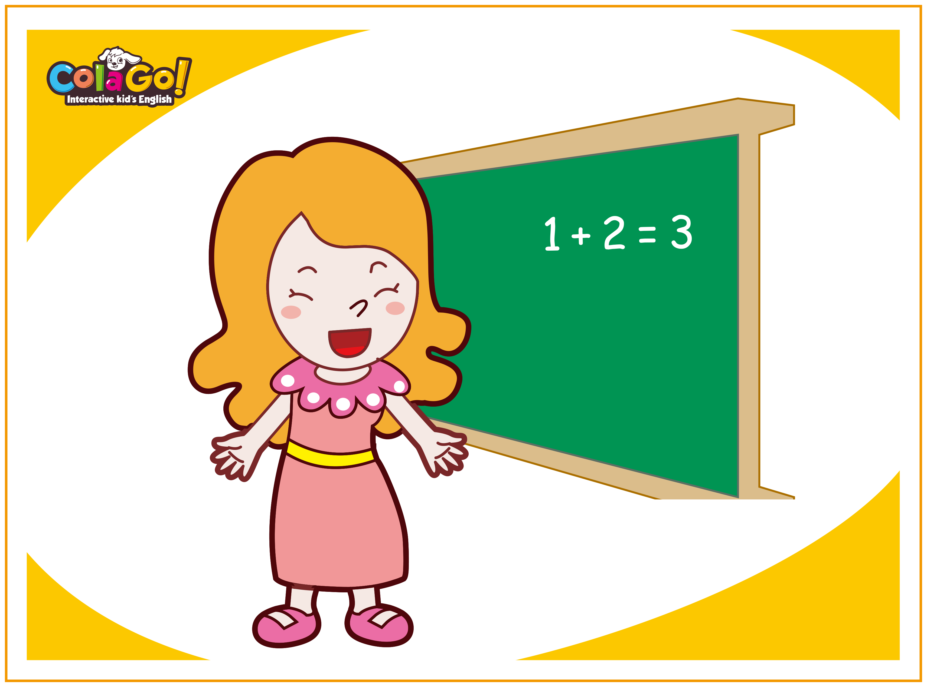

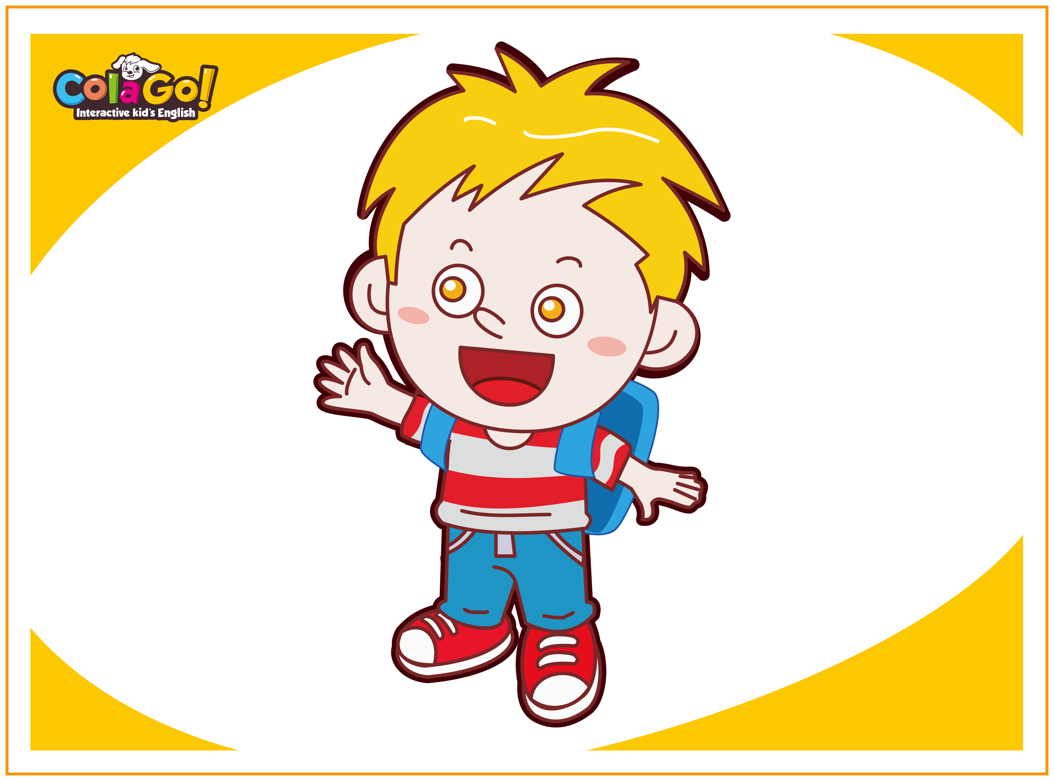
character
Teacher
Robot
doll
Doctor
Student 1
Student 2

Slide 3
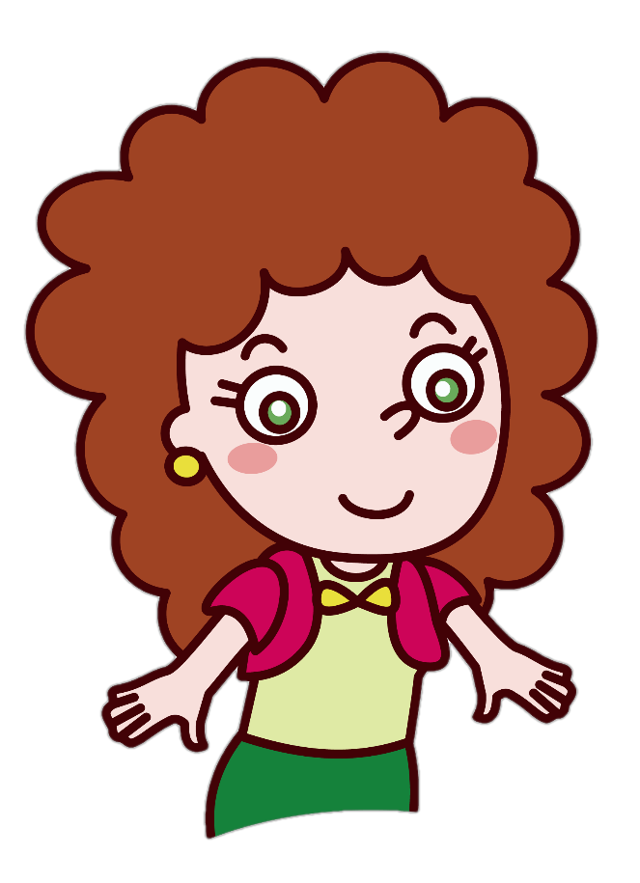
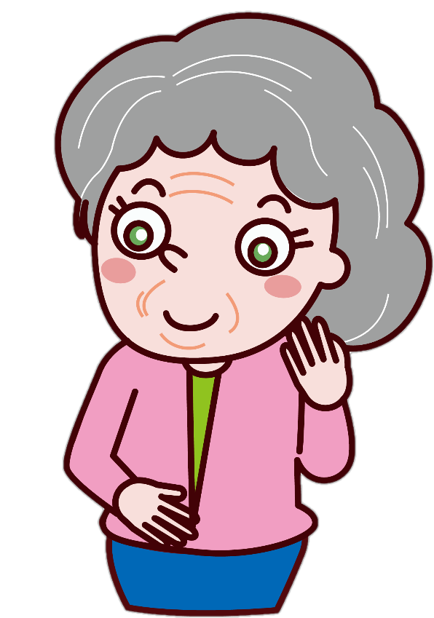
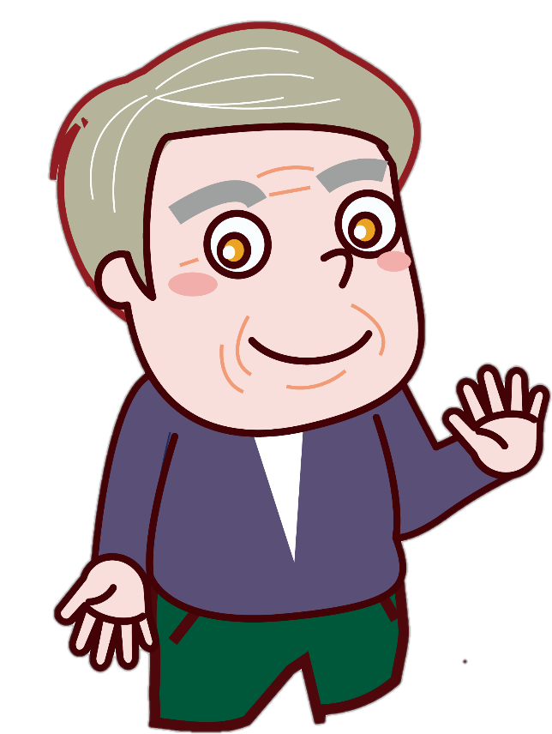
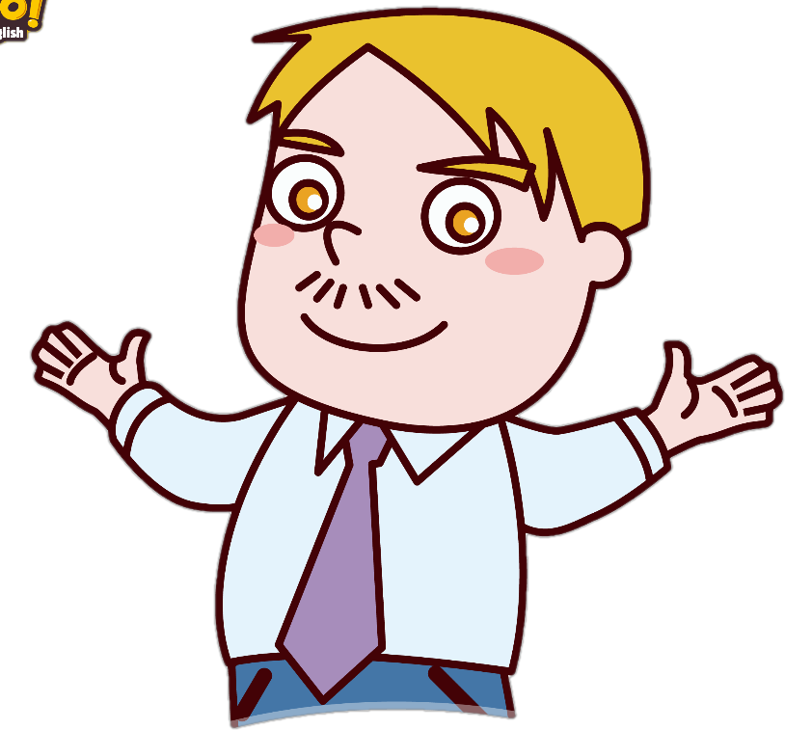
Hello teacher,hello,doctor
She is my .
Student 2
He is my .
Student 1

Slide 4

Are you a boy?
Yes,I am.

Slide 5
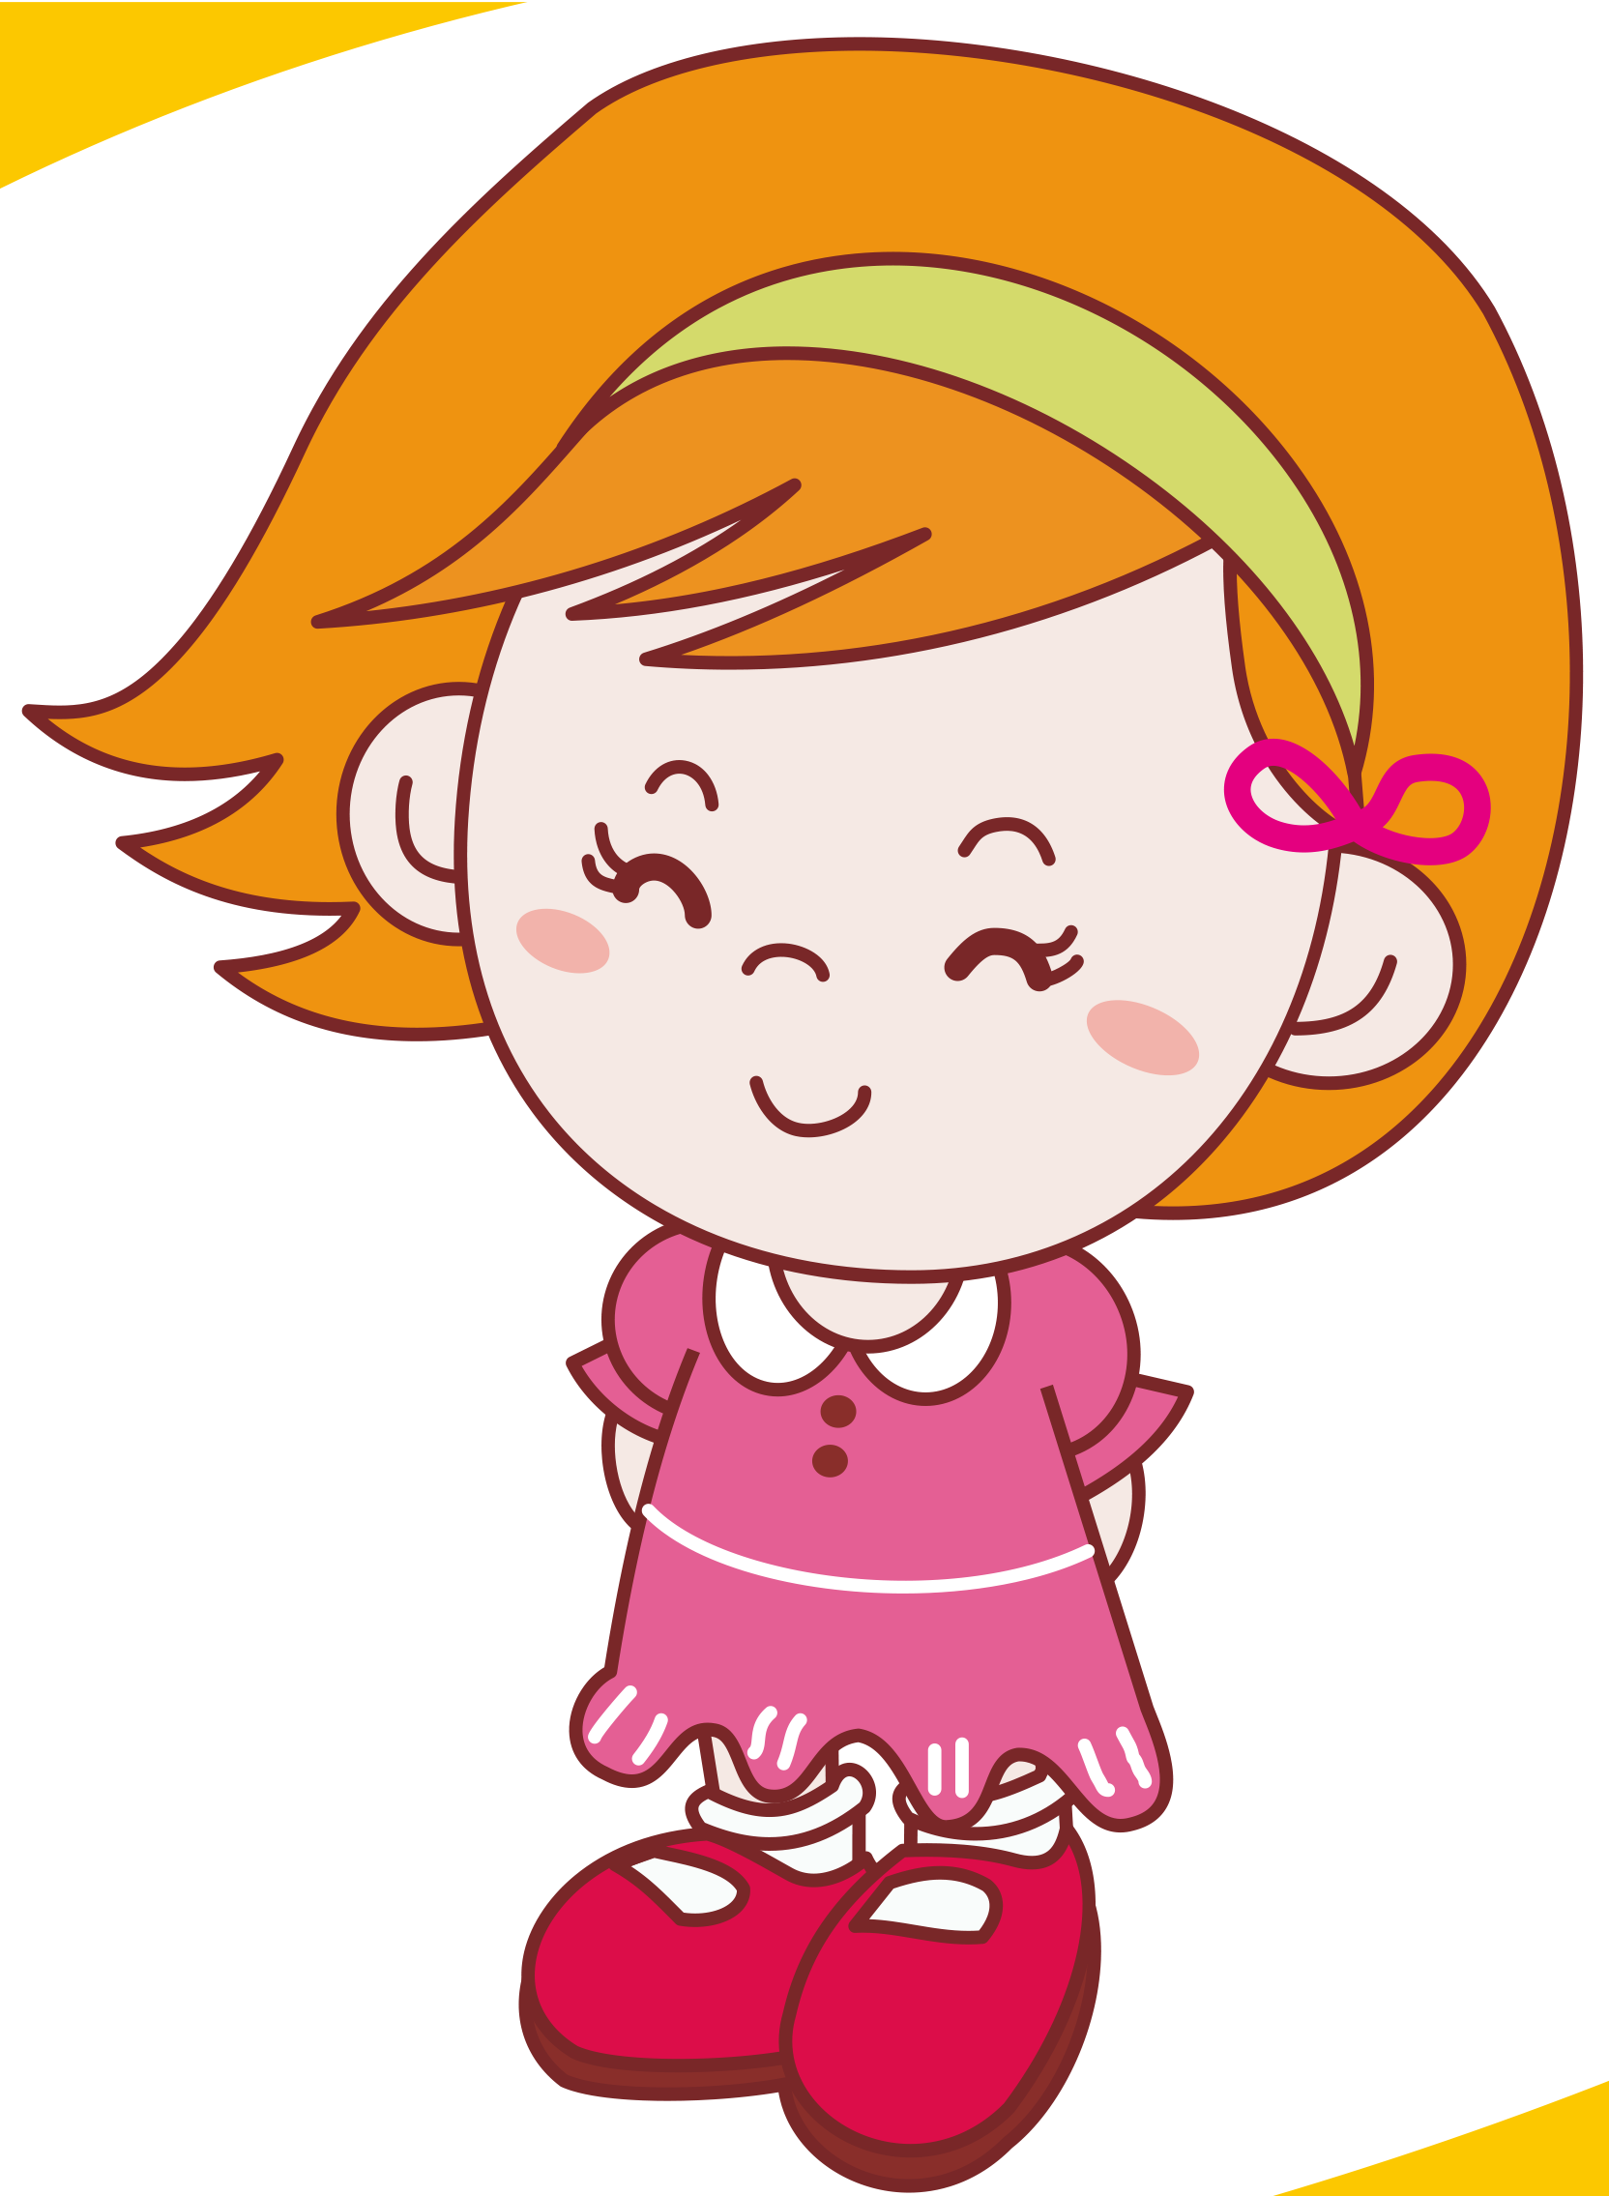
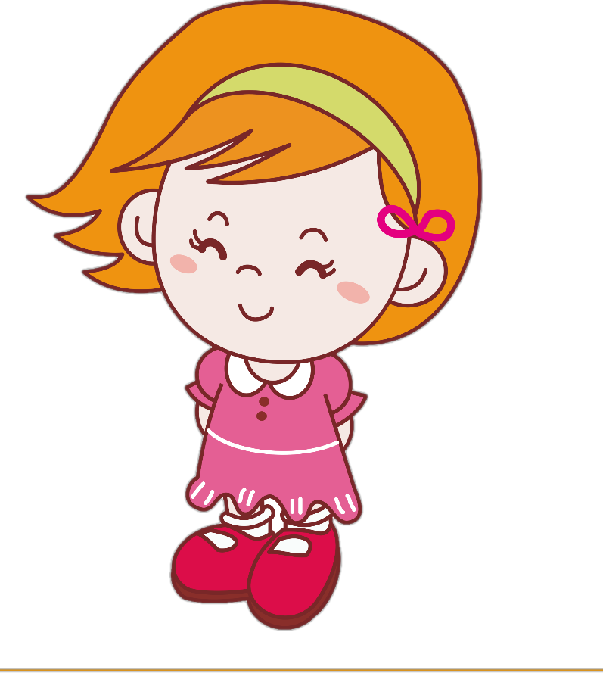
Are you a girl?
Are you a girl?
Yes,I am.

Slide 6
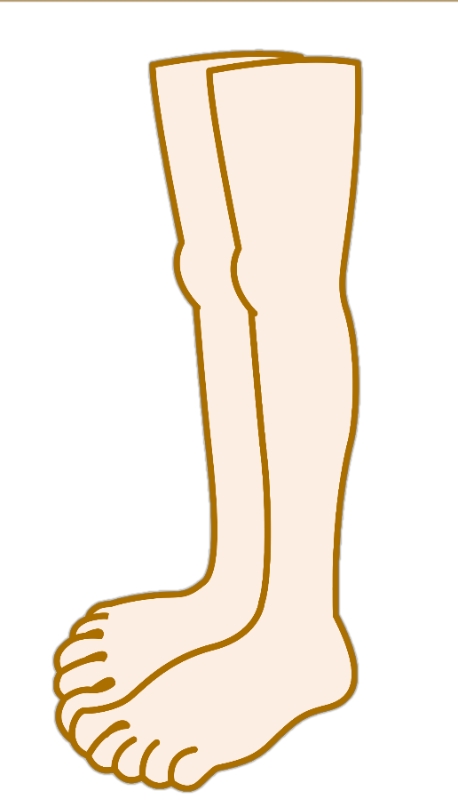
Show me your leg.
Student 1
My leg.

Slide 7
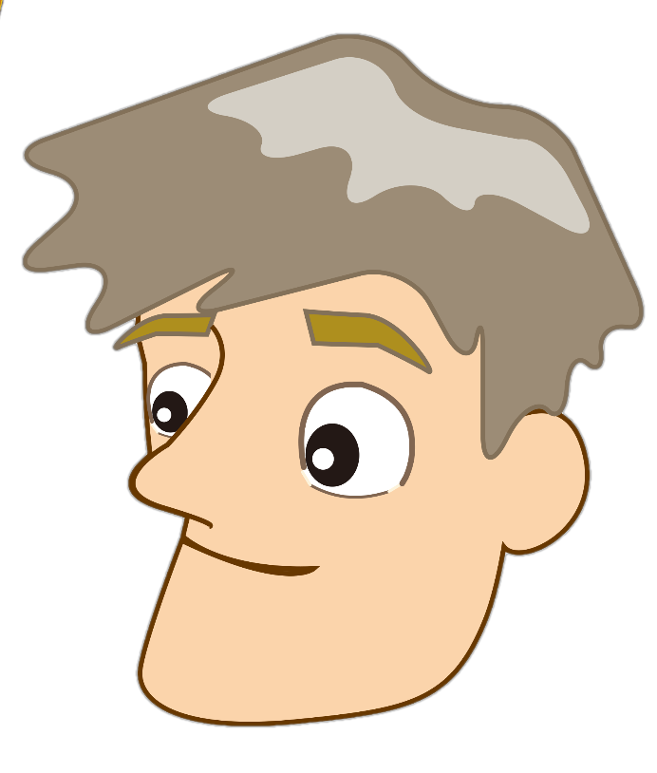
Show me your head.
Student 2
My head.

Slide 8


Here is a .
Thank you.

Slide 9
Wow，It's a cat.

Slide 10
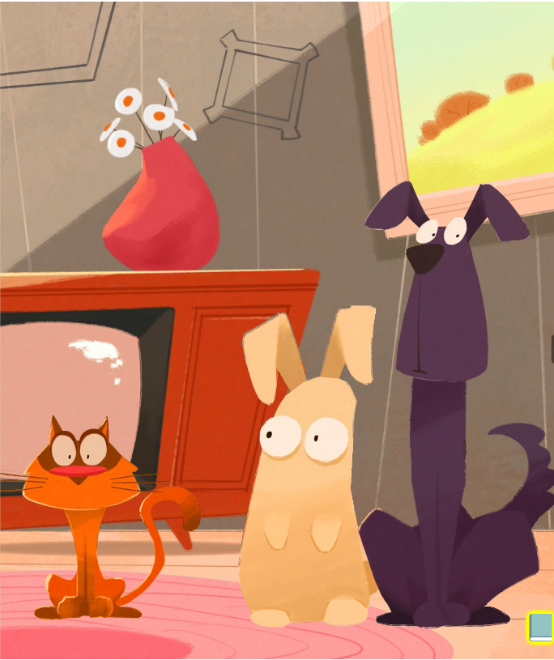

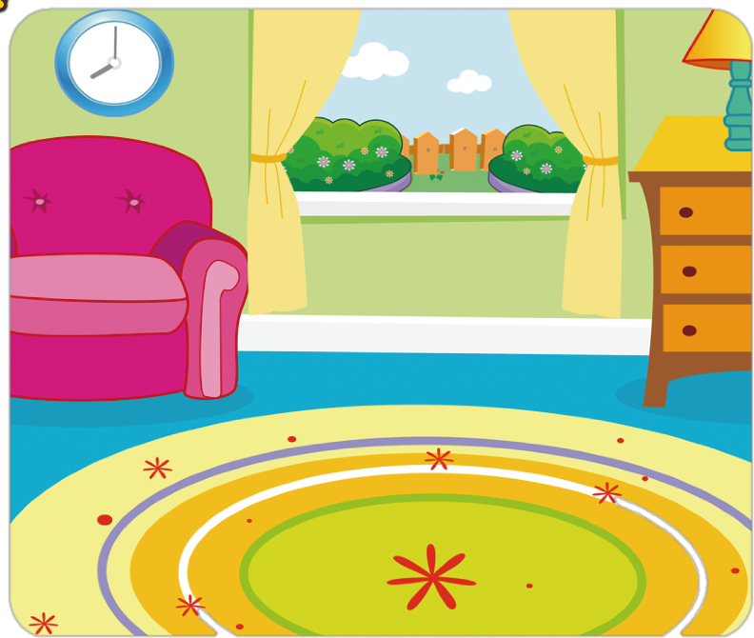
It's orange in the livingroom.

Slide 11
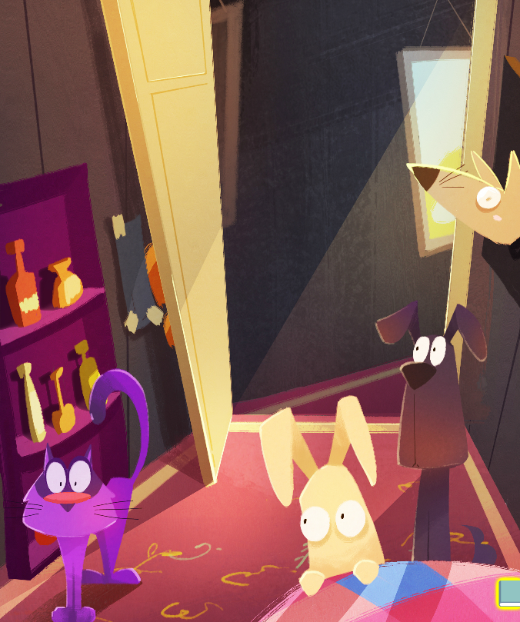

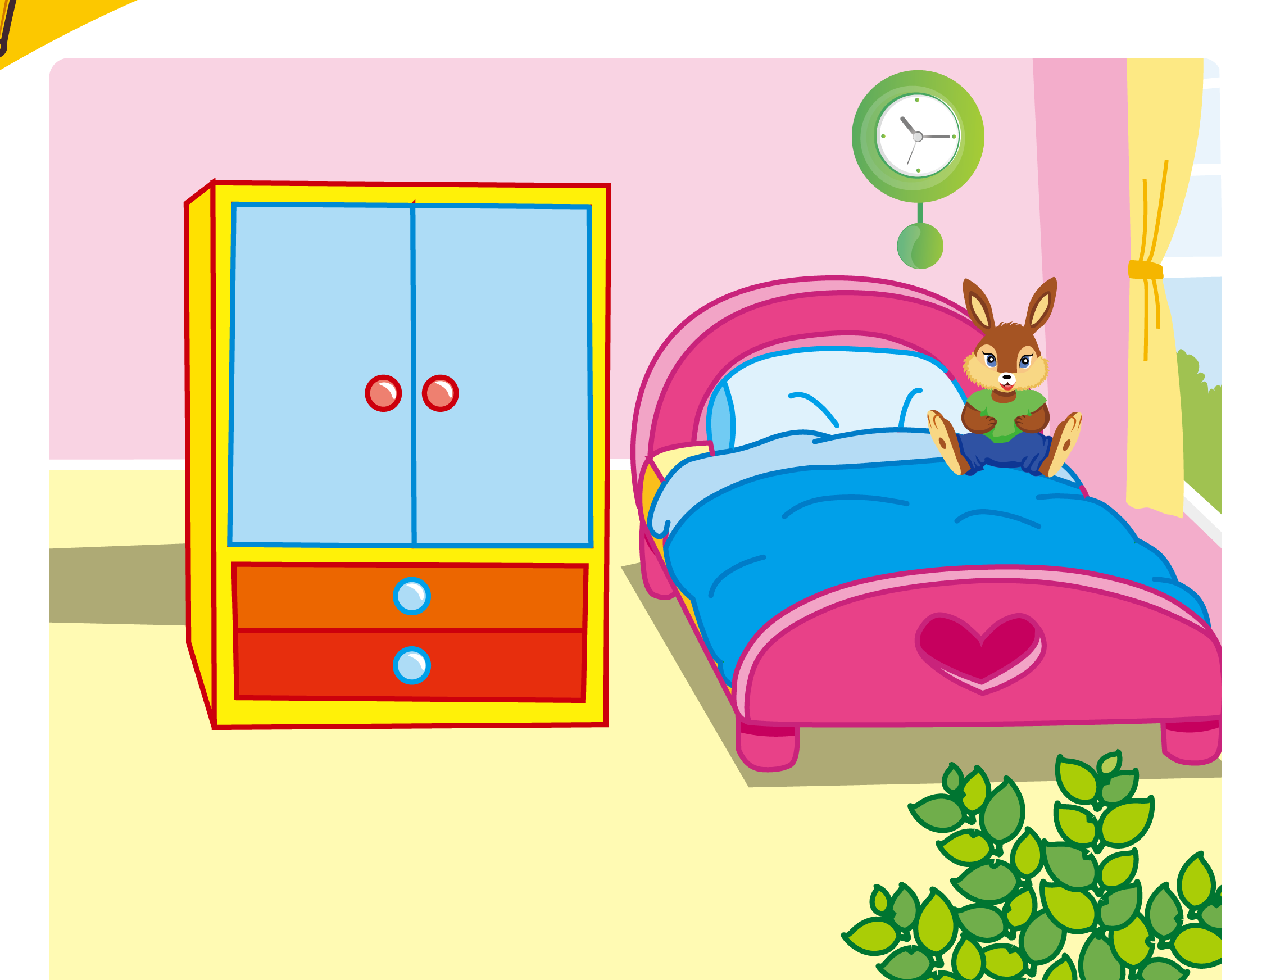
It's purple in the bedroom.

Slide 12
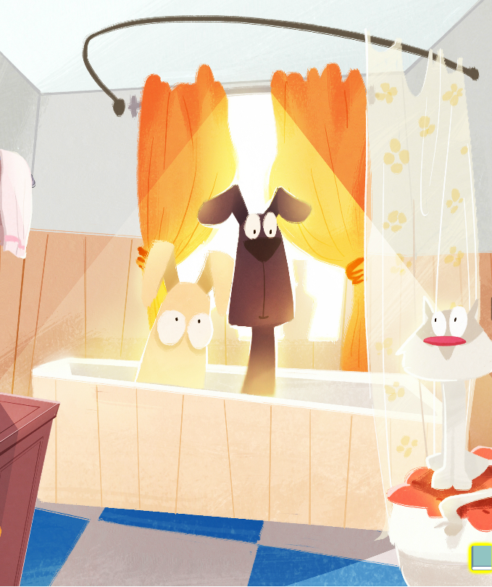
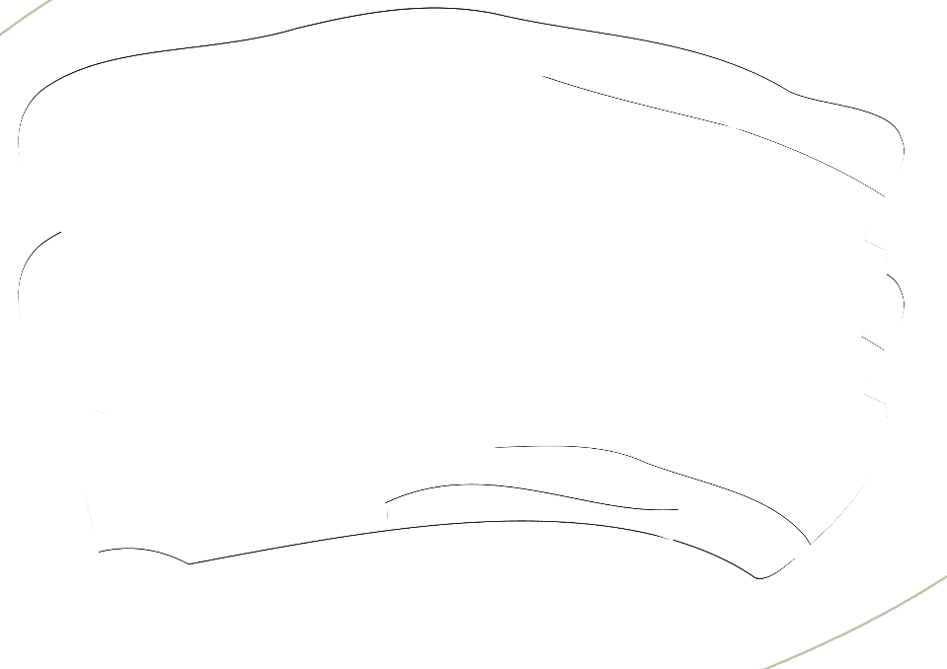
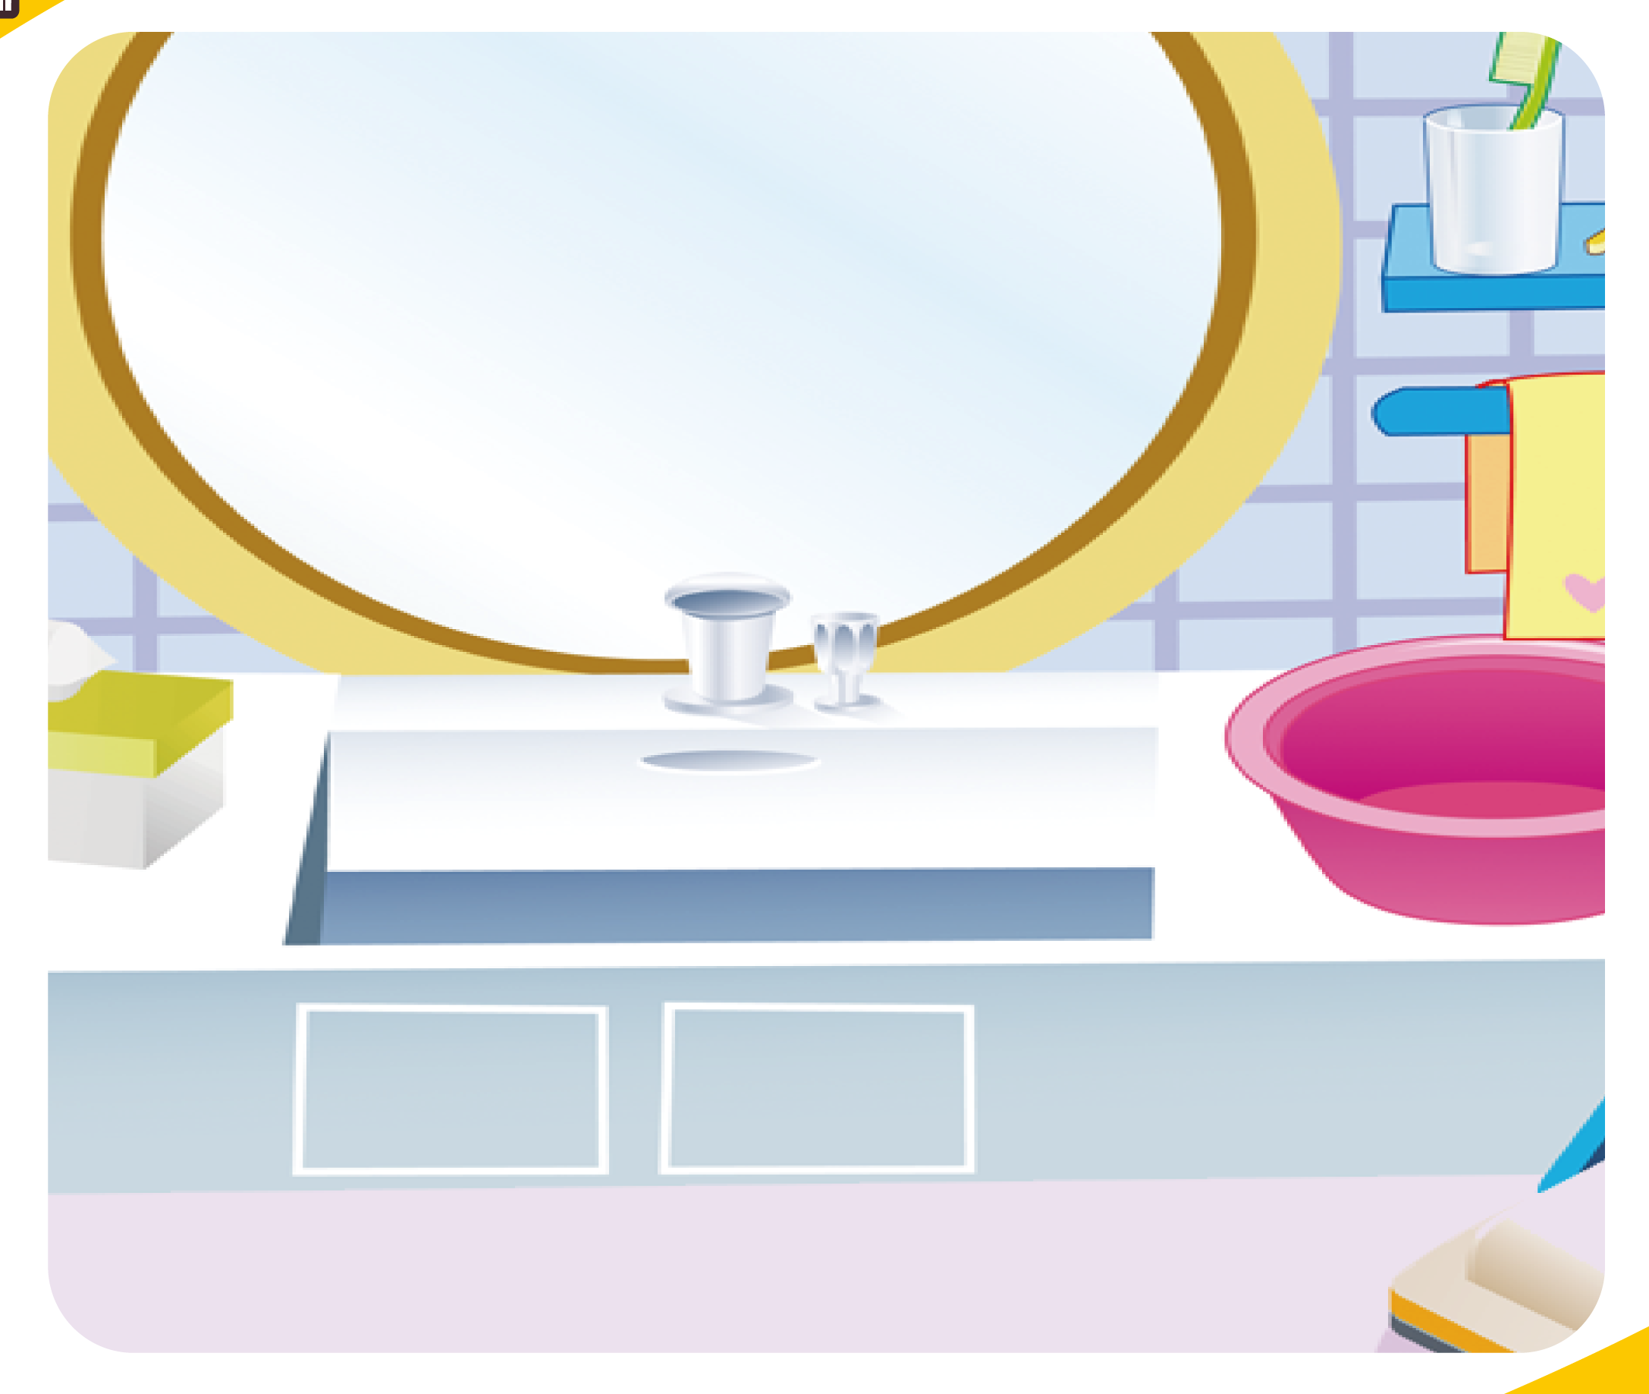
It's white in the bathroom.

Slide 13
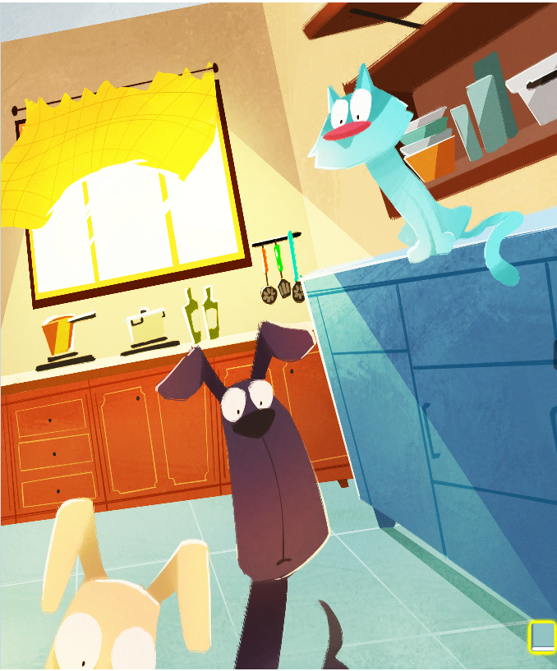

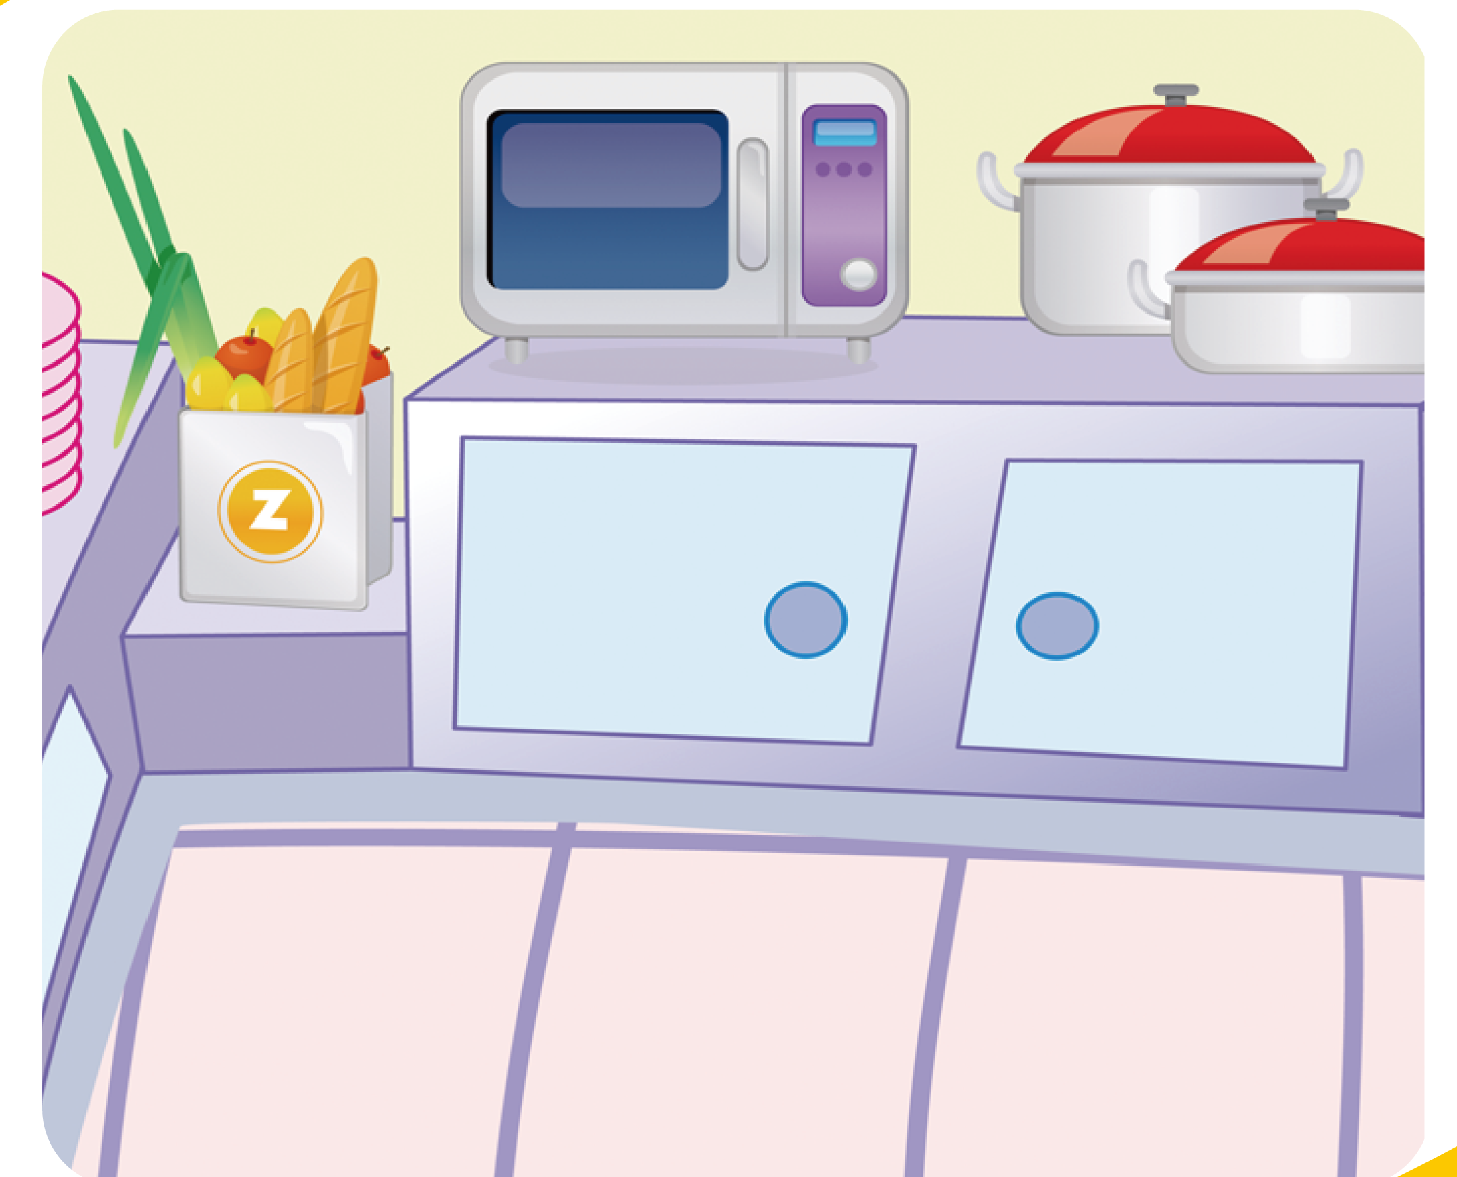
It's blue in the kitchen.

Slide 14
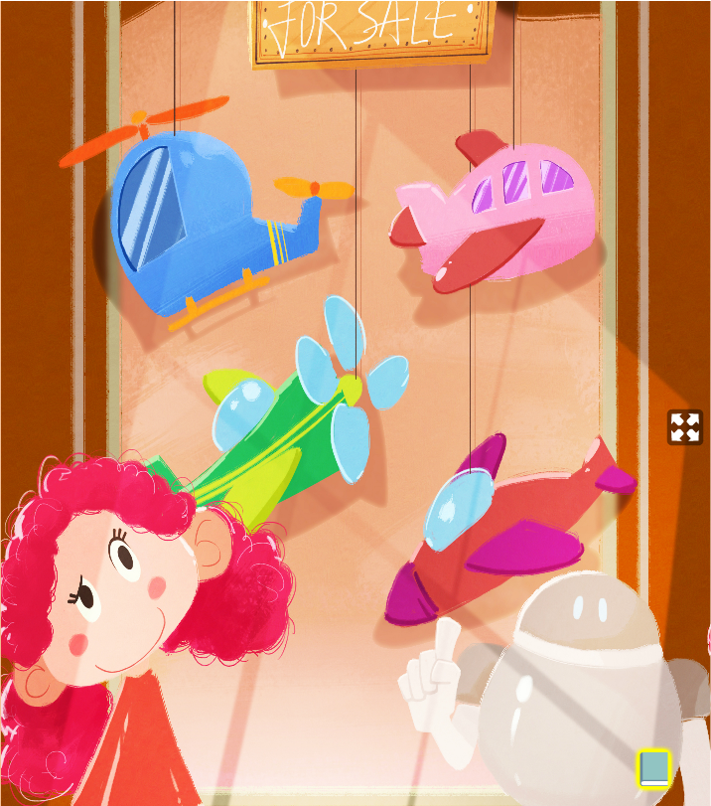
Student 2
It's a plane.
How many planes?
Annie

Slide 15
Student 1
I can count. one two three four (1.2.3.4),four planes.

