Slide 1



YOYO 8 final term PBL CAMP

Slide 2

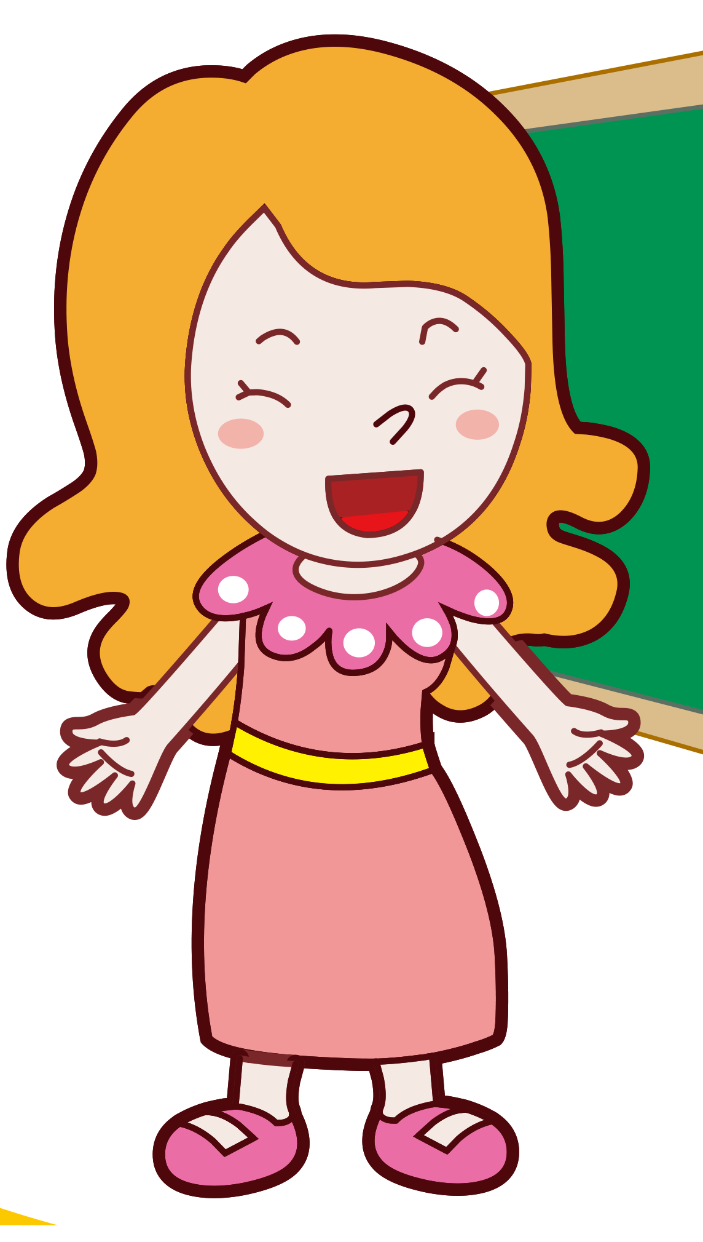
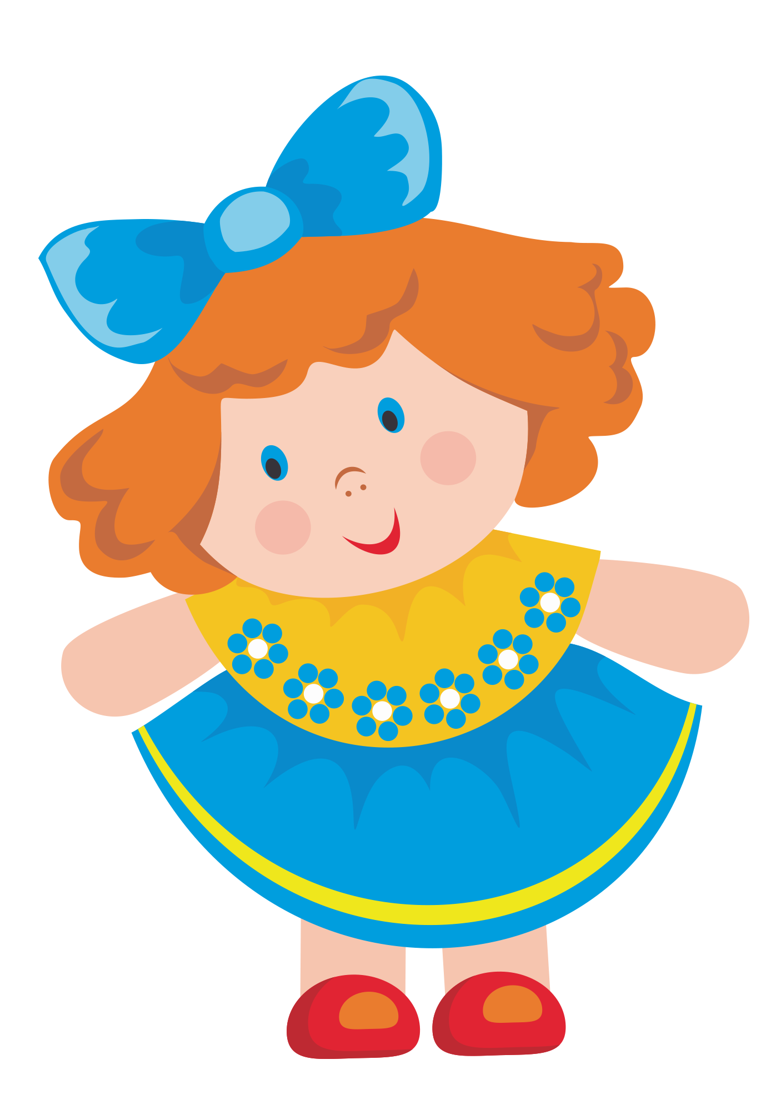


character
Sofia
Jack
Lucina
Zane
Elin
Eve

Slide 3

Sofia
Are you a boy?
Yes,I am.
Jack

Slide 4

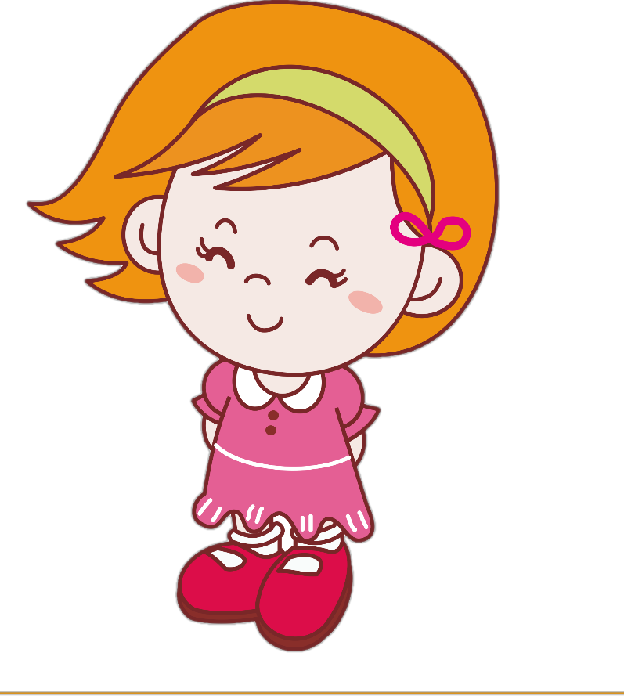
Zane
Zane
Are you a girl?
Are you a girl?
Yes,I am.
Lucina

Slide 5
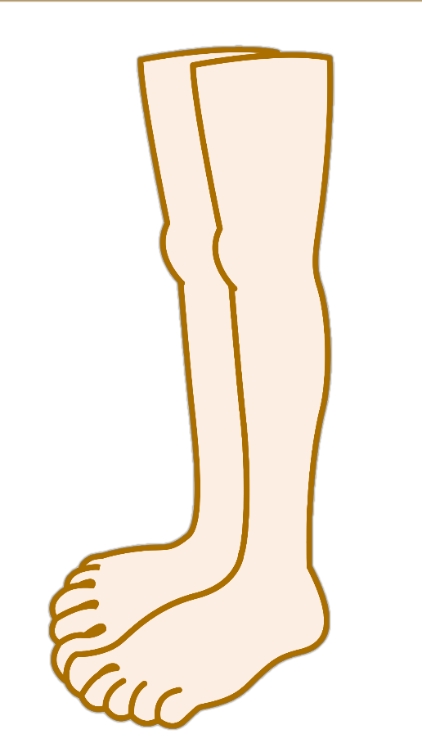
Show me your leg.
Eve
My leg.
Jack

Slide 6
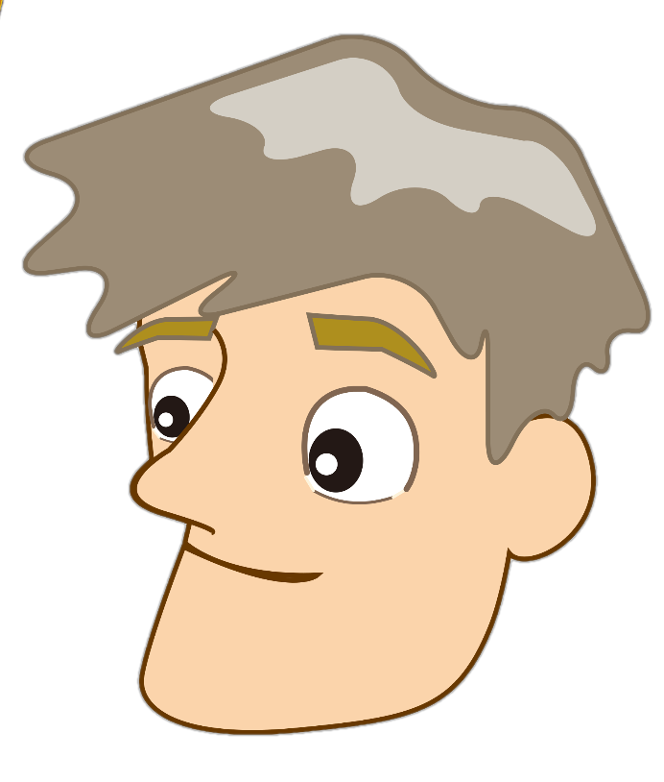
Show me your head.
Elin
My head.
Lucina

Slide 7
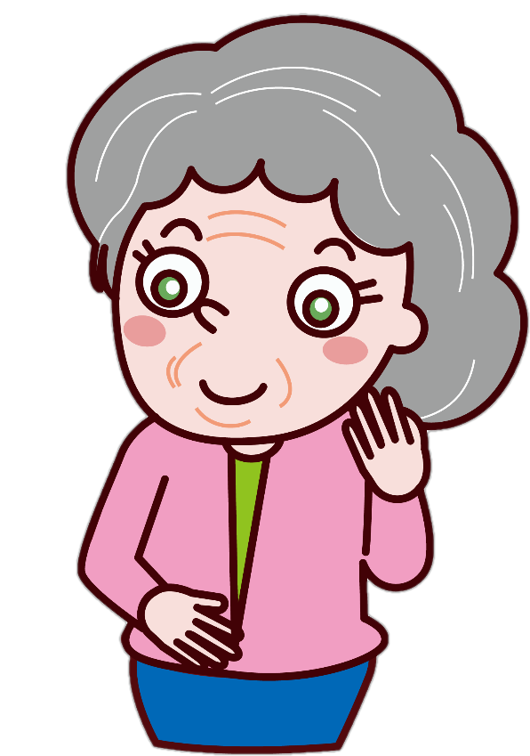
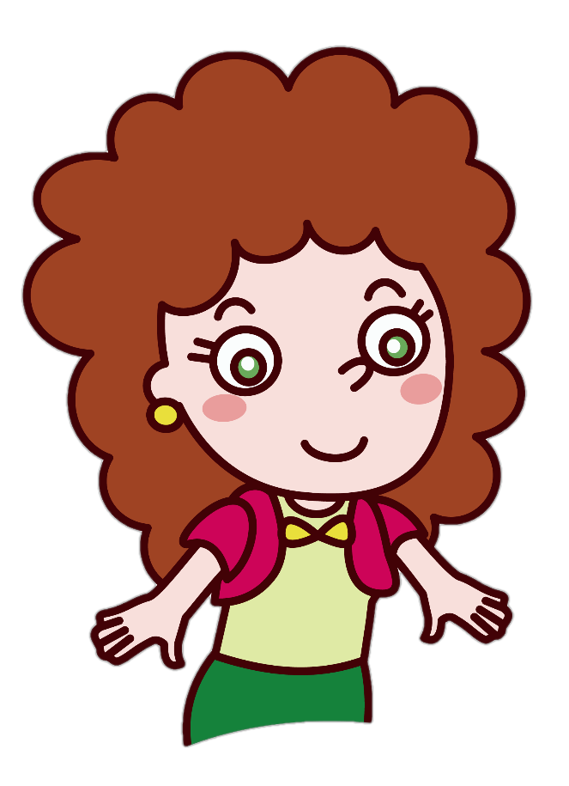
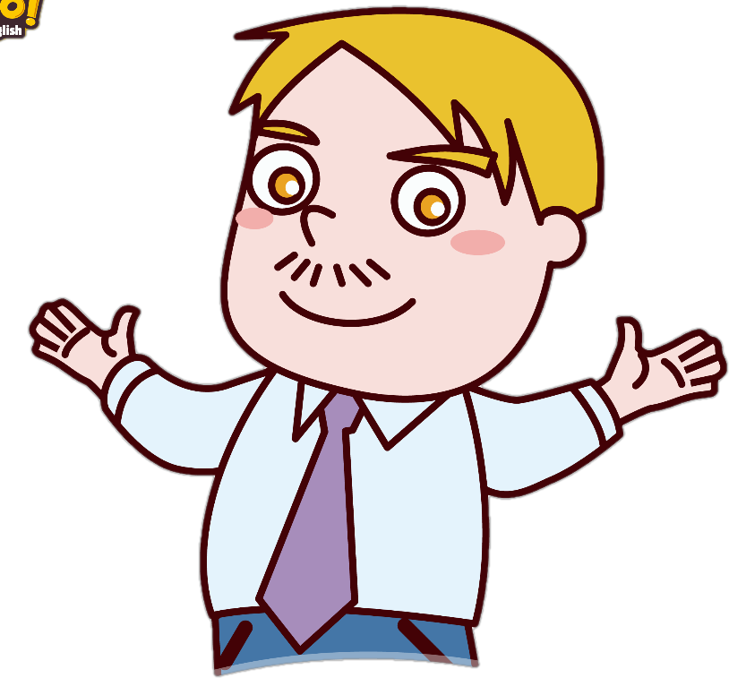
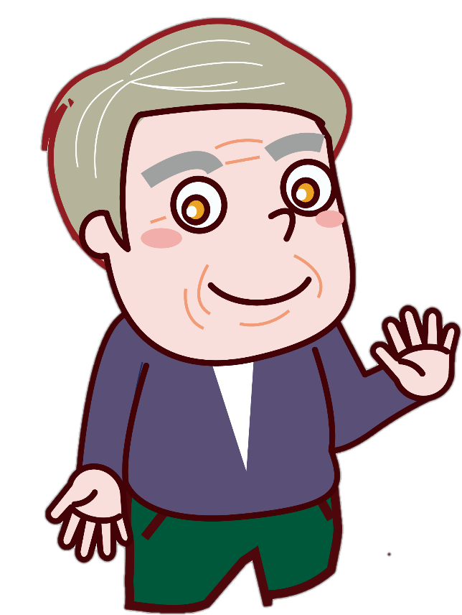
Eve
She is my .
He is my .
Elin

Slide 8


Zane
Here is a .
Jack
Thank you.
Lucina

Slide 9
We have a magic cat.
Sandy

Slide 10
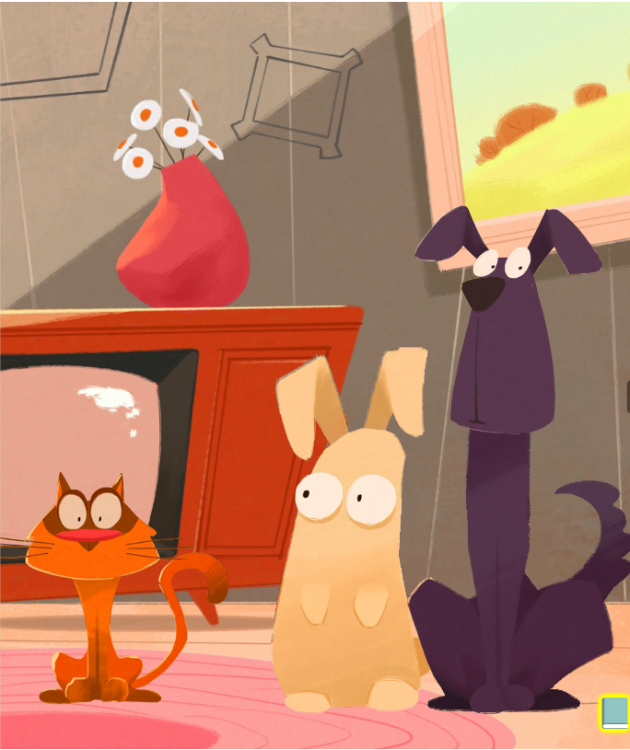

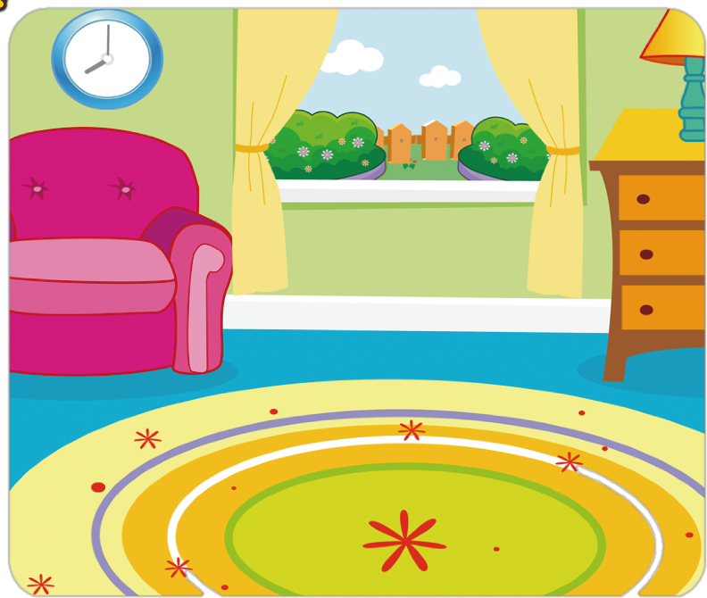
Sofia
It's orange in the livingroom.

Slide 11
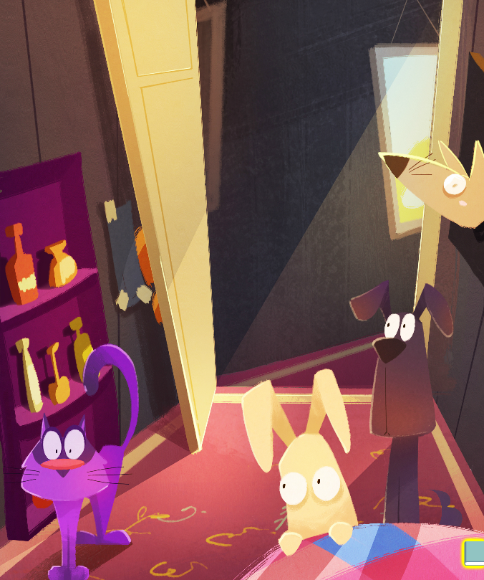

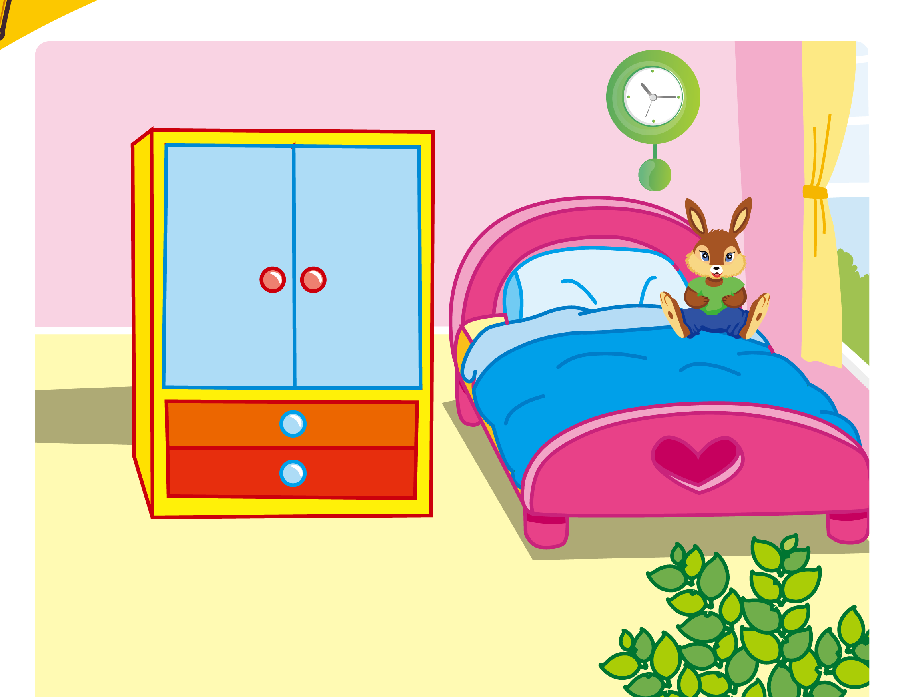
Zane
It's purple in the bedroom.

Slide 12
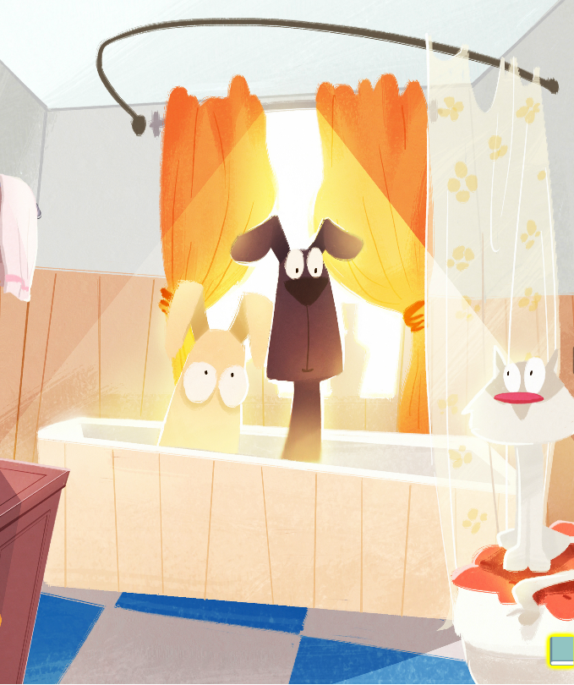

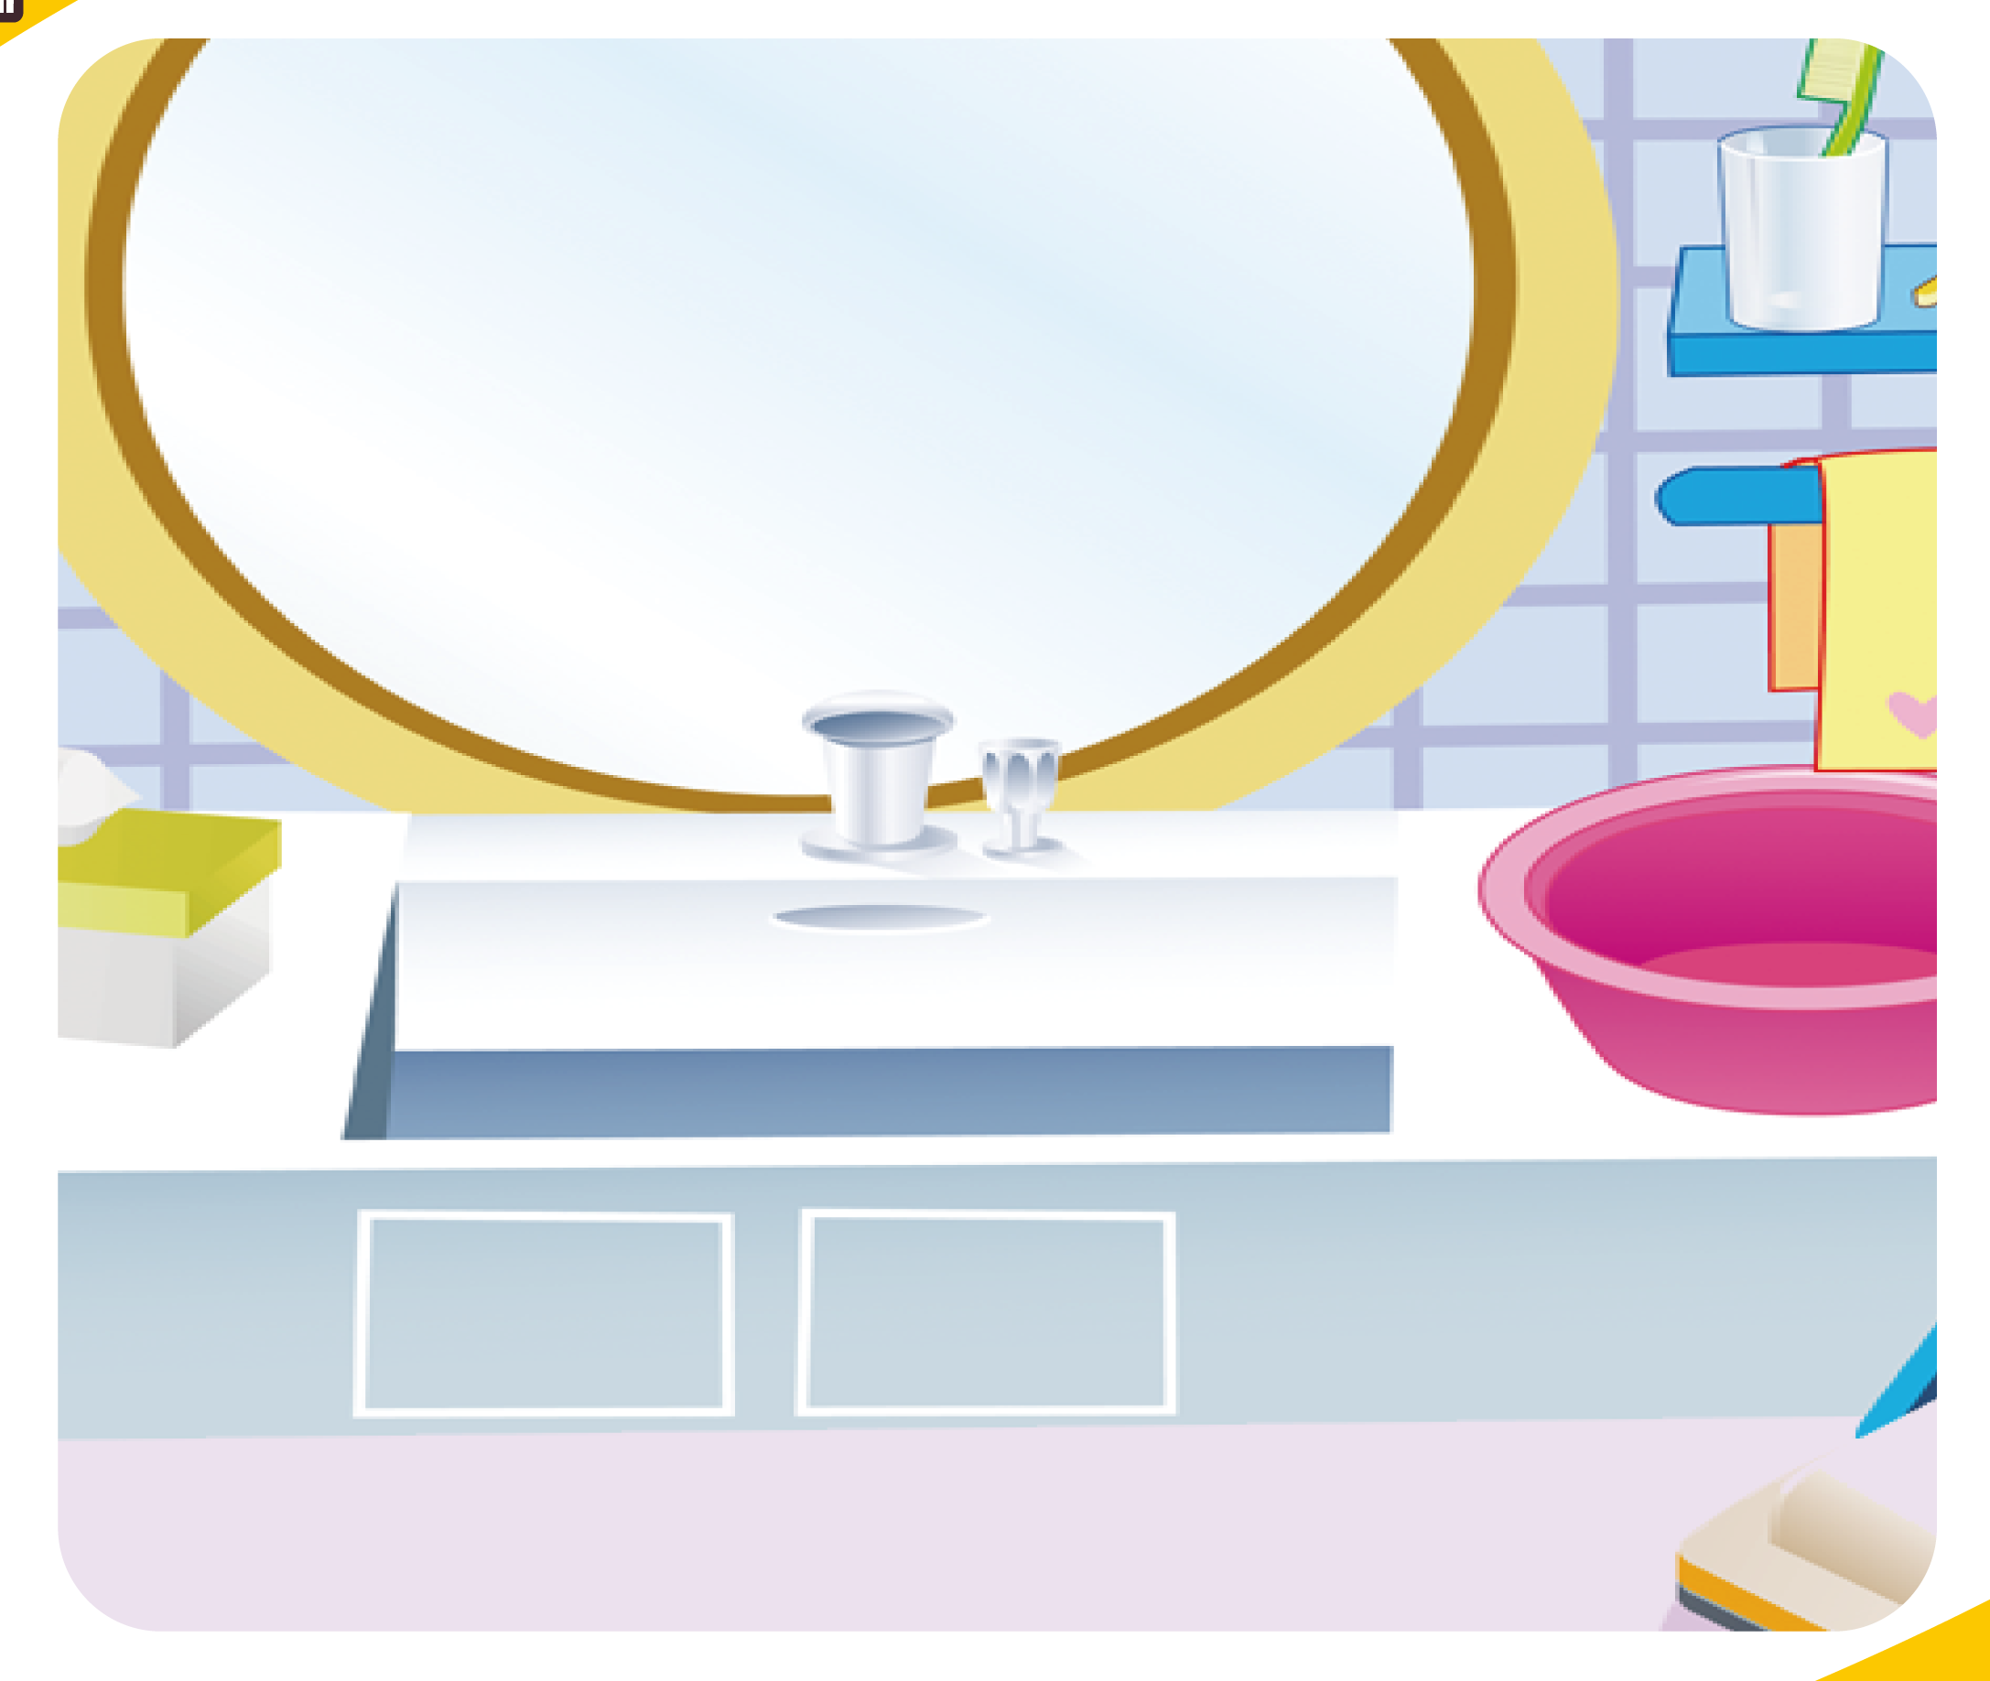
Lucina
It's white in the bathroom.

Slide 13
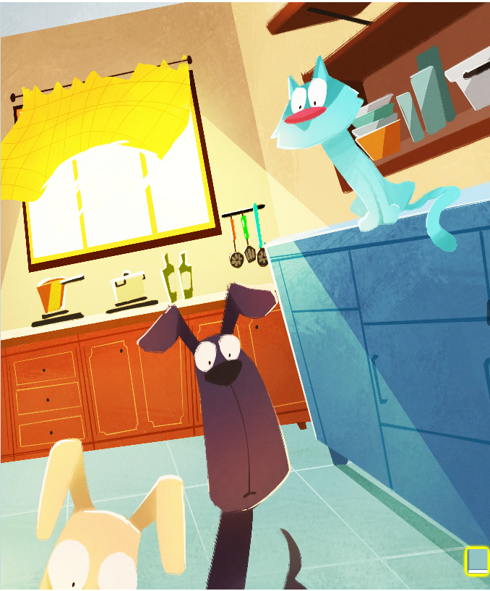

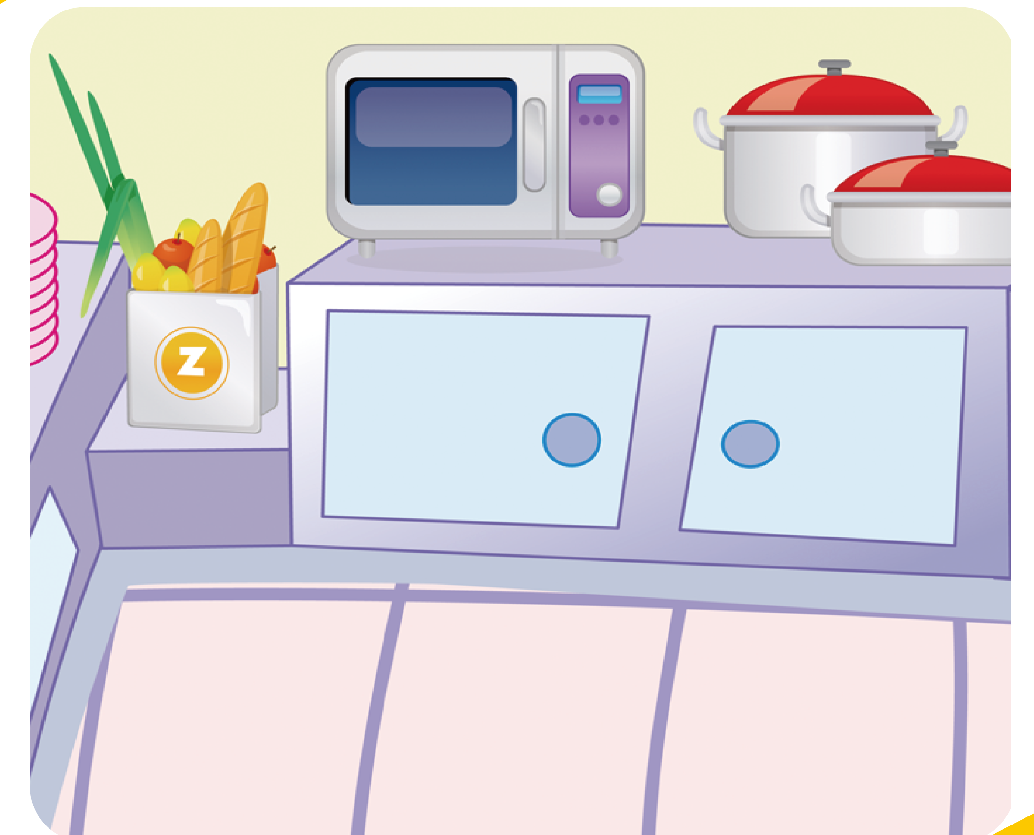
Jack
It's blue in the kitchen.

Slide 14
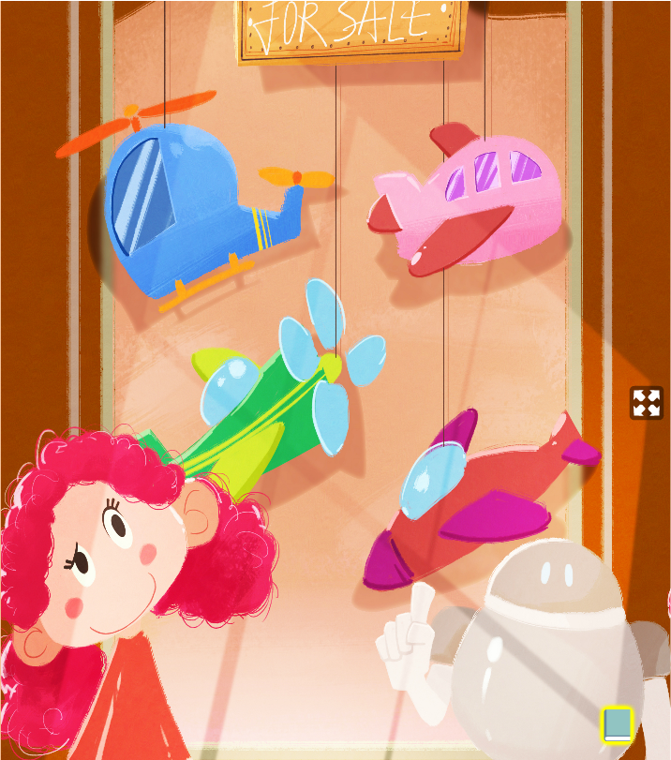
Sofia
It's a plane.
How many planes?
Jack

Slide 15
Lucina
I can count. one two three four (1.2.3.4),four planes.

