Slide 1

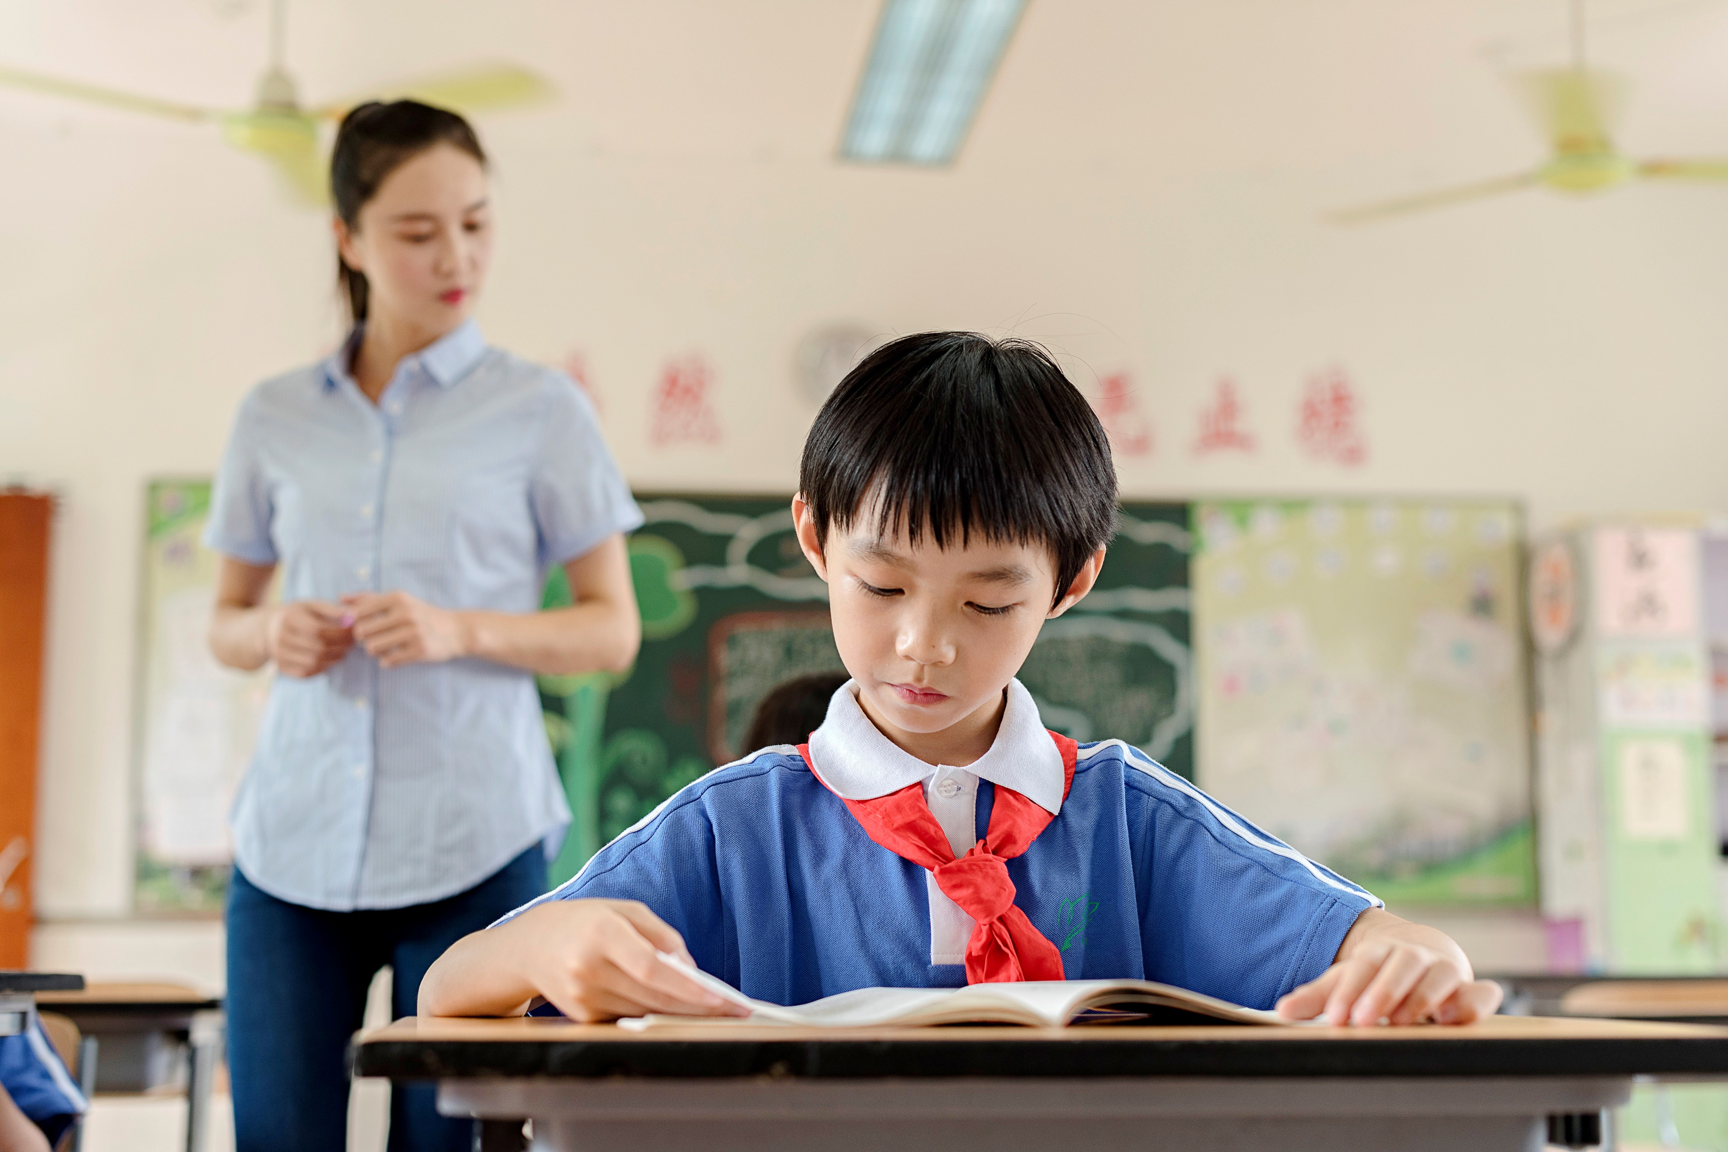
陈述句变一般疑问句
肯定及否定回答
主讲：刘界 Edison 随州市澜鲸教育科技有限公司

Slide 2
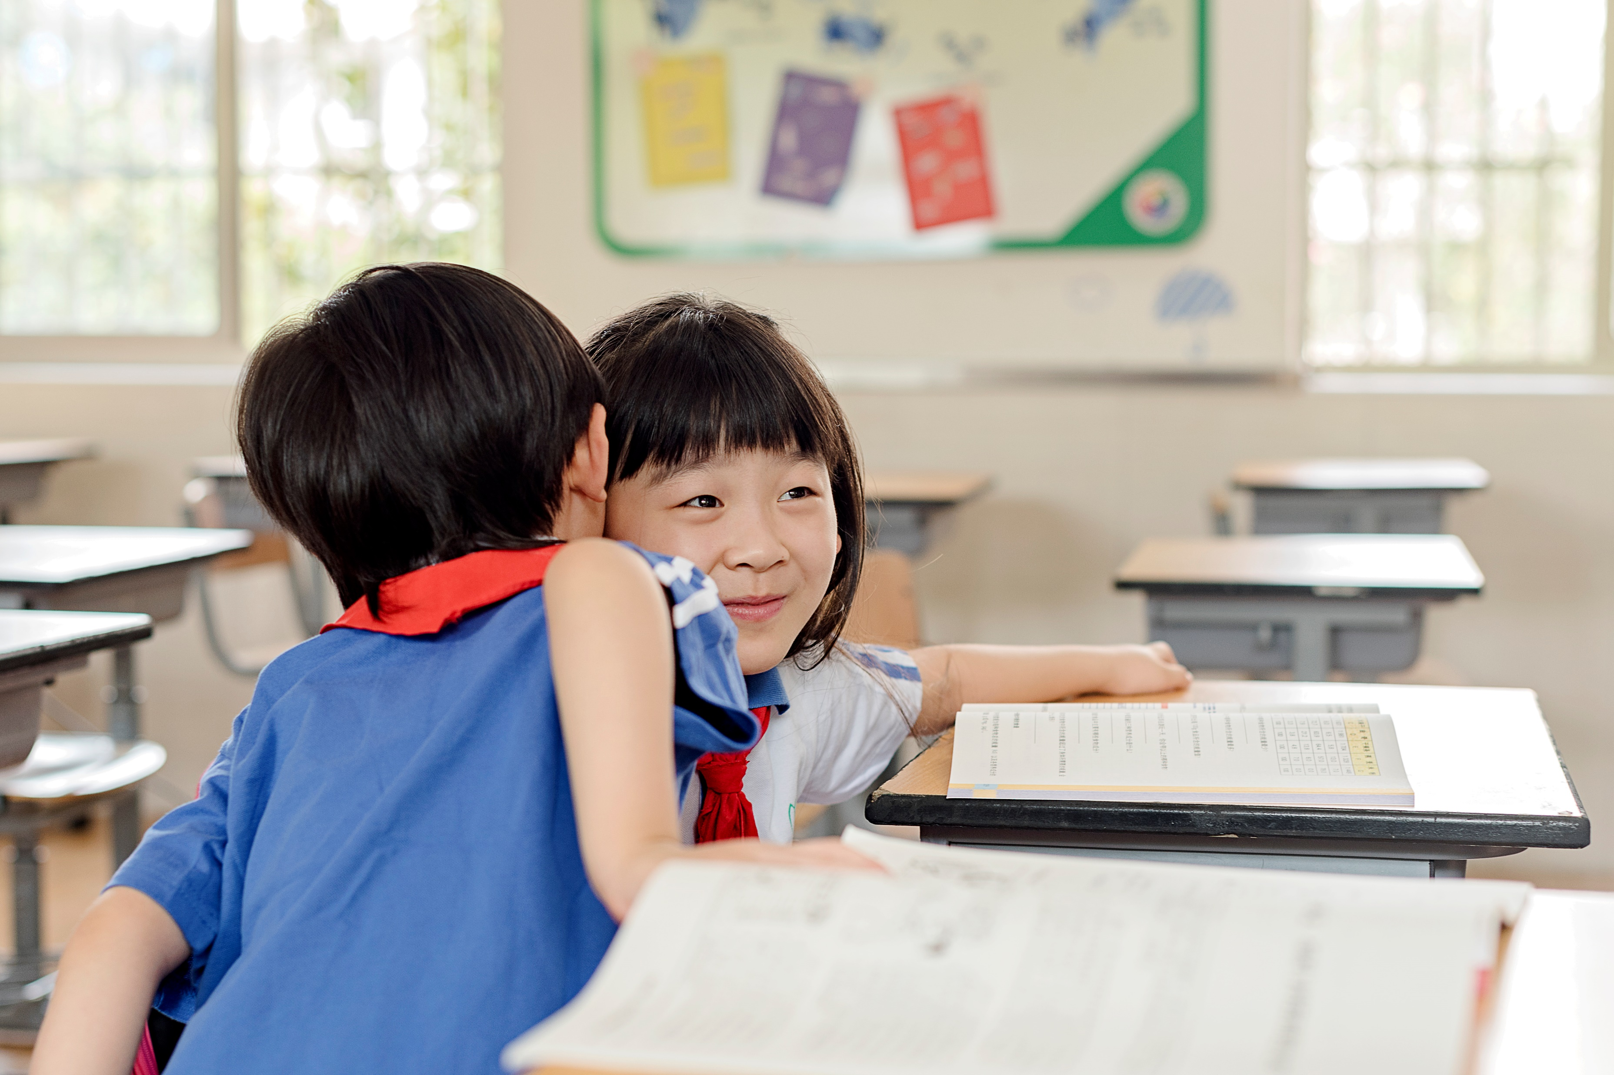
陈述句变为一般疑问句，首先看句中有没有系动词be或情态动词，如果有，把be或情态动词直接提到句首就可以了；如果没有，要用助动词do 或does 来帮助。基本句式如下：
Be + 主语 +宾语 + 其他 + ？
情态动词 + 主语 + 谓语 + 宾语 + 其他 + ？
Do(Does + 主语 + 谓语 + 宾语 + 其他 + ？

Slide 3
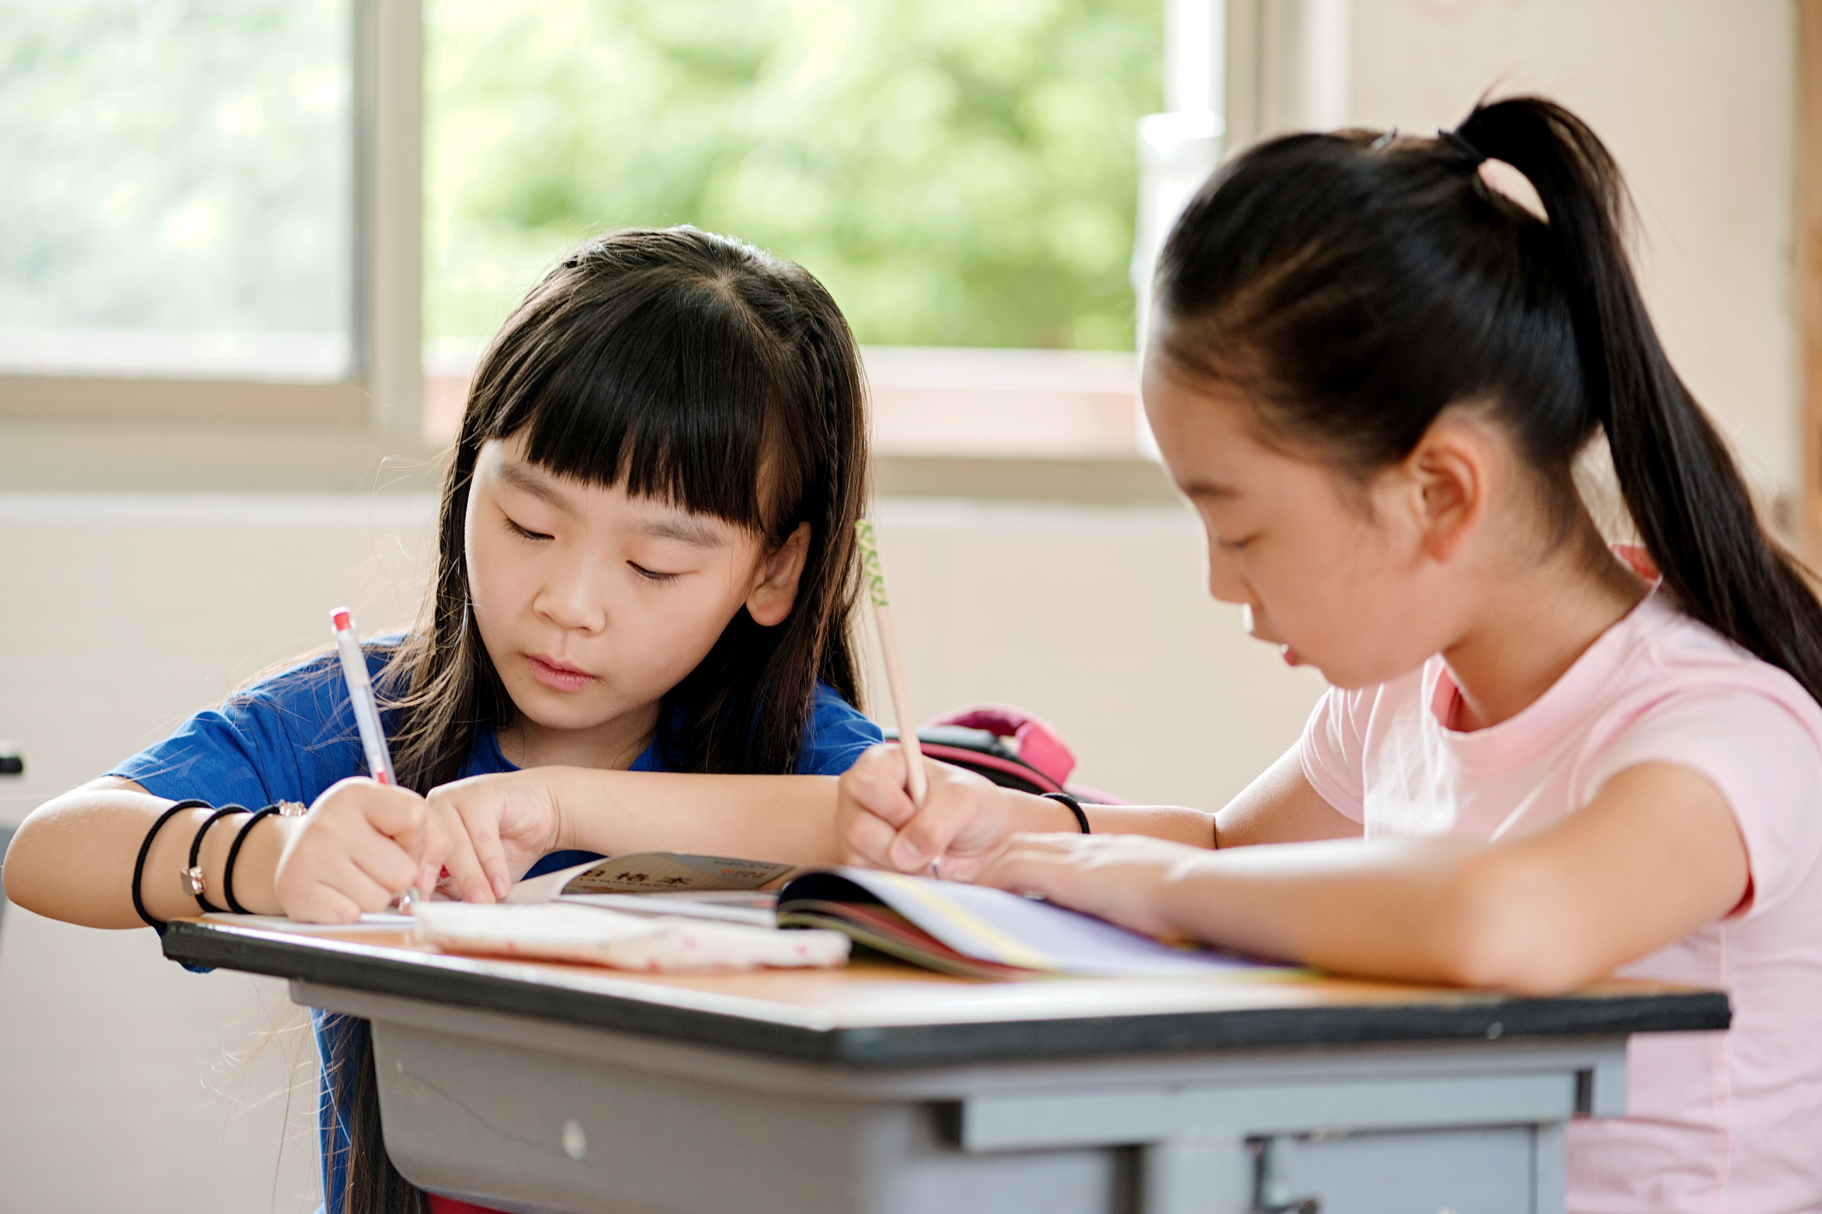
be动词：is, am, are, were, was
助动词：do, does, did
情态动词：can, could, will, would等

Slide 4
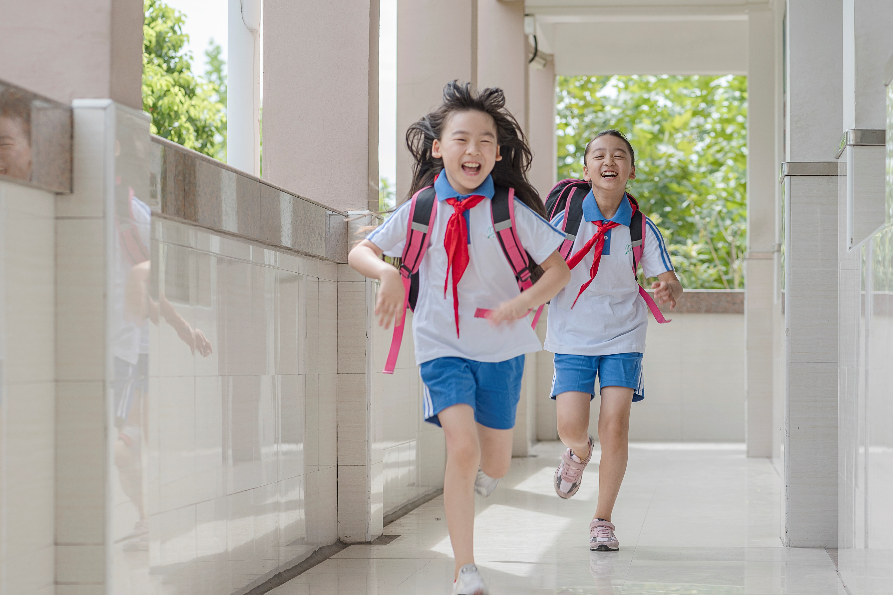
01.He is a student.
一般疑问句就是：
肯定回答：Yes, he is. 否定回答：No, he isn’t.
02.They can play football.
一般疑问句就是：
肯定回答：Yes, they can. No, they can’t.
Is he a student?
Can they play football?

Slide 5
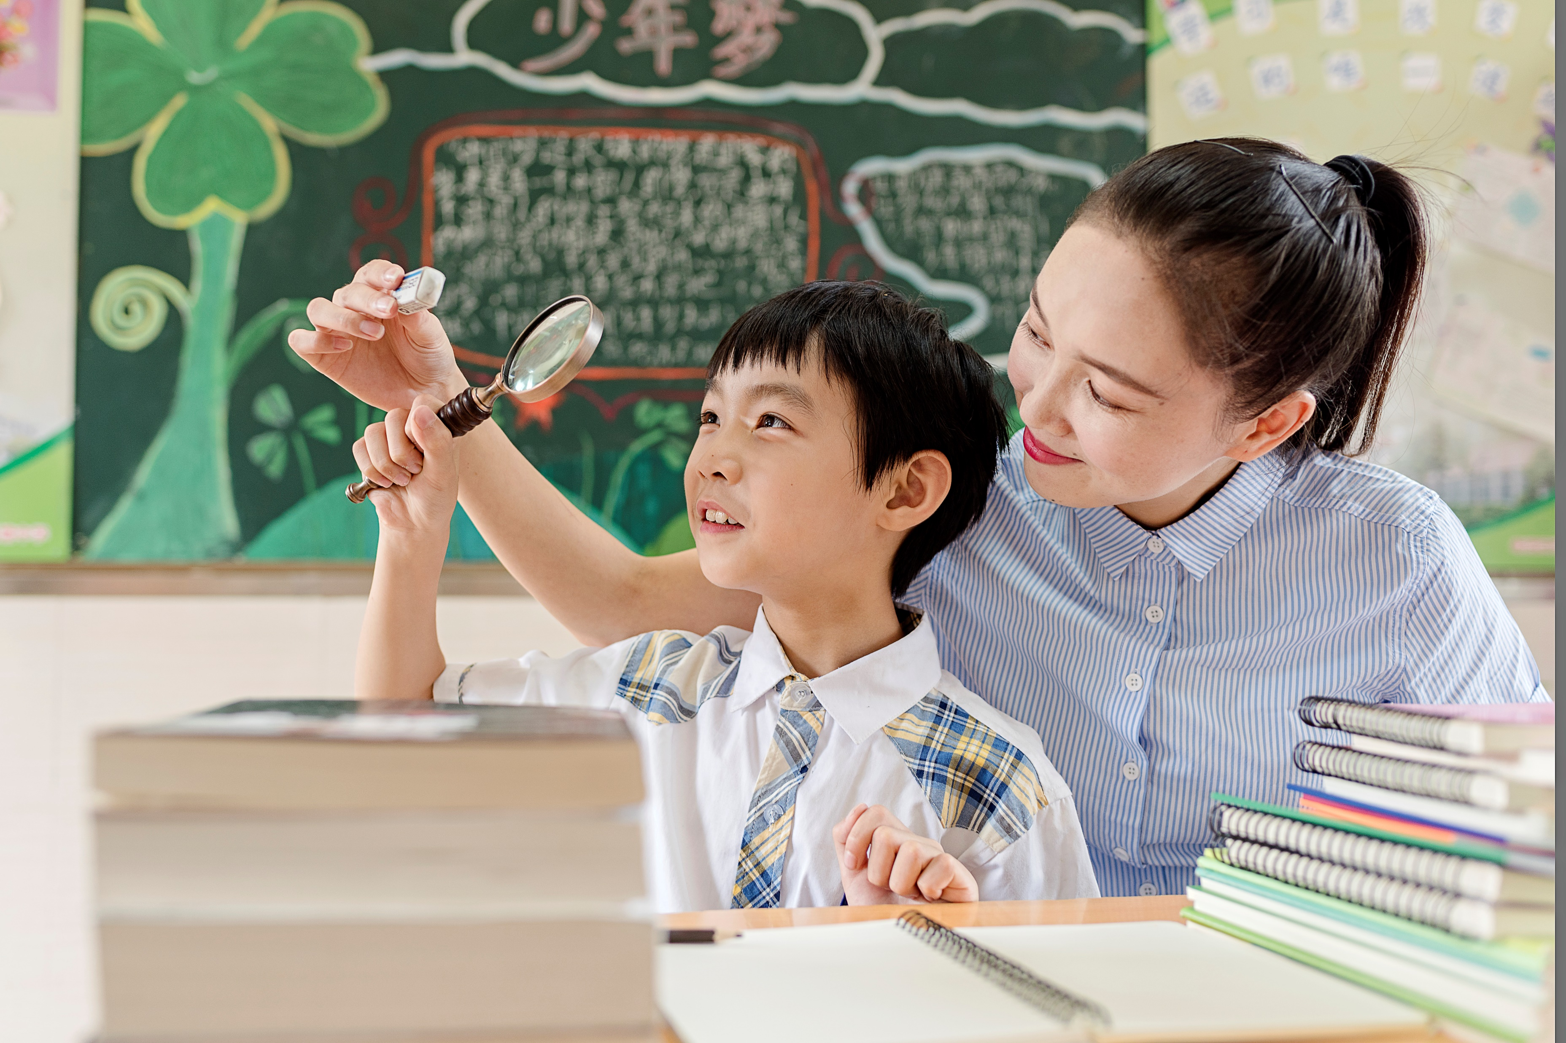
03.I am a student.
一般疑问句就是：
肯定回答：Yes, I am. 否定回答：No, I’m not.
04.We can help you.
一般疑问句就是：
肯定回答：Yes, we can. 否定回答：No, we can’t.
Are you a student?
Can we help you?
如果主语是I或是we的，一般疑问句一般情况下要把人称改为you。反之you要改成I，we，me或us。

Slide 6
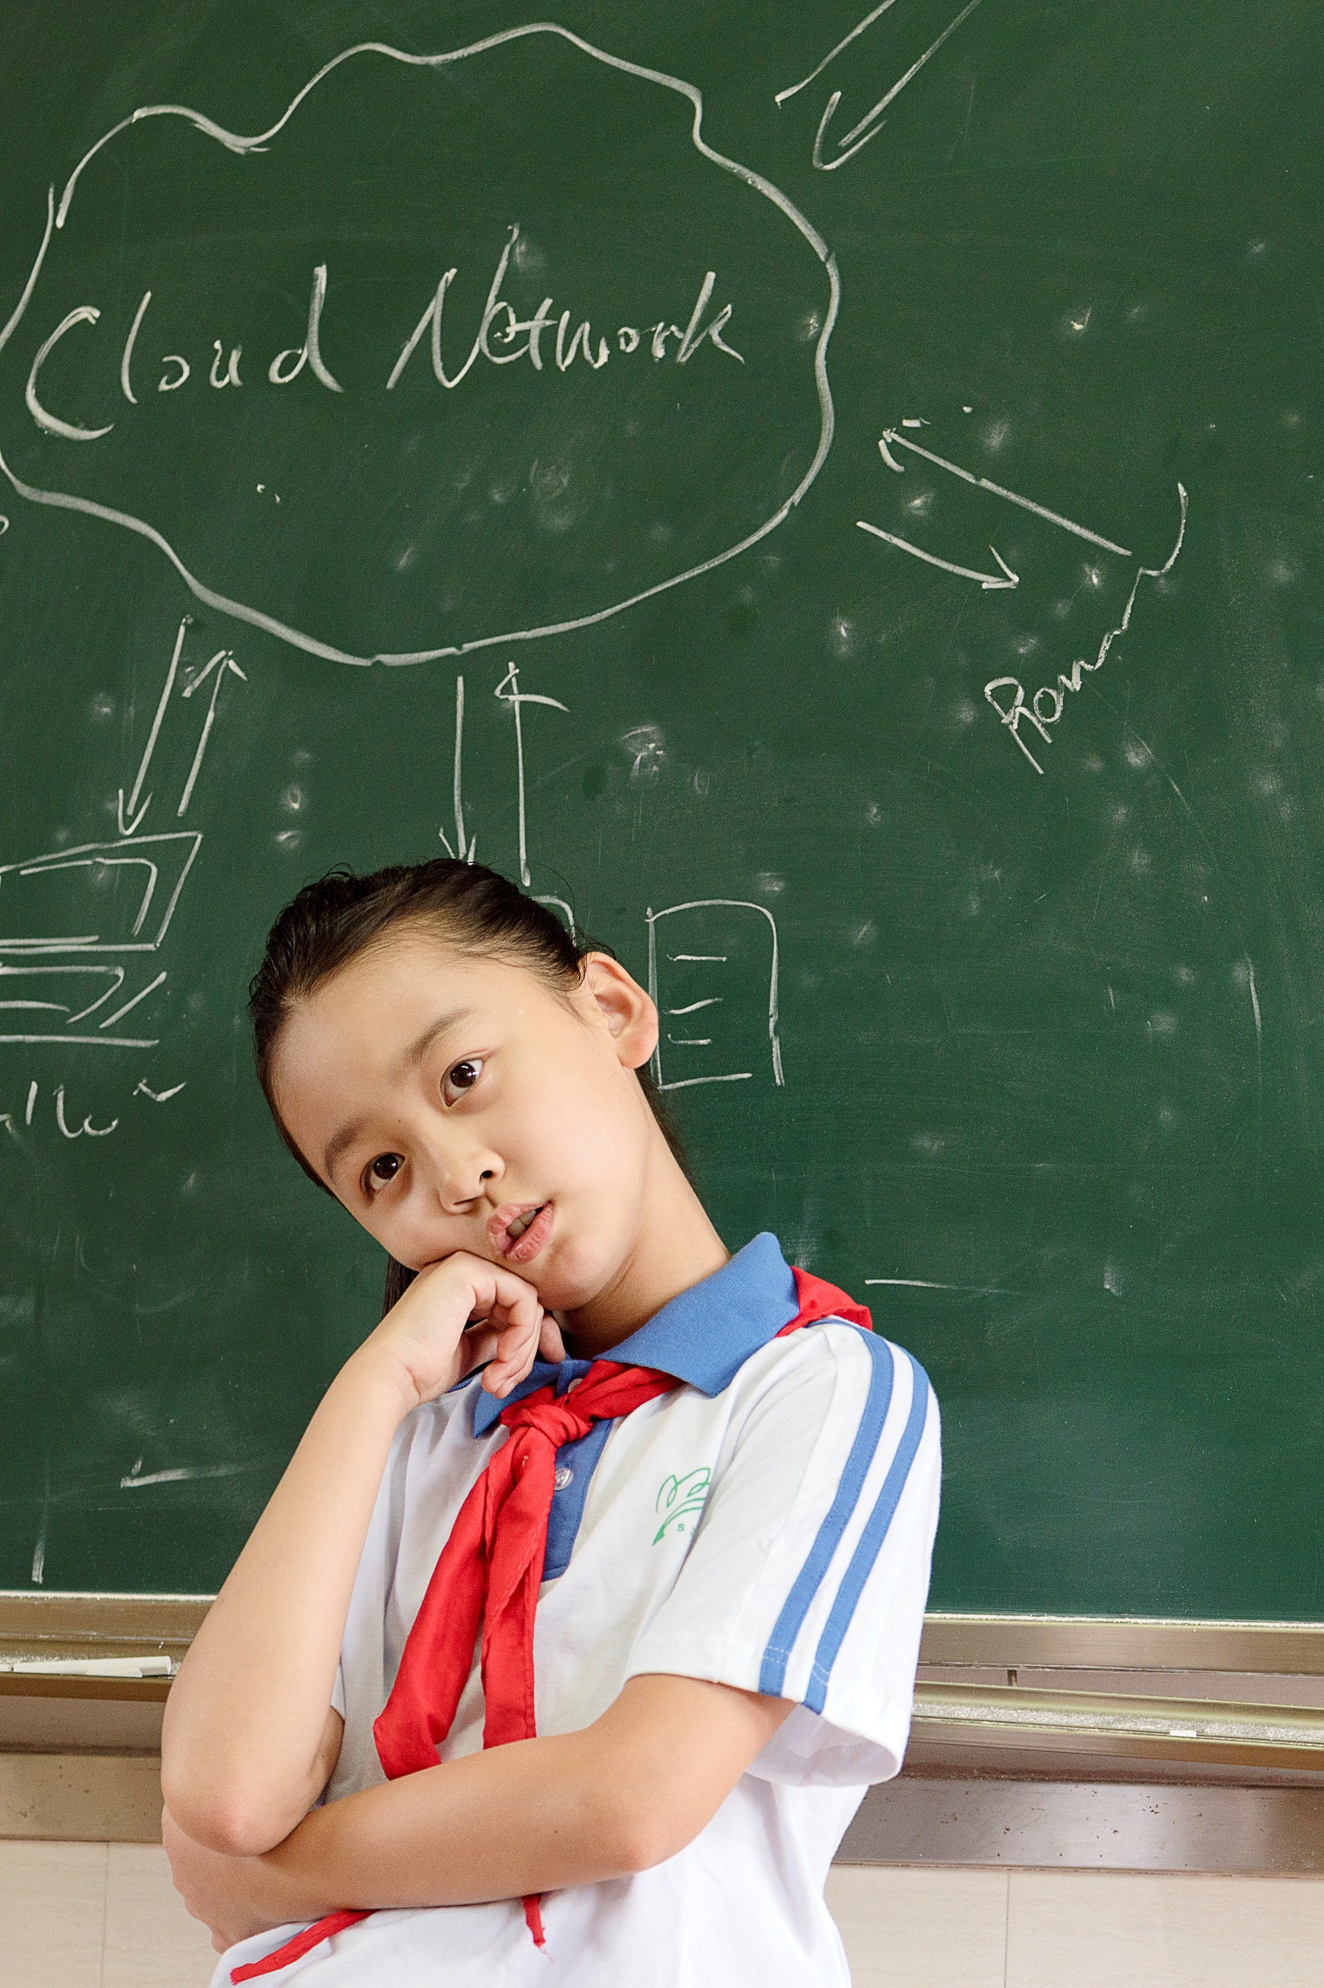
01.His father is an English teacher.
肯定回答： 否定回答：
02.They can swim.
肯定回答： 否定回答：
03.She is Jim’s mother.
肯定回答： 否定回答：
Is his father an English teacher?
Yes, he is.
No, he isn’t.
Can they swim?
Yes, they can.
No, they can’t.
Is she Jim’s mother?
Yes, she is.
No, she isn’t.

Slide 7
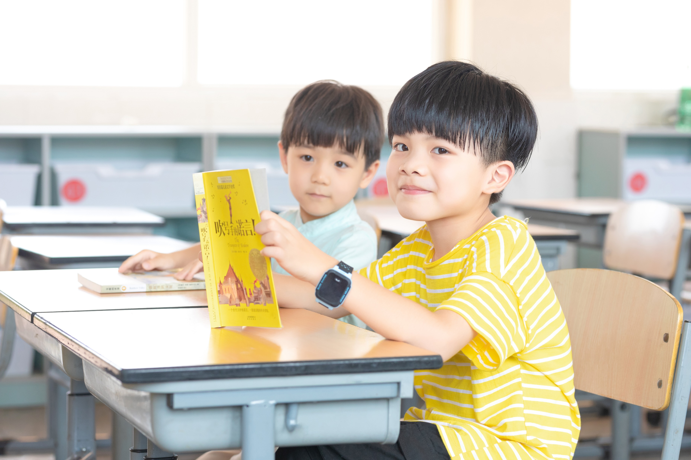
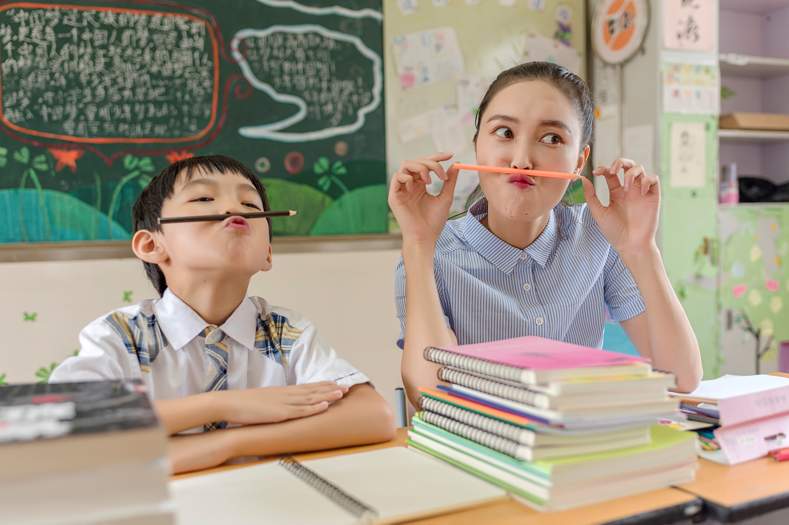
04.He is in Class 3.
肯定回答： 否定回答：
05.She can read fast.
肯定回答： 否定回答：
06. Tom can climb the tree.
肯定回答： 否定回答：
Is he in Class 3?
Yes, he is.
No, he isn’t.
Can she read fast?
Yes, she can.
No, she can’t.
Can Tom climb the tree?
Yes, he can.
No, he can’t.

Slide 8
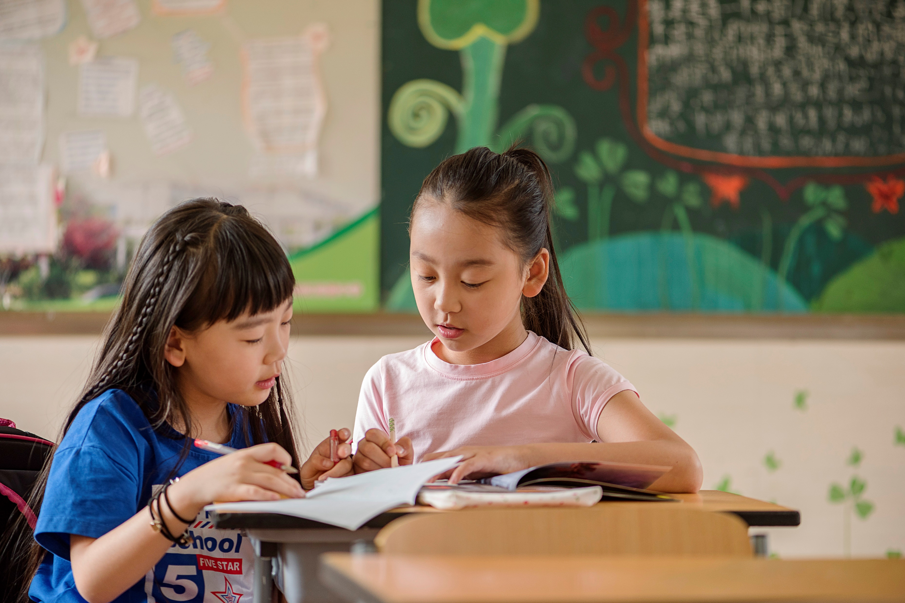
07.Miss White can draw a monkey on the board.
肯定回答： 否定回答：
08.He can play basketball.
肯定回答： 否定回答：
09. He is crying under the tree.
肯定回答： 否定回答：
Can Miss White draw a monkey on the board?
Yes, she can.
No, she can’t.
Can he play basketball?
Yes, he can.
No, he can’t.
Is he crying under the tree?
Yes, he is.
No, he isn’t.

Slide 9
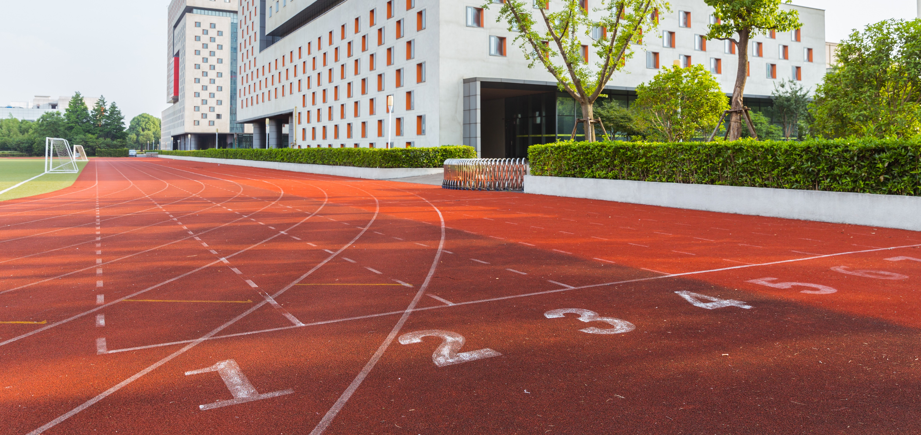
如果没有be动词和情态动词的，就要用助动词来提问，助动词有do, does, did, 而选择哪个助动词就要由陈述句中的动词时态或形式来决定了。

Slide 10
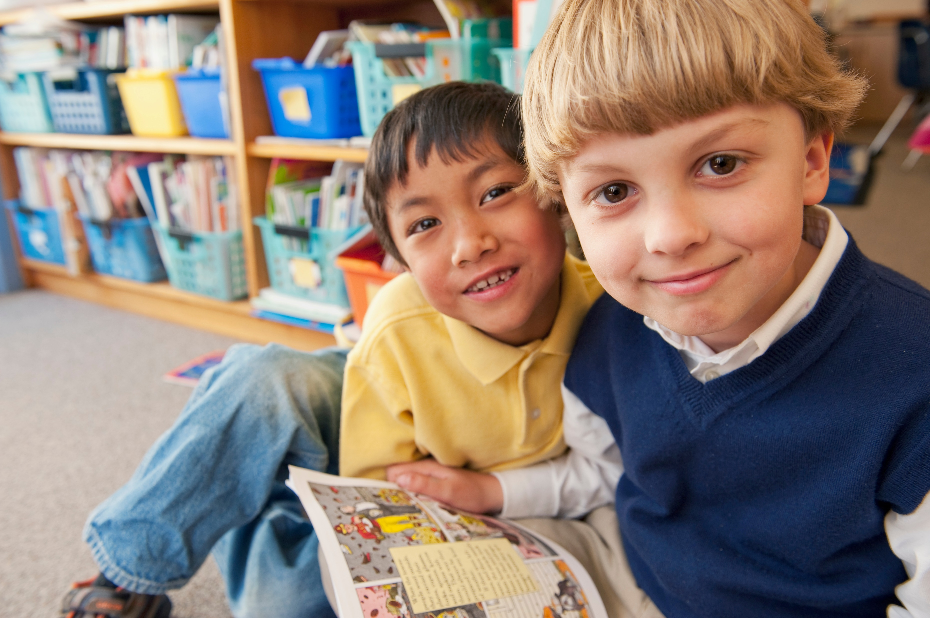
01.She speaks English very well.
一般疑问句变成：
肯定回答： 否定回答：
02.We finished our homework yesterday.
一般疑问句变成：
肯定回答： 否定回答：
03.I go to school on foot.
一般疑问句变成：
肯定回答： 否定回答：
Does she speak English very well?
Yes, she does.
No, she doesn’t.
Did you finish your homework yesterday?
Yes, we did.
No, we didn’t.
Do you go to school on foot?
Yes, I do.
No, I don’t.
选择好助动词后就可以把原句跟上去，要注意的是后面的动词要用原形了。

Slide 11
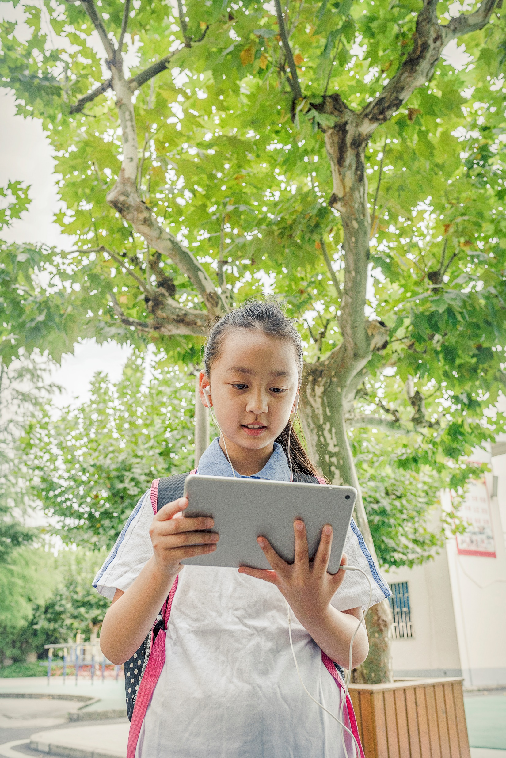
01.I like to read English.
肯定回答： 否定回答：
02. She goes to school on foot.
肯定回答： 否定回答：
03. Huang Bo likes English.
肯定回答： 否定回答：
Do you like to read English?
Yes, I do.
No, I don’t.
Does she go to school on foot?
Yes, she does.
No, she doesn’t.
Does Huang Bo like English?
Yes, he does.
No, he doesn’t.

Slide 12
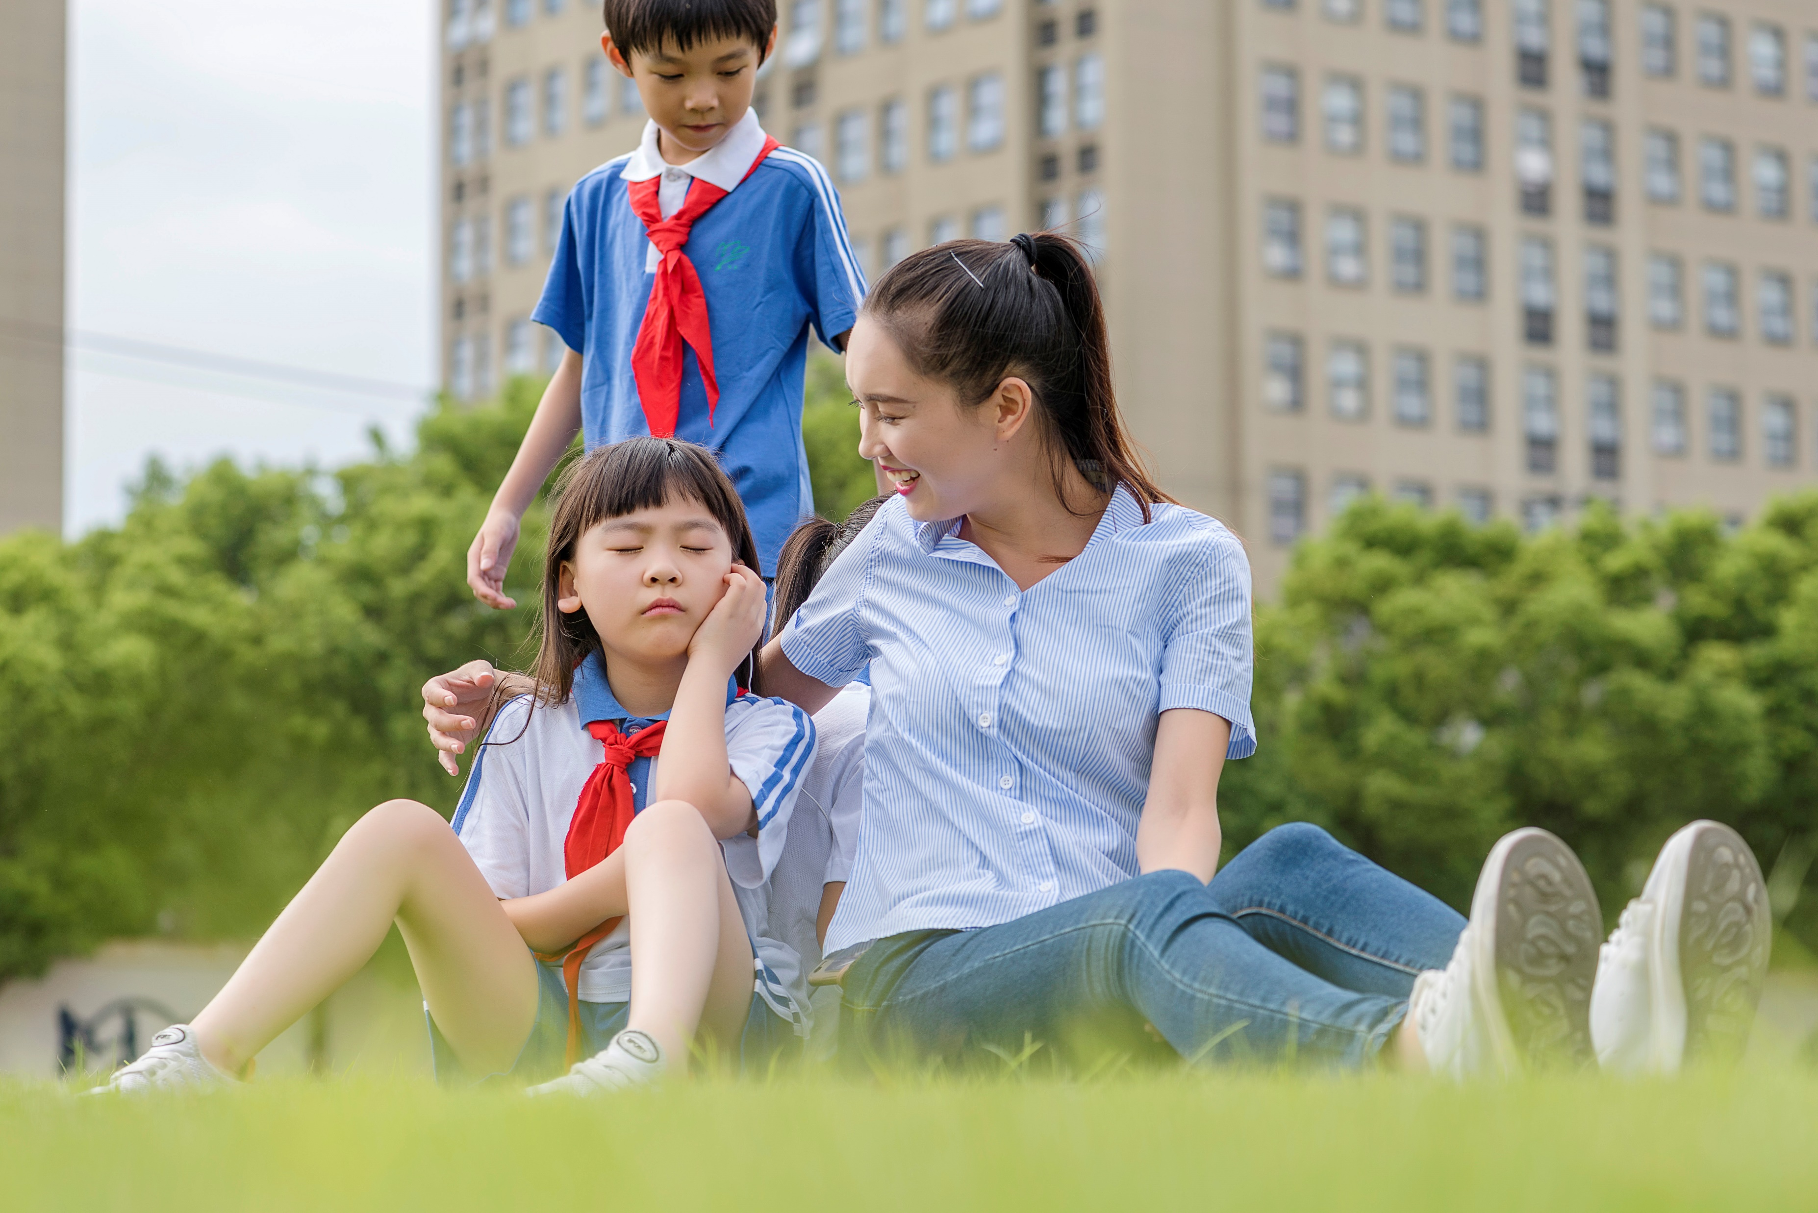
04. She wants a cup of coffee.
肯定回答： 否定回答：
05. He often watches TV.
肯定回答： 否定回答：
06. My teacher goes to the library on Sundays.
肯定回答： 否定回答：
Does she want a cup of coffee?
Yes, she does.
No, she doesn’t.
Does he often watch TV?
Yes, he does.
No, he doesn’t.
Does your teacher go to the library on Sundays?
Yes, he does.
No, he doesn’t.

Slide 13
Thank you!
主讲：刘界 Edison 随州市澜鲸教育科技有限公司

