Slide 1
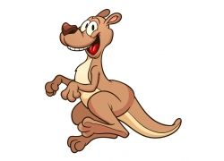
Let's play a game ！！！
What's missing?

Slide 2
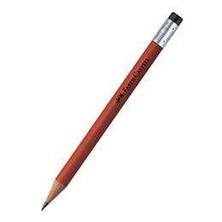

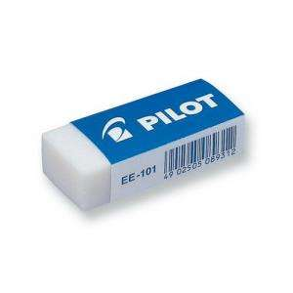

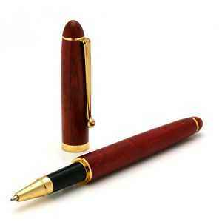
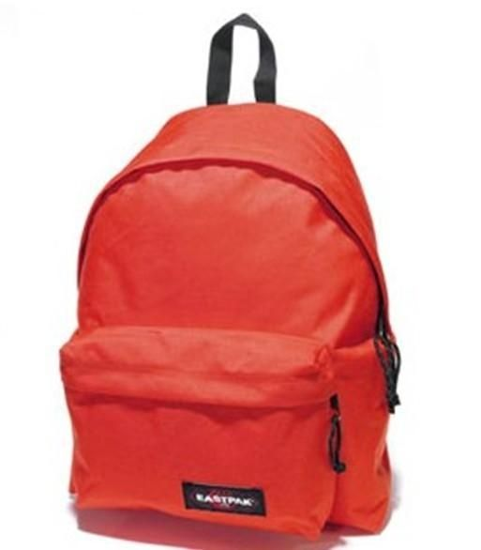
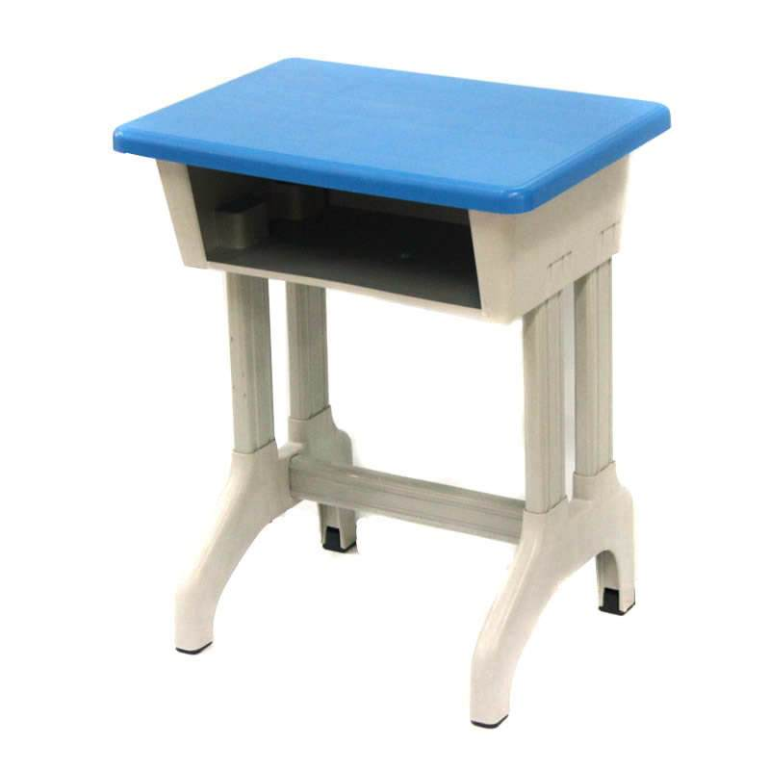

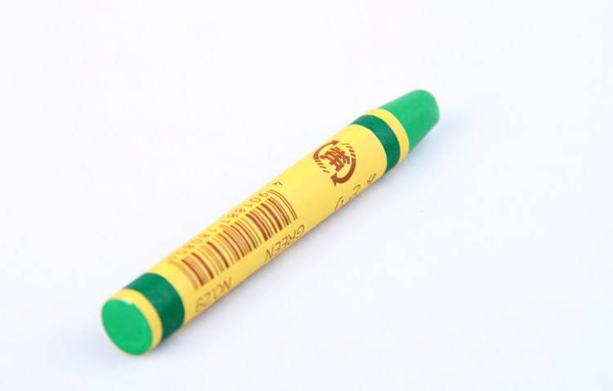
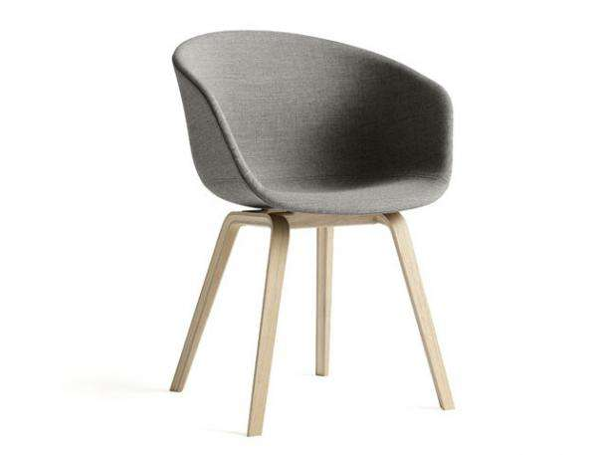


Slide 3

fish +2
eraser
+2
book
+1
pencil
+1
marker
+1
desk
+1
pen
+1
chair
+2
ruler
+1
crayon
+2

Slide 4

eraser +2
book+1
pencil
+2
-1
pen
+2
marker+1
backback +3
-2
desk
+1
crayon
+2
chair
+2
-2
* Choose any of star，words with plus points and bombs with minus points will appear on the Powerpoint.

