Slide 1
Can you read these words？
plate cane lake cave lime pine bike cape tape like

Slide 2
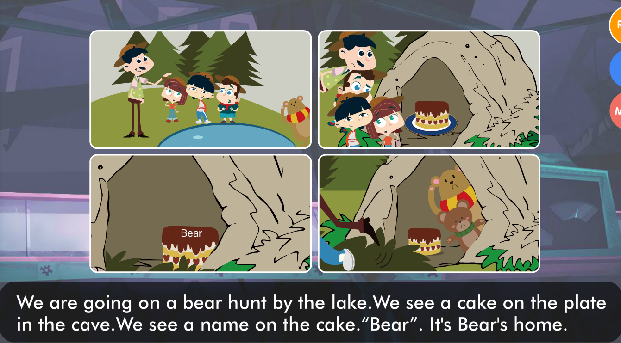
Look at the picture，please read the sentences.
.

Slide 3
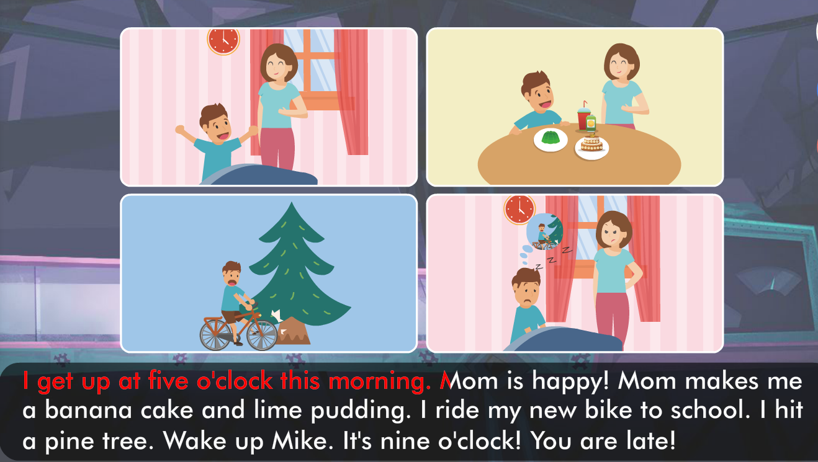

Slide 4
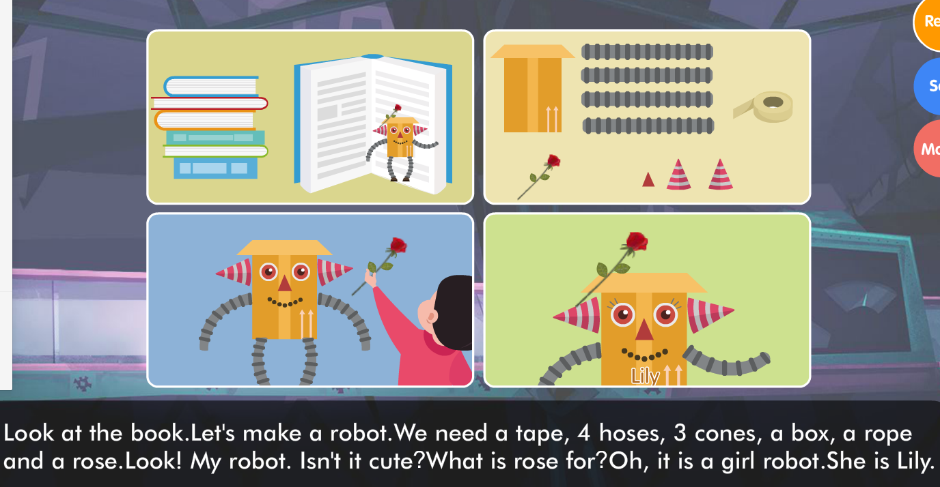

Slide 5
