Slide 1


Let’s read
第5级

Slide 2

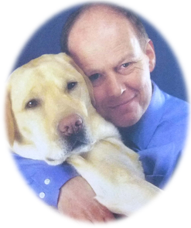
Are they good friends?
What do you think of them?

Slide 3
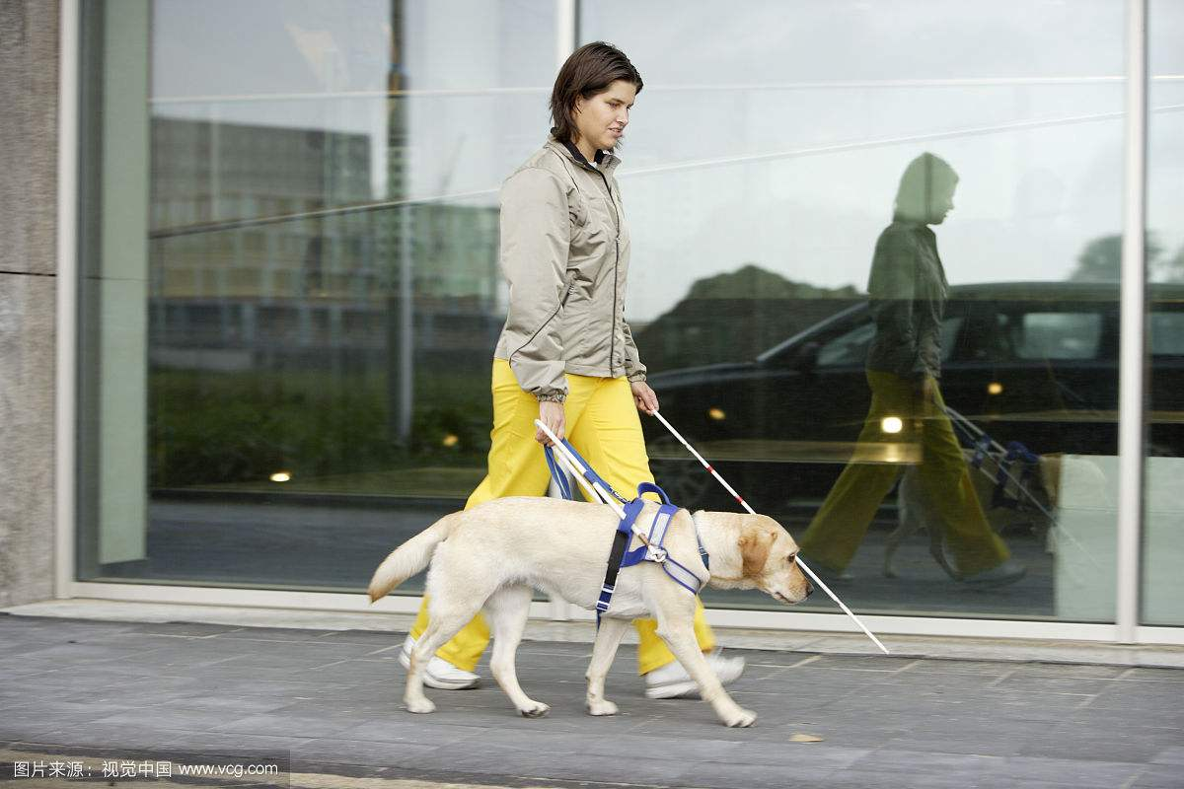
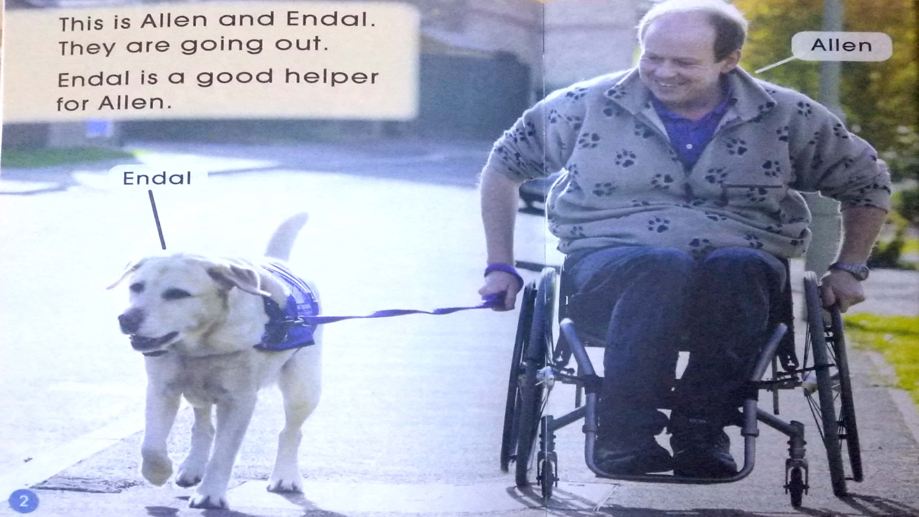
blue collar dog
Who is the helper?
Why does Endal have this blue coat?

Slide 4


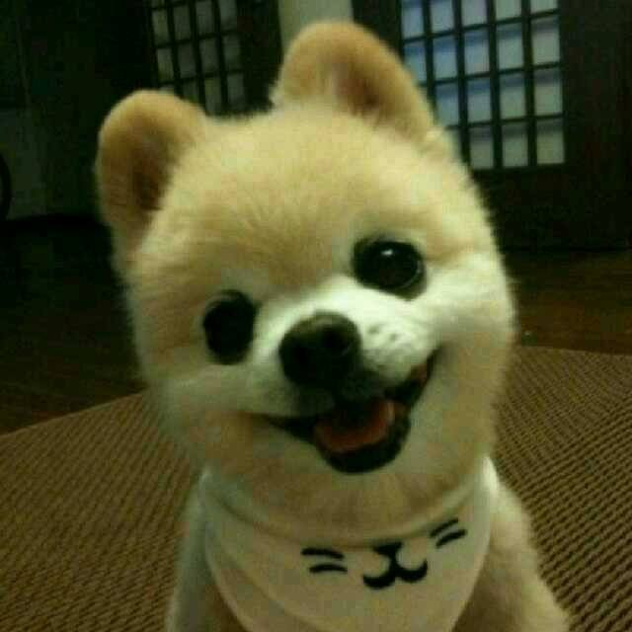
Q: What are the differences between blue collar dogs and other dogs?
VS
Q: How can blue collar dogs help people?

Slide 5

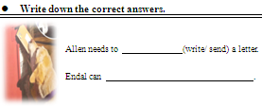
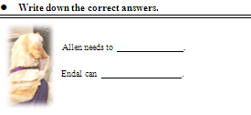
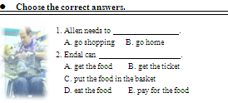
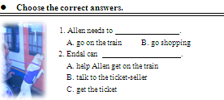
Jigsaw reading
Tips:
1. Four students work together.
2. Each student should choose one part.
3. Finish your own chart.
(Page 4)
(Page 5)
(Page 6-9)
(Page 9-11)

Slide 6
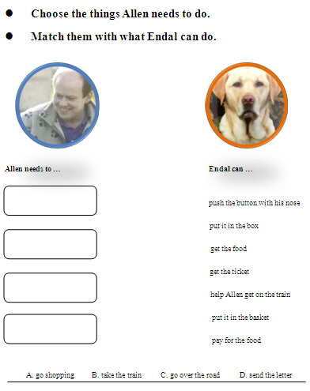
Group work
Tips:
1. Share the information you’ve read.
2. Help each other.
3. Finish the chart together.

Slide 7
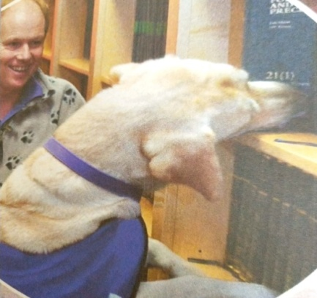
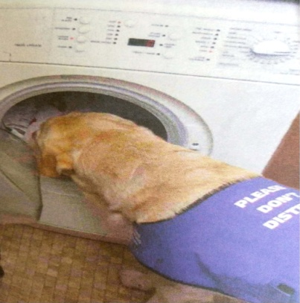
Fast reading
Tips:
Read Page 12-13 and find out:
What can Endal do at home?
get a book
help with
washing

Slide 8
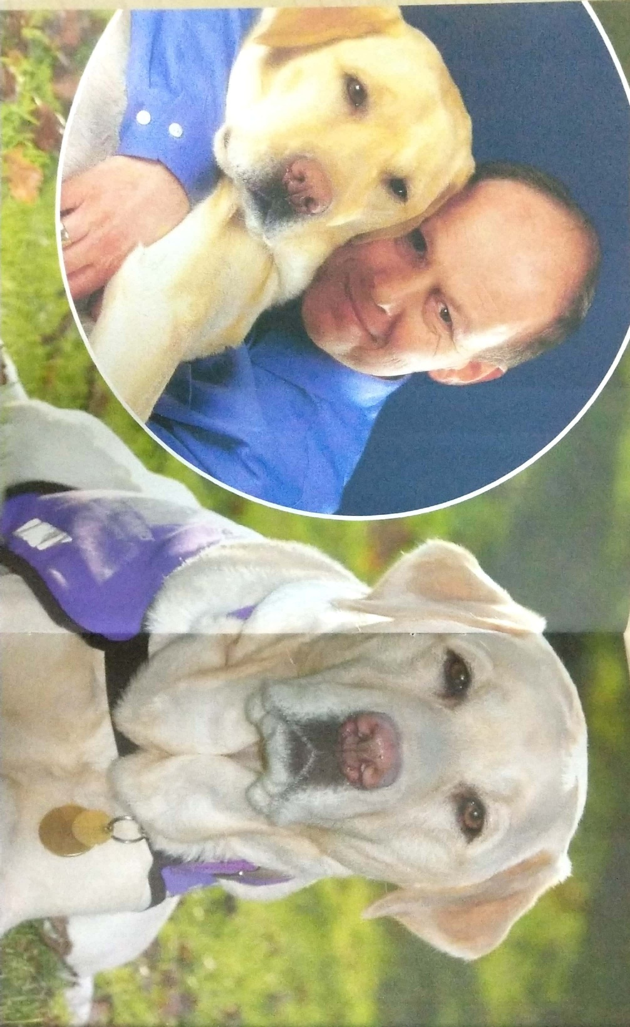
Good friends

Slide 9
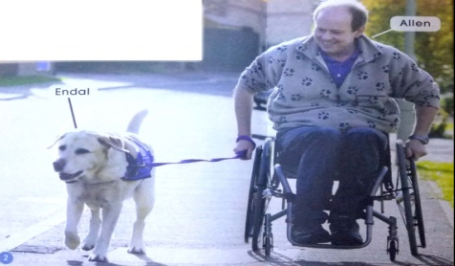
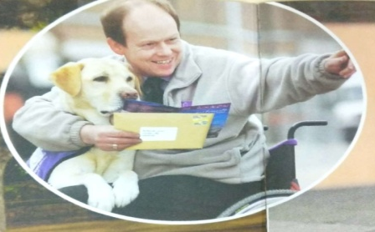

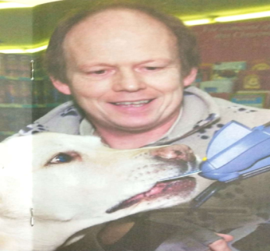
Q: Does Allen feel happy?
Q: Why does Allen look so happy even though he can’t walk?
Endal is being with him all the time!

Slide 10
Q: In what other ways might Endal help Allen?
Q: What do you think of Endal?
Useful sentences:
Please look at Page…, Endal gets/helps/…,
so I think Endal is…
Q: What name is right for the book?

Slide 11

Series
Level
Title
Authors
Publisher

Slide 12

Enjoy the story
Tips:
1. Read the story by yourself.
2. Read after the computer.

Slide 13

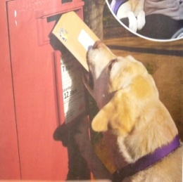
Memory card
Tips:
1. Two students work together.
2. Open two cards each time.
3. Describe the cards.
Get the cards
What Allen needs to do
How Endal helps him

Slide 14
Let’s think
Q: What problems might blue collar dogs meet?
Q: How to solve those problems?
Q: What should we do for dogs and other animals?

Slide 15
Homework
1. Draw a comic strips about your super animal.
2. Write down the things that blue collar dogs can do.

