Slide 1
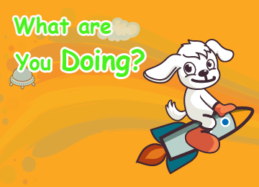
Welcome
Unit 6
Susan

Slide 2


Word time

Slide 3


Word
meaning
Sentence
Lion
Tiger
Snake
Laugh/laughing
Stand/standing
Watch/watching
Do/doing
Look/looking
狮子 狮
I see a lion.
老虎 虎 凶暴的人
The tiger is so big.
蛇 阴险的人
The snake is long.
笑 发笑
They are laughing at the lion.
站立 立 直立
A lion is standing over there.
看 注视 观看 手表
I am watching TV.
做 干 办
What are you doing?
看 期待
I am looking at the animals.

Slide 4



常见动词 的
分词形式
Verb
Verb + ing
Verb
Verb + ing
Verb
Verb + ing
walk
play
sing
go
do
walking
Playing
singing
going
doing
watch
stand
help
climb
save
watching
Standing
Helping
Climbing
saving
find
jump
look
laugh
have
finding
jumping
looking
laughing
having
listen
eat
listening
eating
read
write
reading
writing
draw
come
drawing
coming
我们要背下来哦！
发音+书写

Slide 5
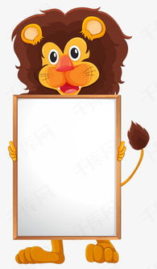
“变身术”
Do 的变身
do
动词原形
does
动词单三形式
doing
动词分次形式
动词
did
done
动词的过去式
动词的完成式
我们现在只学习了前三个哦

Slide 6
Let’s talk

Slide 7

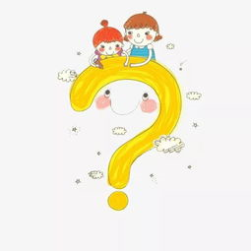



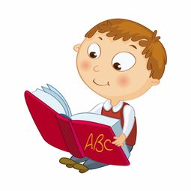
我们在哪里？
We are on the Lion Planet.
我们在狮子星球上。
Points :
where 引导的特殊疑问句。
一般疑问句：可以用yes/no，回答的句子哦
Are you a boy? Yes, I am.
Who knows? What does “ It isn’t on ” mean?
不行 没门

Slide 8

Look ! I see a lion.
看！我看见一只狮子。
Wow ! It’s so big.
哇哦！他这么大！
Points :
字母 I ，不管是在句首还是句中都要大写哦！
a/an 不定冠词，a 用辅音音素前，an则用于元音音素前,表示一个，an apple 。
定冠词the， 表示某个或者某些特定的人或东西哦！
So adv. （表示程度）这么 那样 那么 那样 如此
Who knows? What does “ so be it ” mean?
（表示完全接受）就那样好了

Slide 9


What are you doing?
你正在做什么？
I am looking at the animals.
我正在看动物。
Points :
动词的分次用在“现在进行时”，表示说话的时候正在发生的动作哦！
问句怎么问的，就要怎么回答哦，用进行时问，就要用进行时回答哦！
What is he doing? He watches TV.
Right or wrong?
What is he doing? He is watching TV.
What does he do? He is playing with his train.
What does he do? He plays with his train.

Slide 10
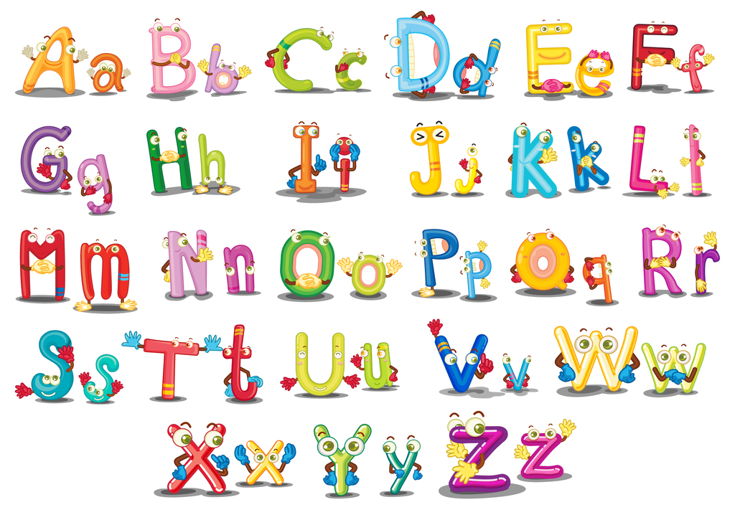
Summary Time

Slide 11
Word | Chinese meaning | Sentence
Lion | 狮子 狮 | I see a lion.
Tiger | 老虎 虎 凶暴的人 | The tiger is so big.
Snake | 蛇 阴险的人 | The snake is long.
Laugh/laughing | 笑 发笑 | They are laughing at the lion.
Stand/standing | 站立 立 直立 | A lion is standing over there.
Watch/watching | 看 注视 观看 手表 | I am watching TV.
Do/doing | 做 干 办 | What are you doing?
Look/looking | 看 期待 | I am looking at the animals.

Slide 12
常见动词 的
分词形式
Verb | Verb + ing | Verb | Verb + ing | Verb | Verb + ing
walk | walking | watch | watching | find | finding
play | Playing | stand | Standing | jump | jumping
sing | singing | help | Helping | look | looking
go | going | climb | Climbing | laugh | laughing
do | doing | save | saving | have | having
listen | listening | read | reading | draw | drawing
eat | eating | write | writing | come | coming
我们要背下来哦！
发音+书写

Slide 13
“变身术”
Do 的变身
动词原形
动词单三形式
动词分次形式
动词的过去式
动词的完成式
do
does
doing
did
done
动词
我们现在只学习了前三个哦

Slide 14
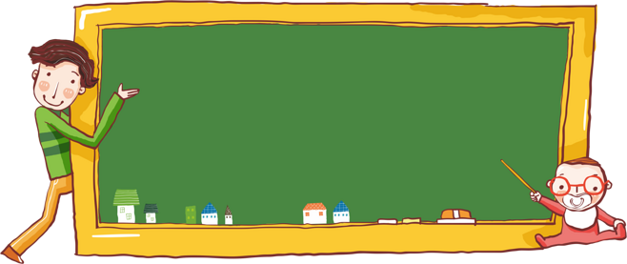
Dialogs
1.Where are we?
We are on the Lion Planet.
2.Look ! I see a lion.
Wow ! It’s so big.
3.What are you doing?
I am watching at the animals.

Slide 15
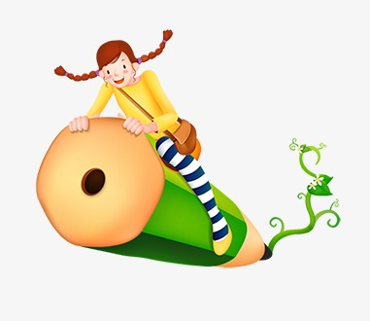

Homework Time
1. Book P23单词抄写 *2,句型*1.
2.Book P22 对话1-3抄写*2.
3.微信群完成课文的音频作业哦！
4.背诵对话1-3！

Slide 16
Goodbye
everyone
Love Susan

