Slide 1
Classroom rules
Sit well & stay in front of the camera
Listen carefully
English only
No eating during the class

Slide 2
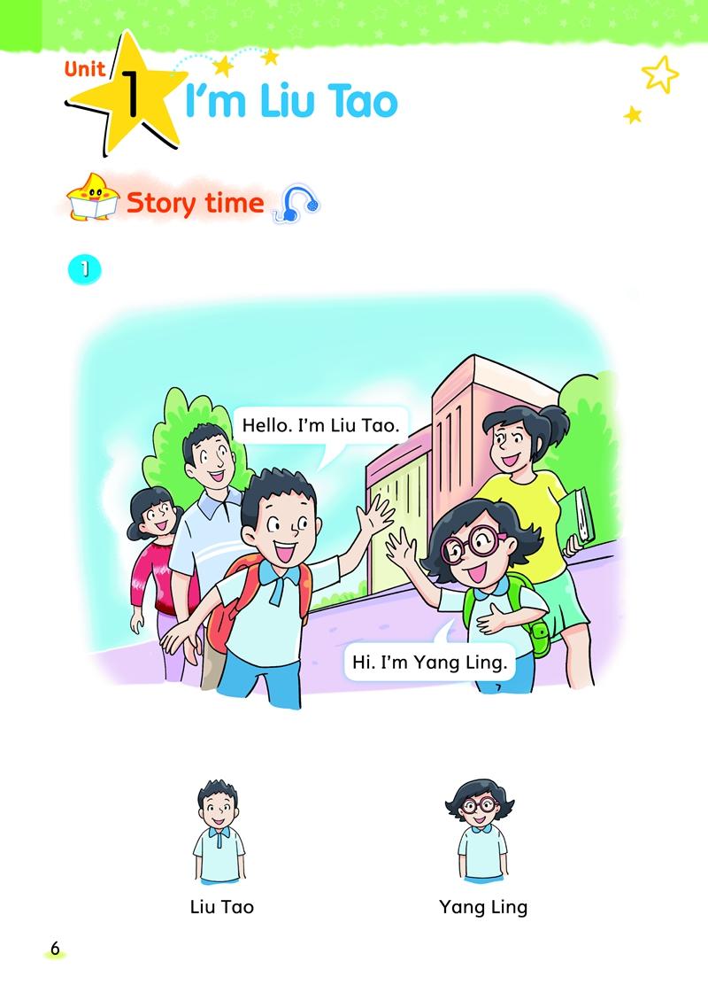

Slide 3
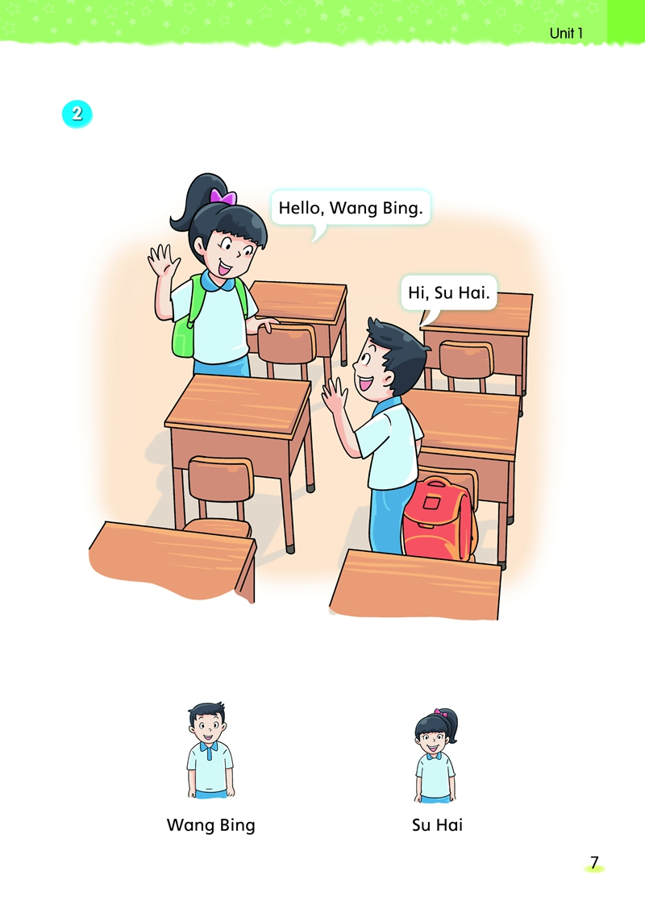

Slide 4
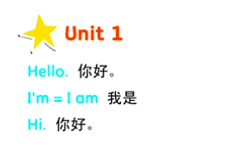

Slide 5







Fruit choose
I choose _________________.

Slide 6

color choose
I choose _________________.

Slide 7
I can shout in the mountain.
I can‘t shout in the classroom.

Slide 8
Hello/ Hi／Good morning/ Good afternoon/ Good evening.
I'm_________. / My name is___________
I'm a ______. (boy/ girl)
I‘m ____ years old.
I can ________.

