Slide 1
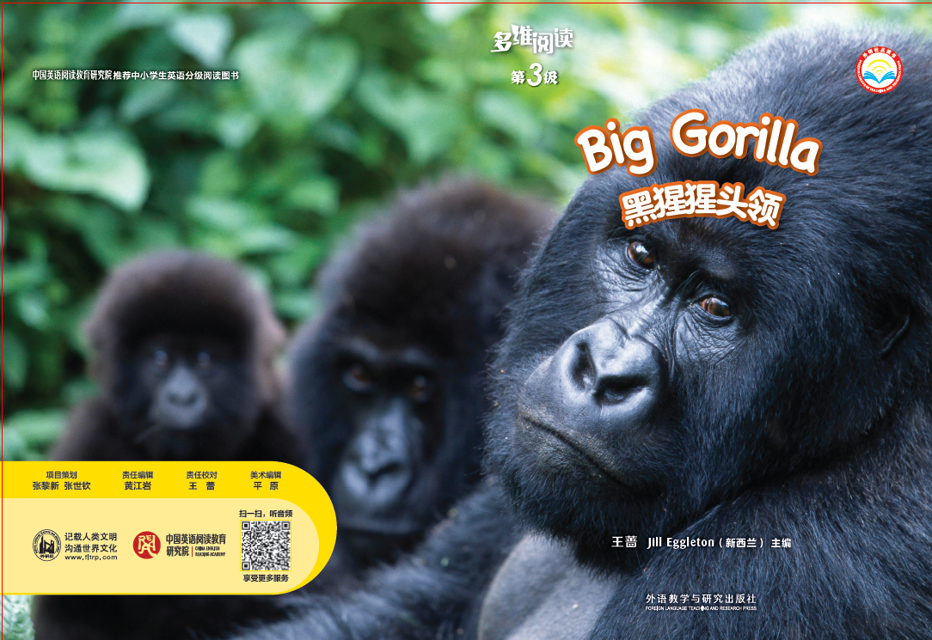
Big Gorilla
多维阅读第3级

Slide 2

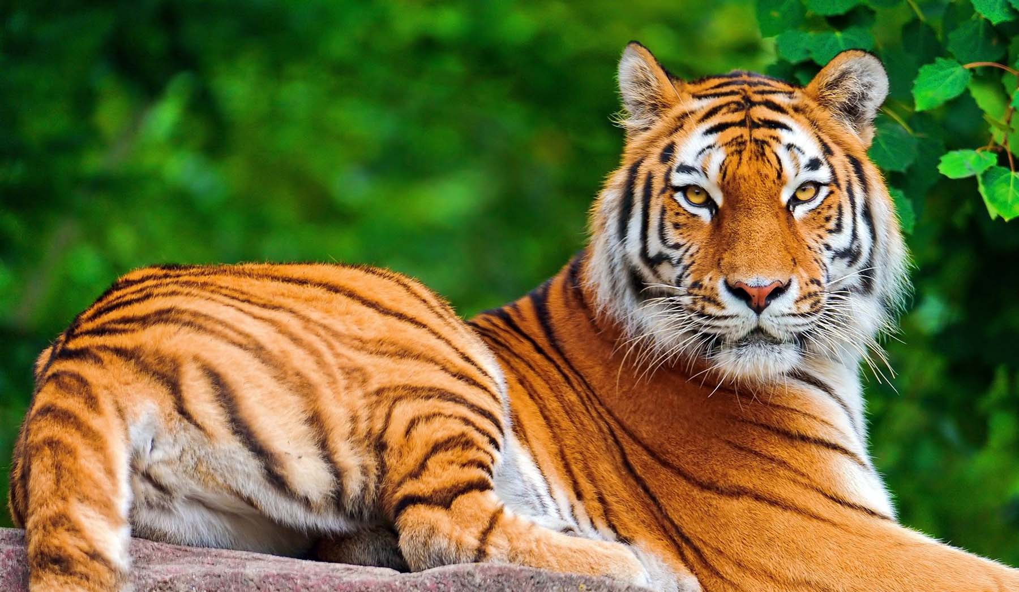
Guessing
What animal is it?

Slide 3
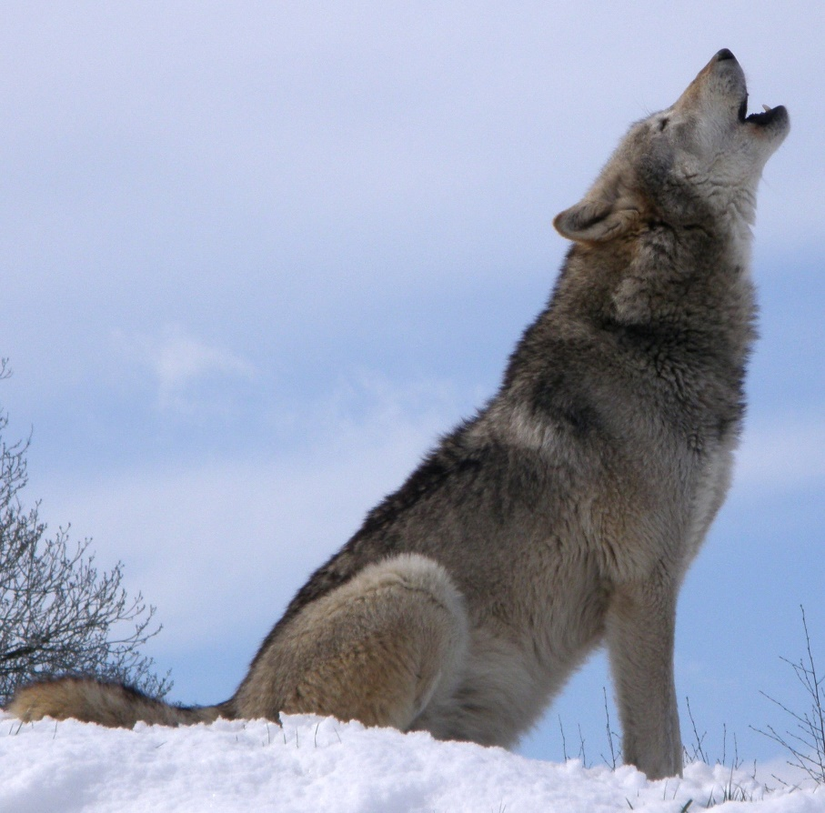

Guessing
What animal is it?

Slide 4
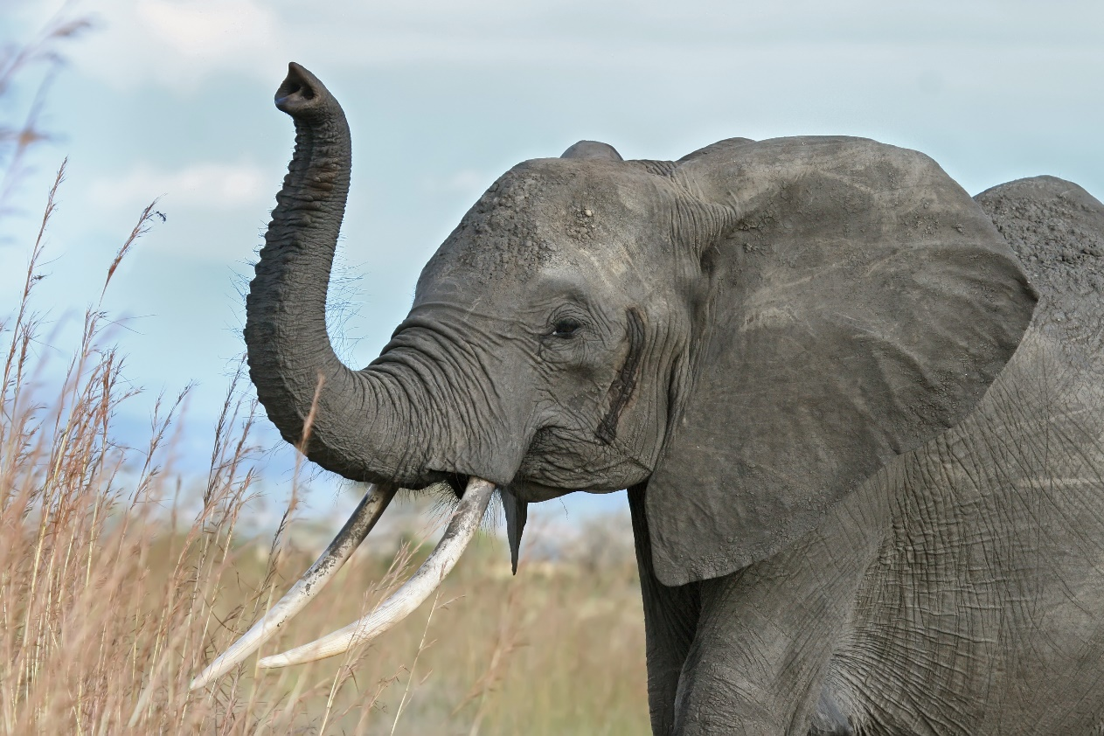
Guessing
What animal is it?

Slide 5
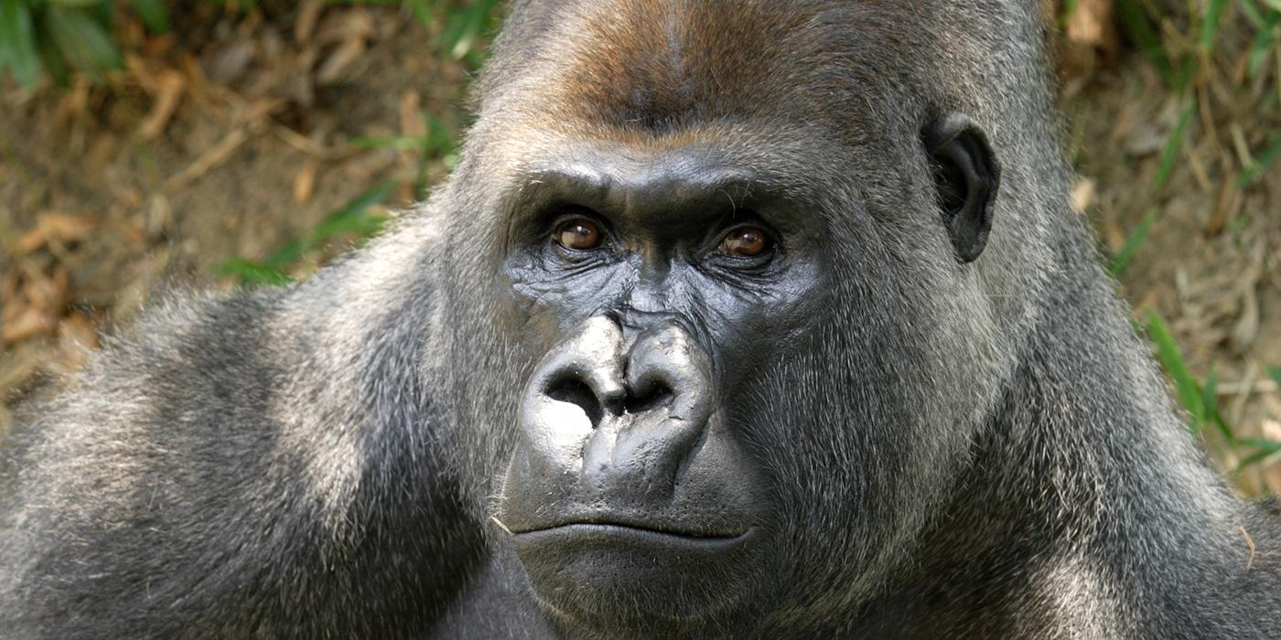
Guessing
What animal is it?

Slide 6




Slide 7
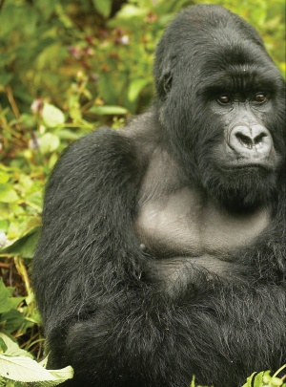
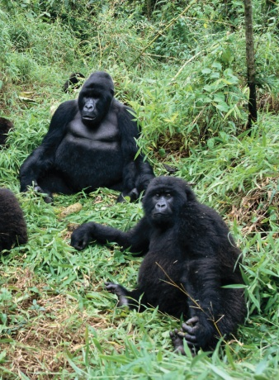
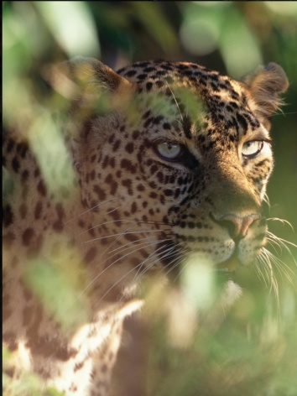
First Reading
What will happen to the big gorilla and the other gorillas in this book?

Slide 8
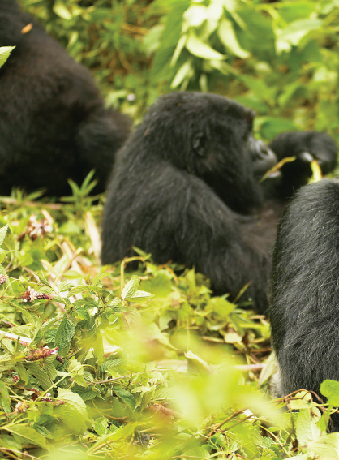
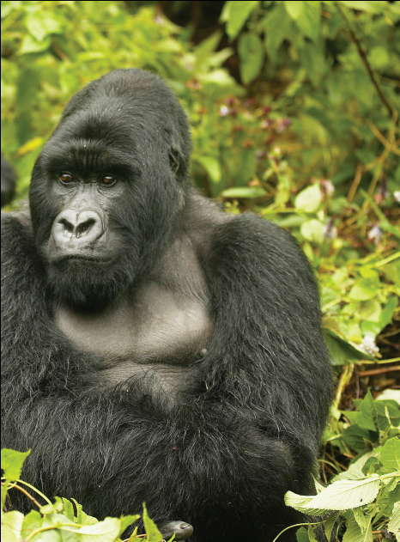
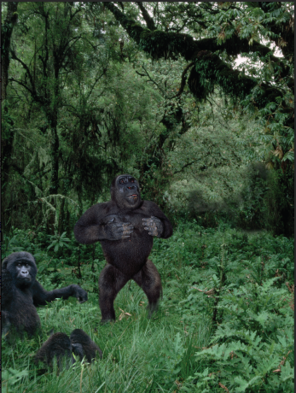
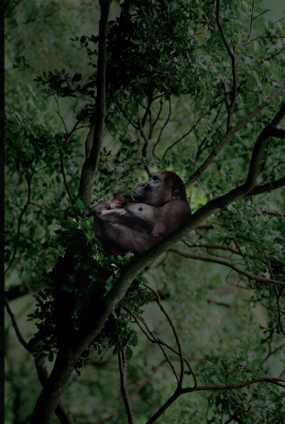

Slide 9
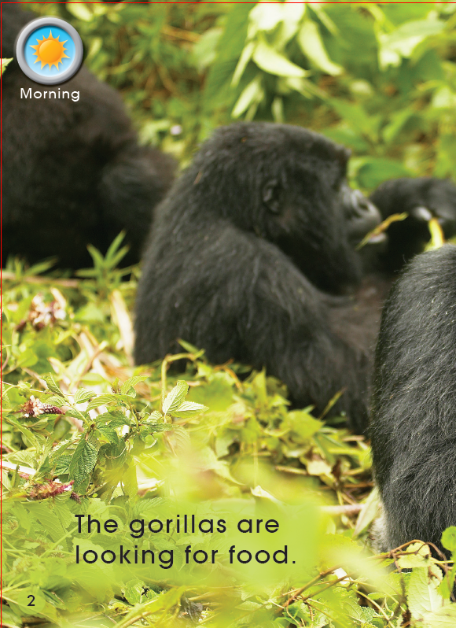
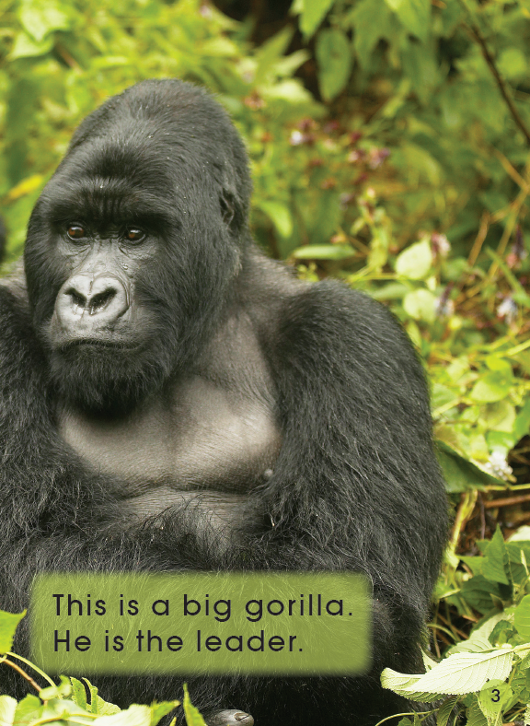
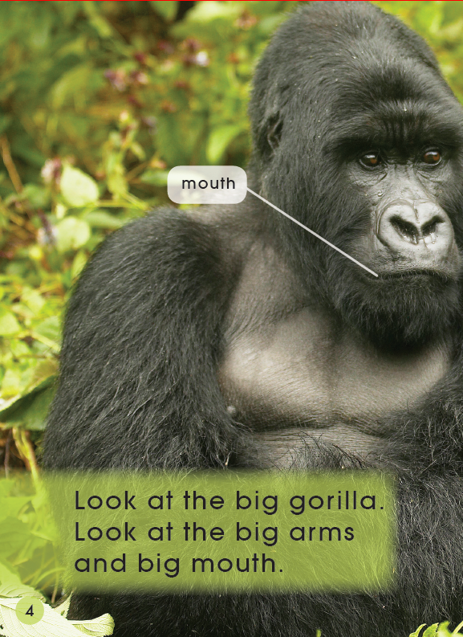
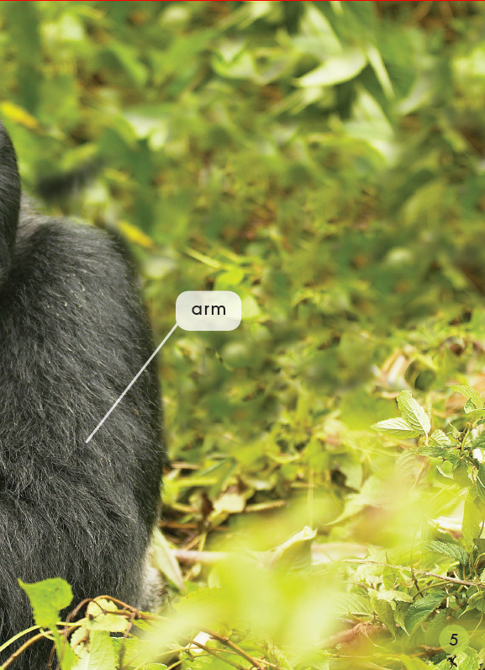
Second Reading
1.What are the gorillas looking for?
2.Who is the leader of gorillas?
3.What does the big gorilla have?
Pages 2-5

Slide 10
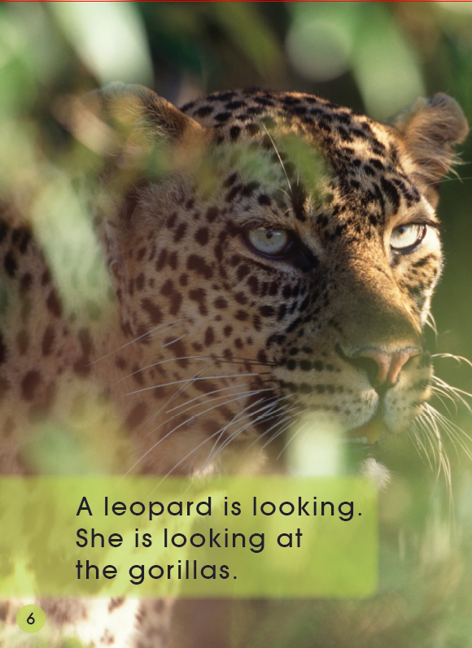
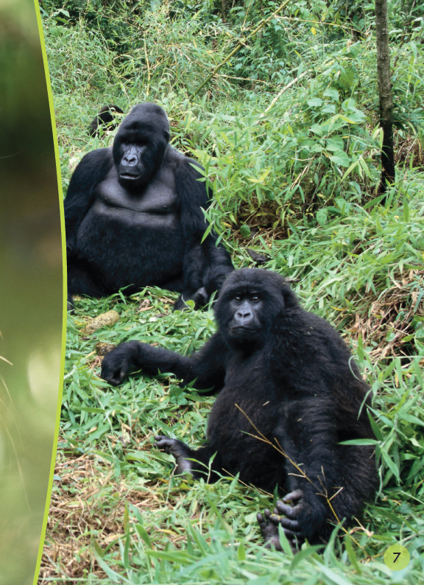


Second Reading
Pages 6-7
Is there any danger to the gorillas?
1.What is this?
2.What is the leopard looking for?

Slide 11
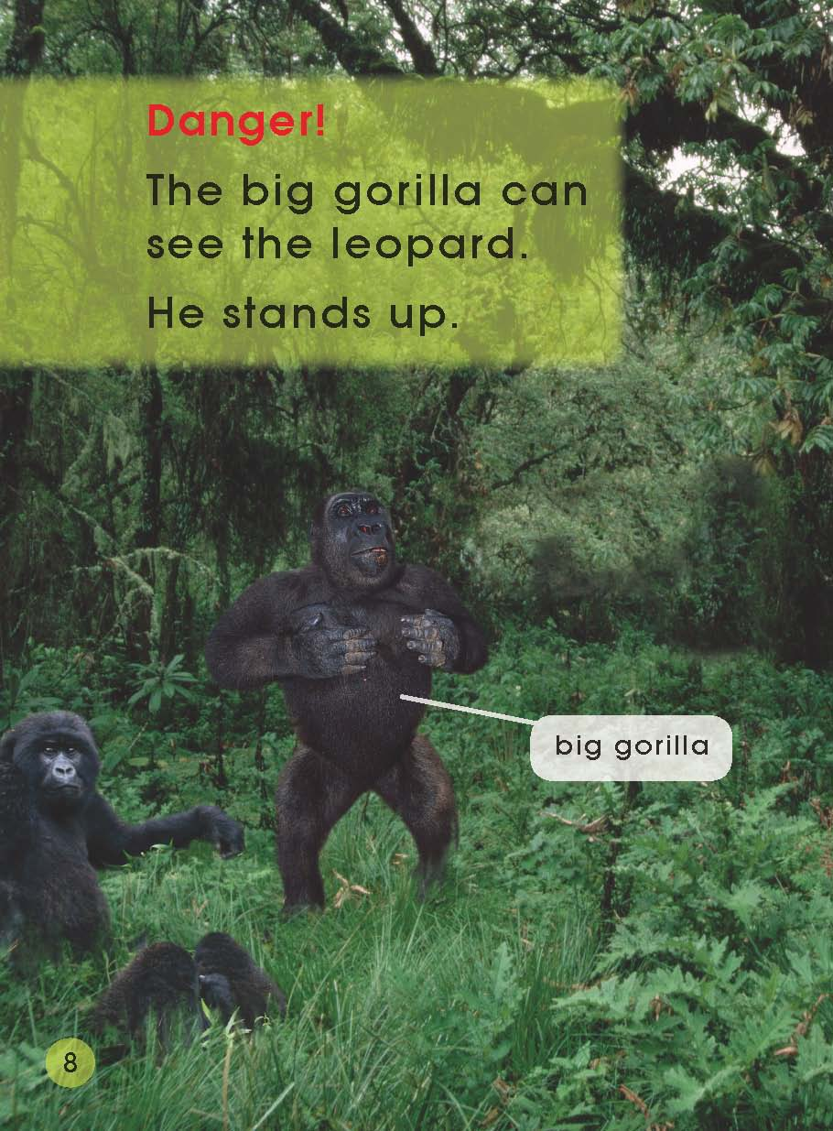
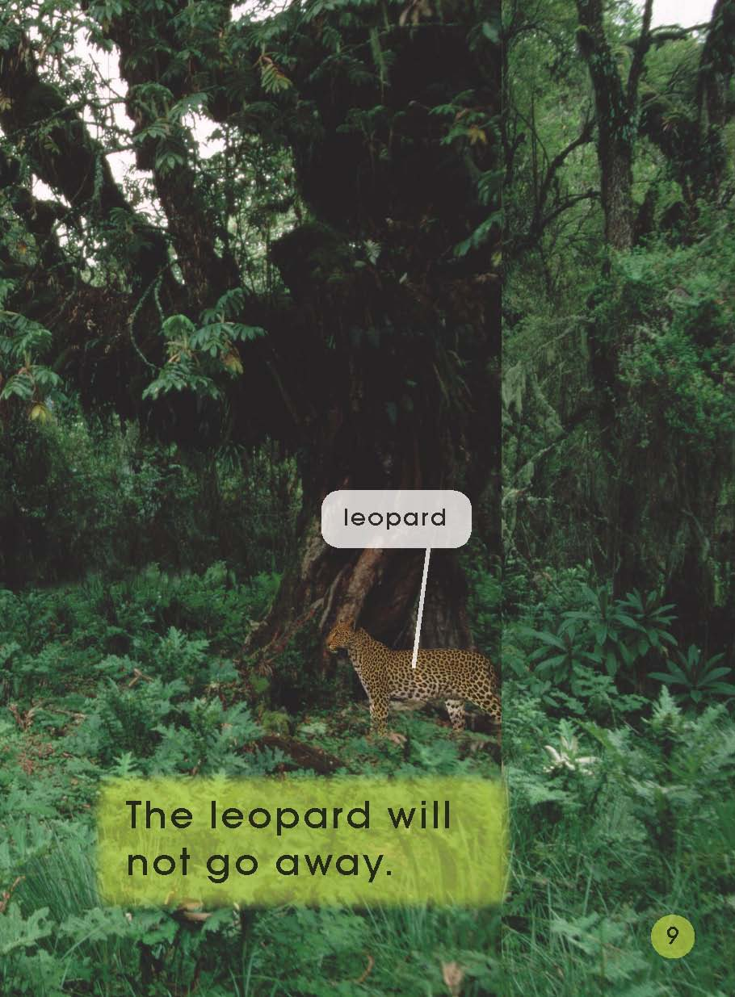
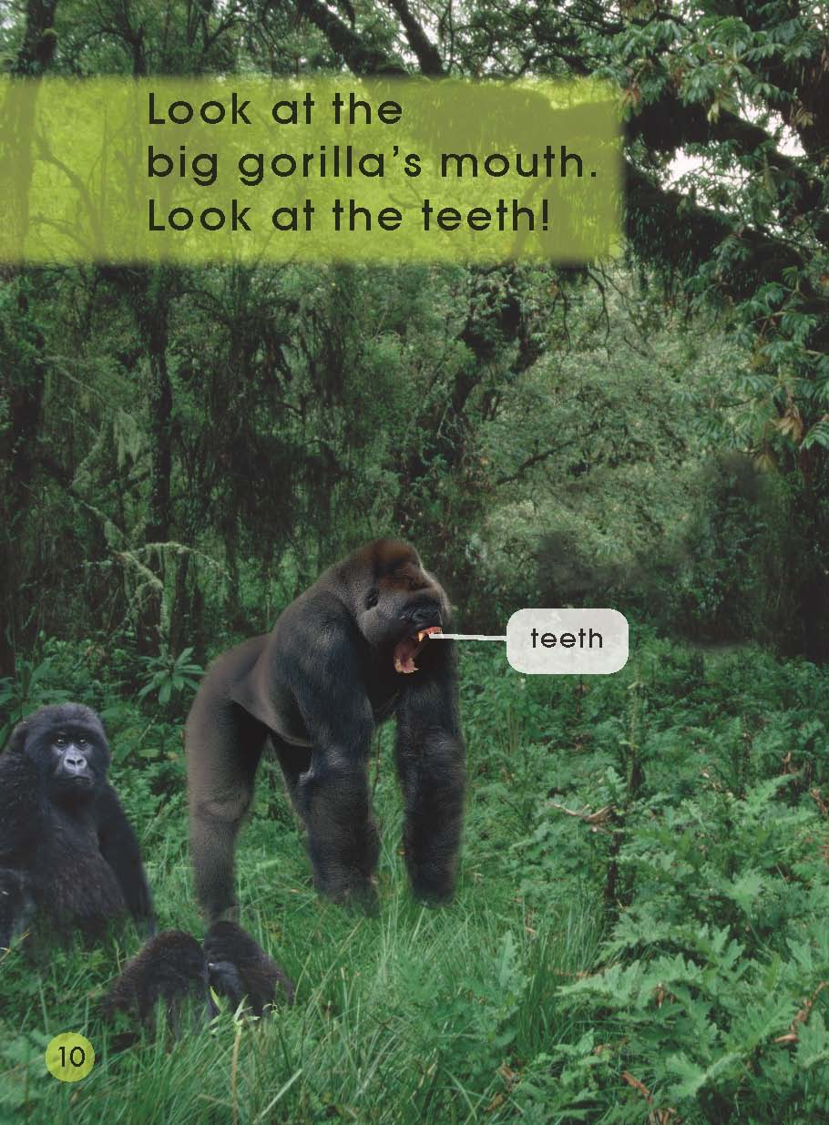
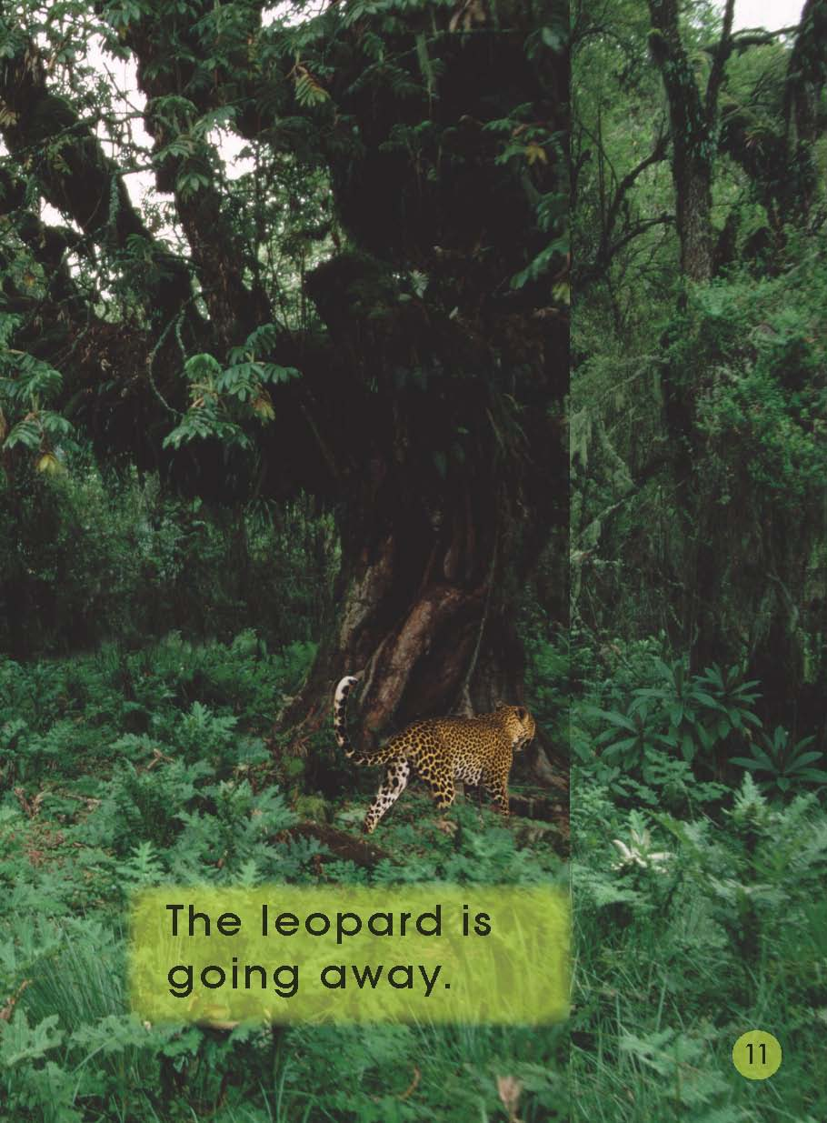
Second Reading
1.What does the big gorilla do?Why?
2.Where is the leopard?Use your finger and point out it in the picture.
3.Is the leopard going away?Why?
Pages 8-11

Slide 12
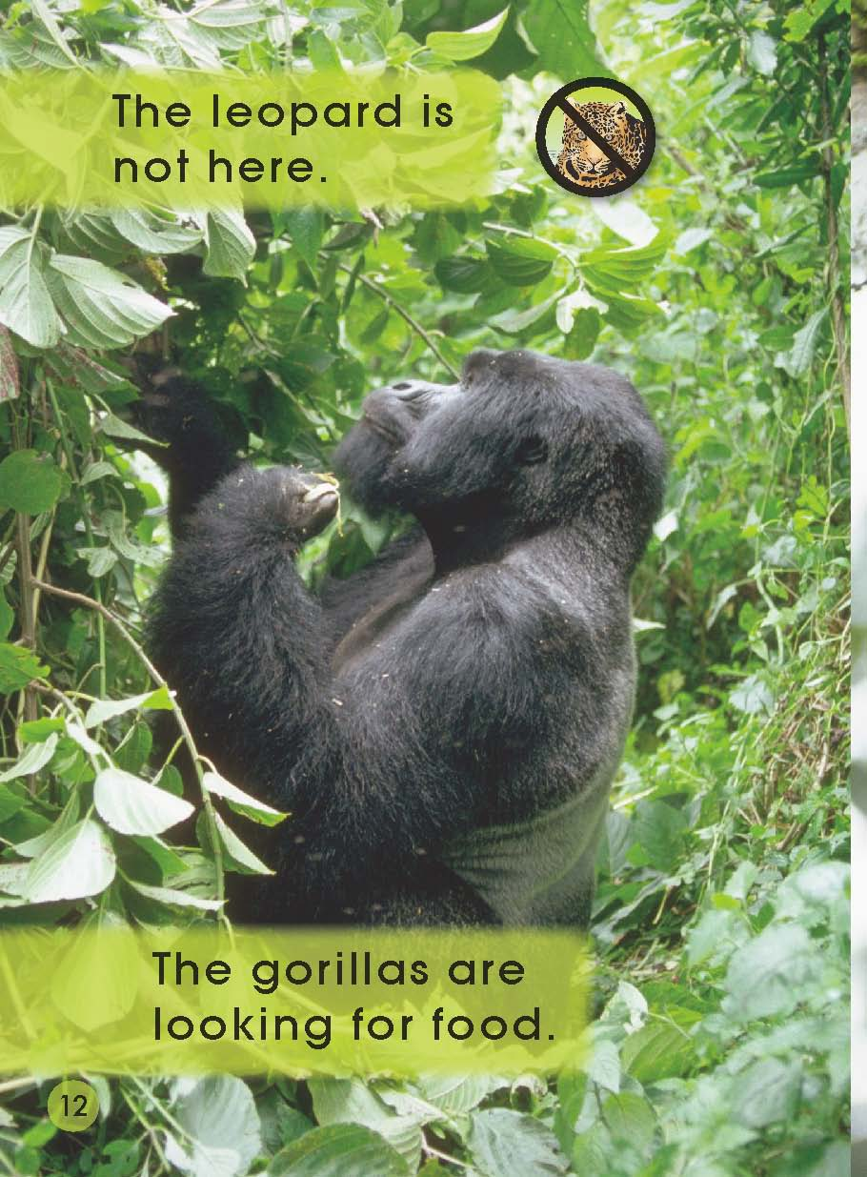
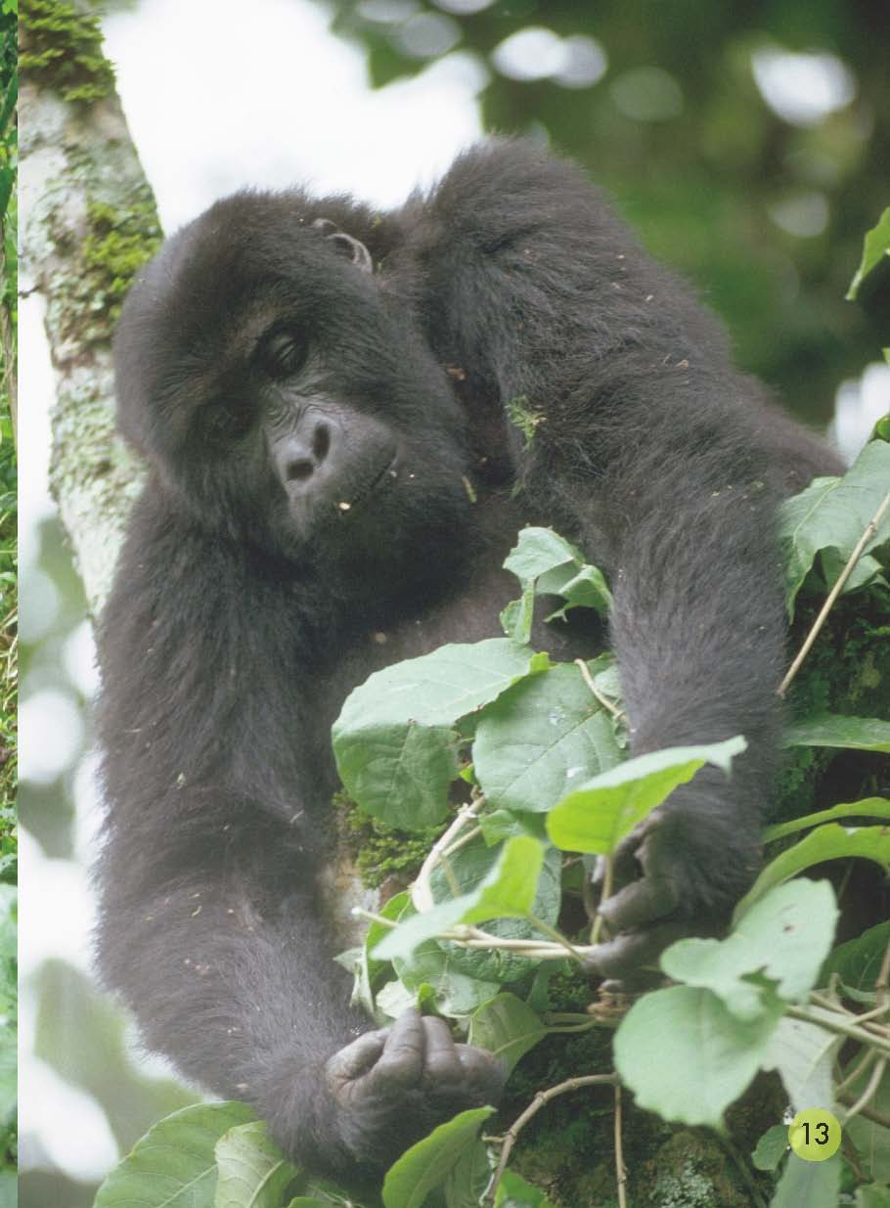
Second Reading
Pages 12-13
1.Is there any leopards?
2.What are the gorillas doing?
3.What food will they find and eat?

Slide 13
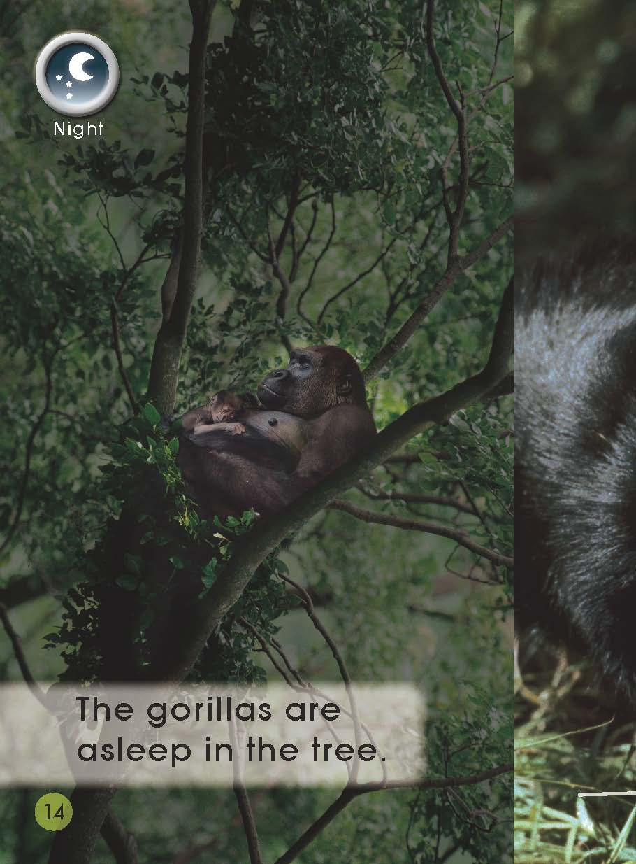
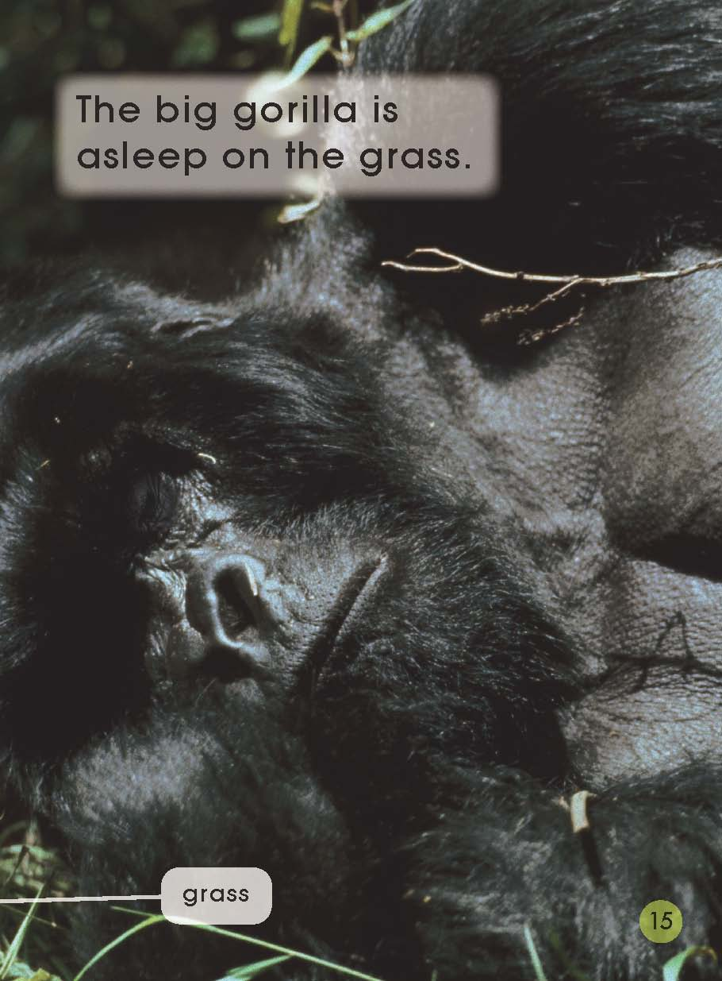
Second Reading
Pages 14-15
1.What are they doing now?
2.Where do they sleep?
3.Is there any danger?Why?

Slide 14
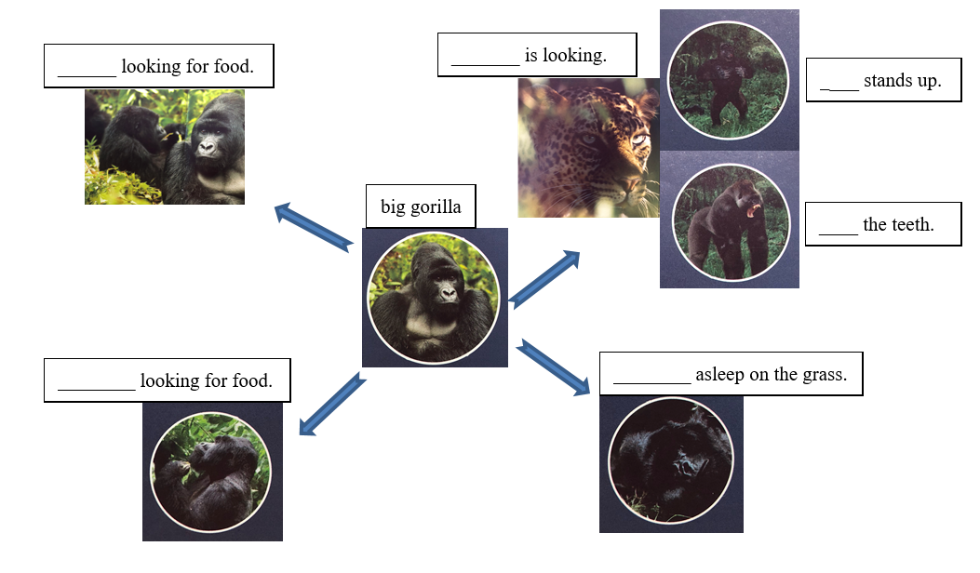
Please complete the diagram to show what happened in the story.

Slide 15
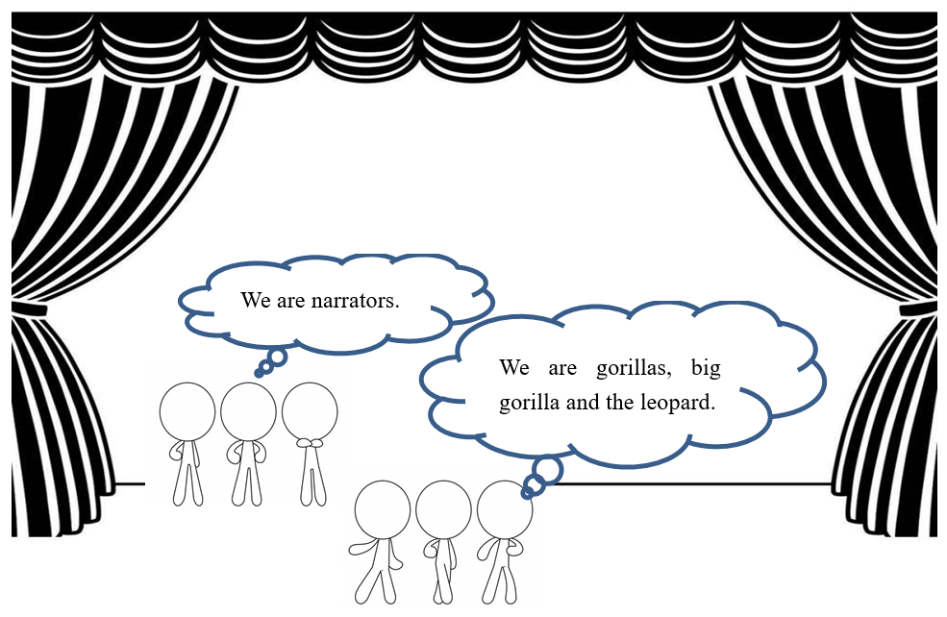
Talk and share in groups.

Slide 16
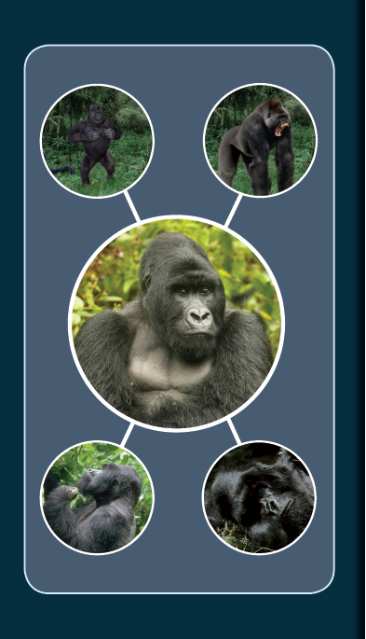
Talk again.

Slide 17
Homework
（1）Talk about the gorillas with your family or your
friends.
（2）Try to get more information about the gorillas.

