Slide 1


Slide 2
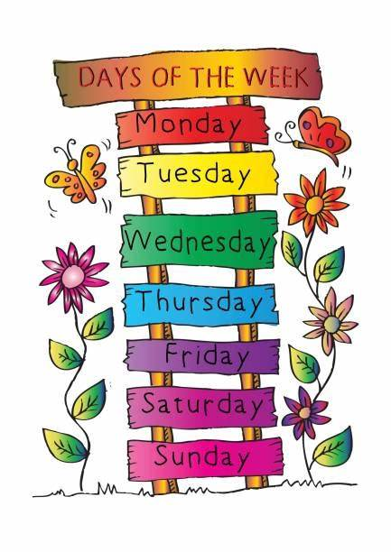
7 Days of the Week

Slide 3
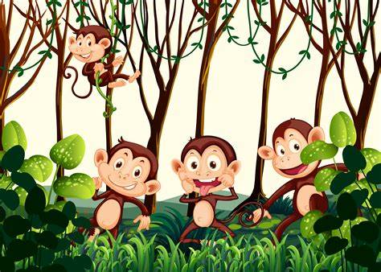

Monday

Slide 4

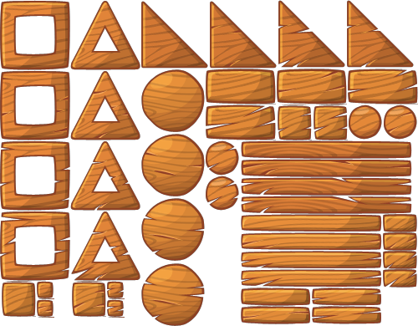






It is Monday.

Slide 5

Tuesday

Slide 6

It is Tuesday.

Slide 7

Wednesday

Slide 8

It is Wednesday.

Slide 9

Thursday

Slide 10

It is Thursday.

Slide 11

Friday

Slide 12

It is Friday.

Slide 13

Saturday

Slide 14


It is Saturday.

Slide 15

Sunday

Slide 16


It is Sunday.

