Slide 1


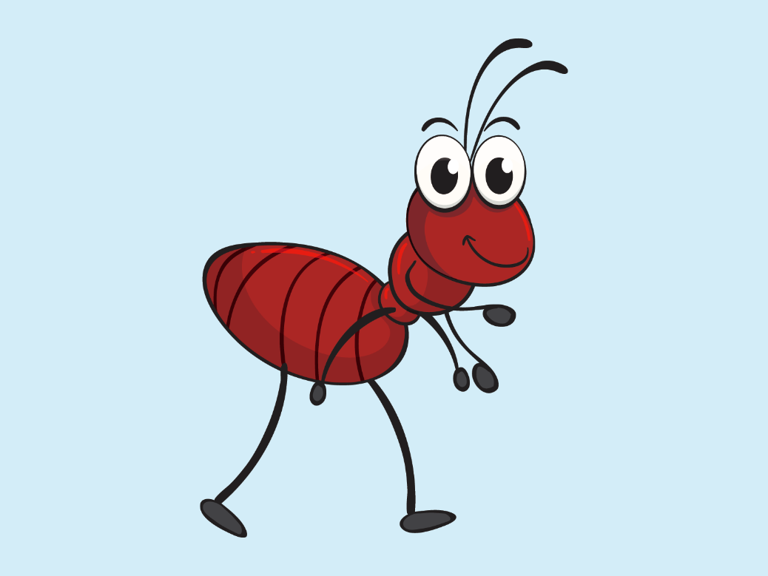
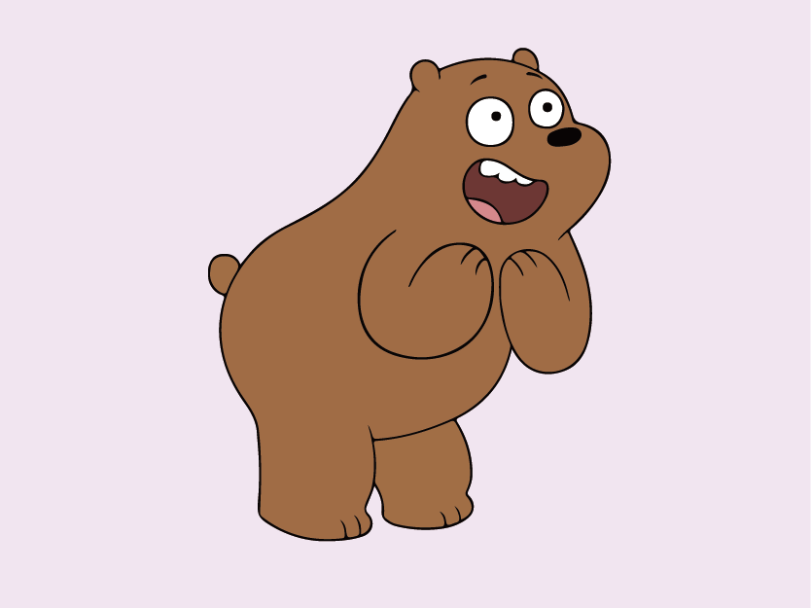



Learn the Word

Slide 2
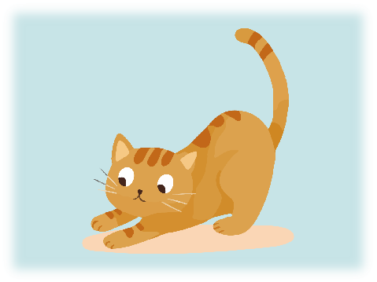
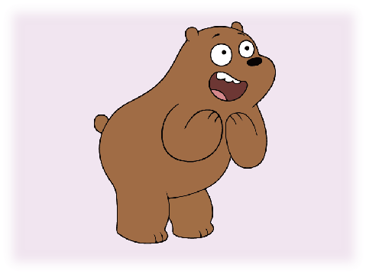
Learn the Word
1.ant
2.bear
3.cat
ant
bear
cat

Slide 3






Listen and Circle
Notes:
点击图片发声

Slide 4
Listen and Circle
Notes:
鼠标滑过图片，发声

Slide 5




Spelling

Slide 6
Match
ant
cat
bear

Slide 7
Fill In
1.ant
2.bear
3.cat
4.dog
5.elephant
a
c
t

Slide 8


Find Out
c

Slide 9
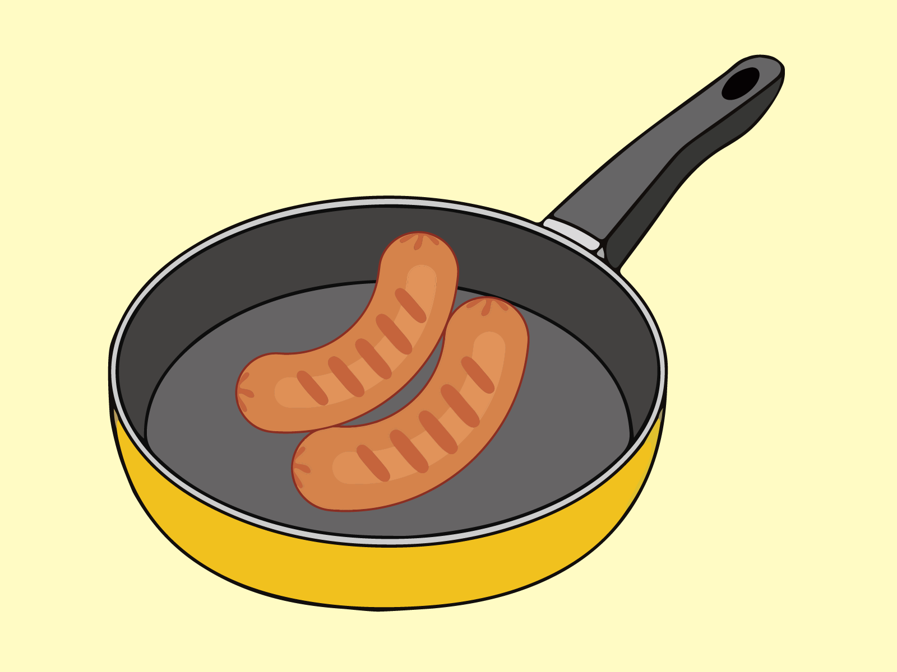



Complete Sentence
The ham is in the .
van
can
pan

Slide 10
Find Out
c

Slide 11
Find Out
c

Slide 12
Find Out
c

Slide 13
Find Out
c

Slide 14
Find Out
c

Slide 15
Find Out

